Slide 1
How to Log Off Citrix Server
12/12/2018

Slide 2
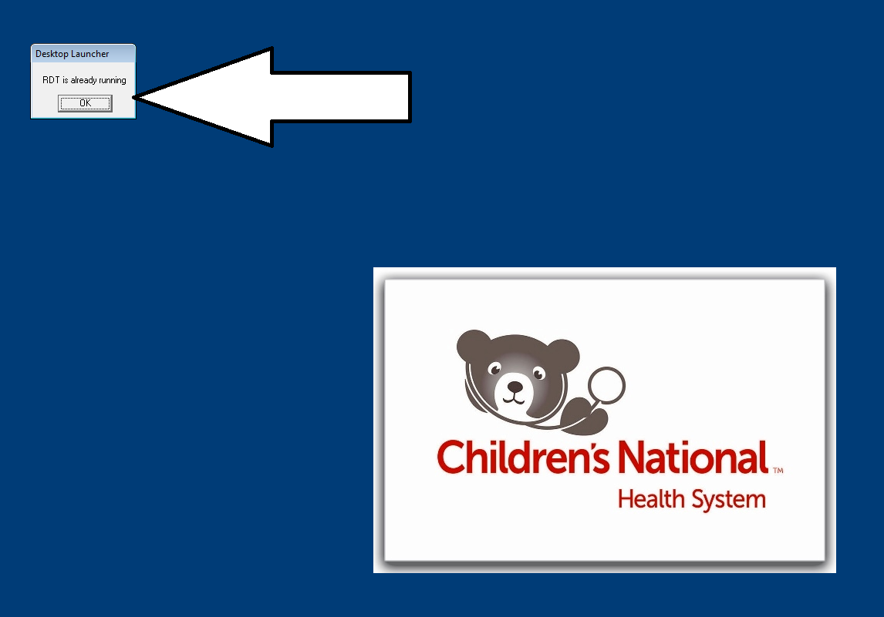
Step 1:Error Message RDT is already Running. The Solution is to logoff Citrix Server.

Slide 3
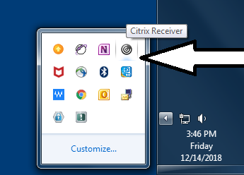
Step 2: Locate Citrix Receiver Icon in Windows System Tray

Slide 4
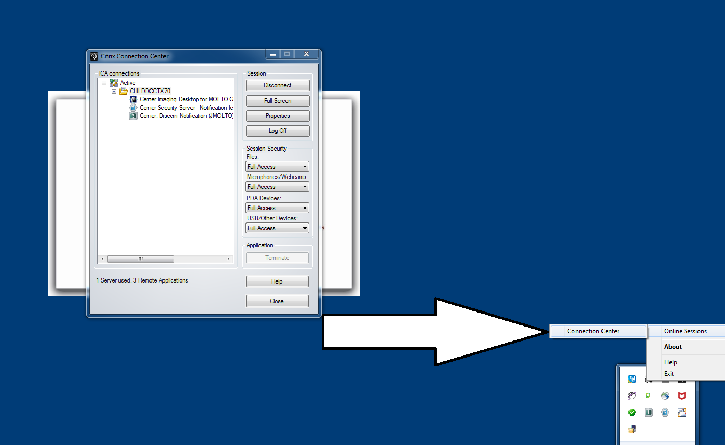
Step 3: Right-Click and then Click Connection Center

Slide 5
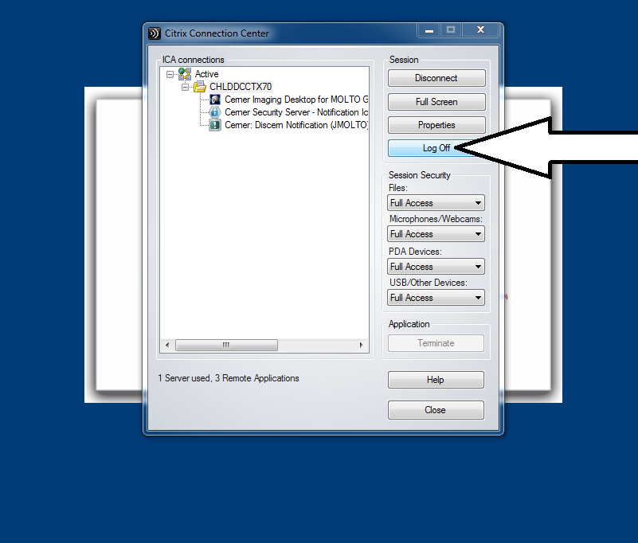
  Step:4 -Click Logoff in the Connection Center

Slide 6
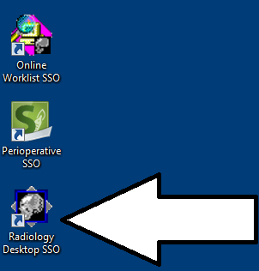
  Step:5 –Click the Radiology Desktop SSO to LOGON Again.

