Slide 1
CT femur/pelvis
Femoral neck to horizontal plane: ___ degrees
Femoral condyles to horizontal plane: ___ degrees
Knee rotation: internal/external
The calculated angle of RIGHT femoral anteversion is ___ degrees.

Slide 3
Femoral anteversion
Refers to the orientation of the femoral neck in relation to the femoral condyles at the level of the knee
Most cases, the femoral neck is oriented anterior as compared to the condyles – if posterior, its femoral retroversion

Slide 4
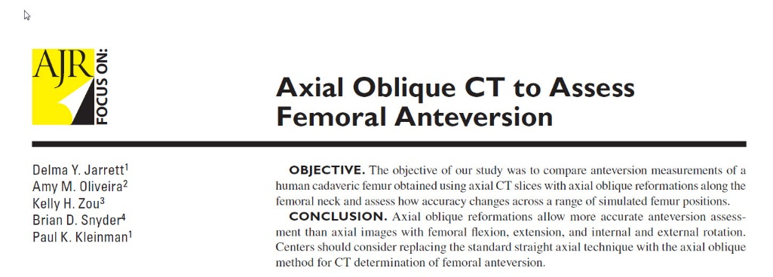
How to measure?
Use axial oblique reformat of the hip
Jarrett et al. Axial oblique CT to assess femoral anteversion. AJR 2010; 194: 1230-1233

Slide 6
Abnormal measurements
Increased femoral anteversion:
Developmental dysplasia of the hip
Development of FAI
Reduced femoral anteversion is associated with cam-type FAI

Slide 9
