Slide 1
Nuclear Medicine Cases Cases # 1 - 48

Slide 2
Case # 1

Slide 3
2 mos old with jaundice, direct hyperbilirubinemia.
Findings?
CBD not well defined
Gall bladder small and
contracted despite npo
No choledochal cyst
No intrahepatic ductal
dilatation

Slide 4
Stomach
Multiple splenules
LONG RIGHT

Slide 5
What structure is missing?
trans
long
No IVC
Azygos vein

Slide 6
What may be the cause of the hyperbilirubinemia? What study should you recommend?
Need to r/o biliary atresia.
Hepatobiliary scan

Slide 7
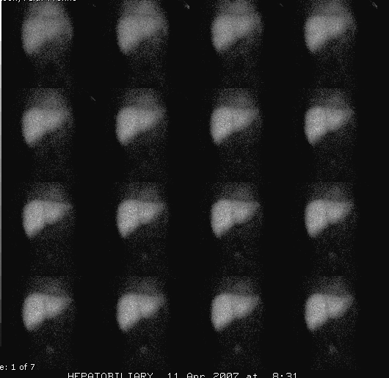
How would you prep the patient before this study?
1- 16 minutes
17- 32 minutes
Phenobarbital 5mg/kg/day x 3-5 days in 2 divided doses

Slide 8
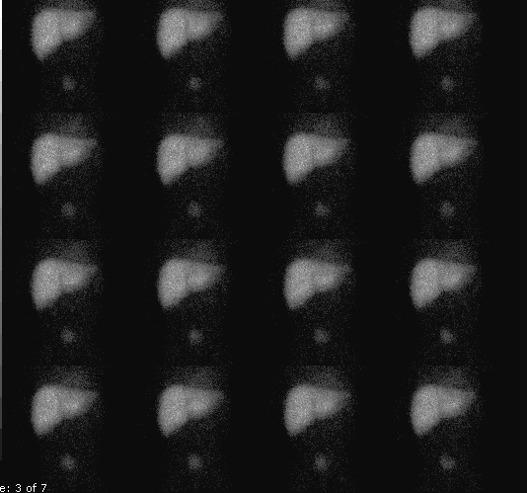
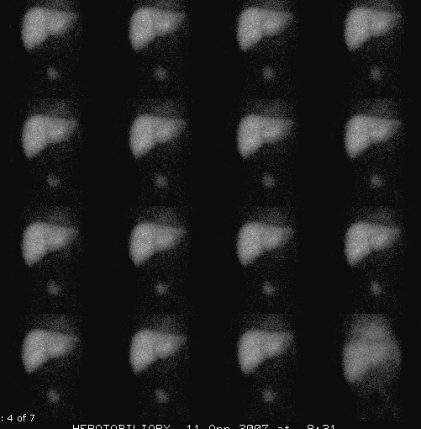
Findings?? What would you tell the tech to do next?
33- 48 minutes
49- 64 minutes
No excretion into small bowel. Need delayed images.

Slide 9
3 hour

Slide 10
Findings?? Differential??
24 hours
No excretion by 24 hours.

Slide 11
Differential diagnostic considerations: normal hepatic uptake, no excretion by 24 hours
Biliary atresia
Cystic fibrosis
Paucity of the intrahepatic ducts
Isolated
Syndromic (Alagille’s syndrome)

Slide 12
Diagnosis
Biliary atresia

Slide 13
Neonate with Jaundice
Direct and Indirect Hyperbili
(>20% Direct = Neonatal Cholestasis)
Indirect Hyperbili
Lab and Genetic Testing
(metab, infect, TPN)
No Imaging Needed
Conclusive
Inconclusive
No Imaging
Needed
US
Hepatobil Scan

Slide 14
Ultrasound:
1. choledochal cyst
2. findings suggesting biliary atresia:
triangular cord sign, contracted/absent
gall bladder and associated anomalies
(heterotaxy)
Hepatobiliary scan: To exclude the
diagnosis of biliary atresia

Slide 15
Diagnosis of Extrahepatic Biliary Atresia—Why the Rush?
Timely diagnosis and treatment are critical to patient outcome and survival

Slide 16
Treatment: Kasai Hepatic Portoenterostomy
15 year survival:
90% if performed within 60 days of age
50% if performed 60-90 days of age
17% if performed >90 days of age
The Jaundiced Infant: Biliary Atresia and Other Obstructions, Ohi and Nio.

Slide 17
Case # 2

Slide 18
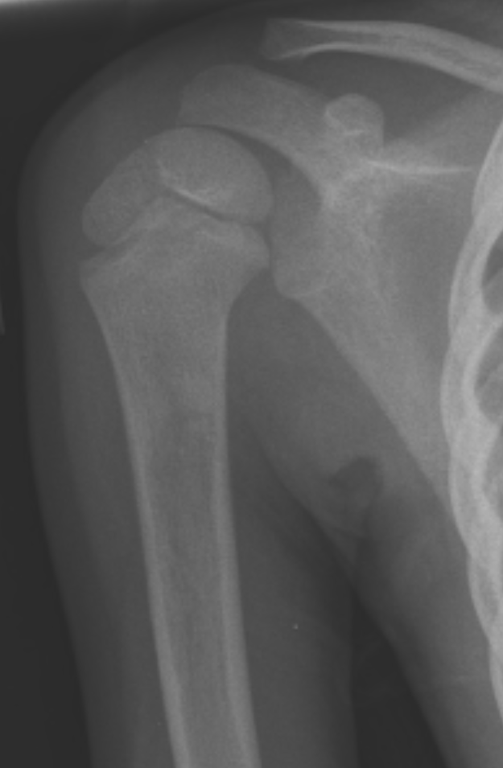
4 year old with RT shoulder pain
Findings?? Differential? What would you do next?

Slide 19
Multiple foci of tracer accumulation on blood pool images in
metaphyses of all long bones, bones of pelvis and spine: c/w marrow
infiltrative process.
Findings??
Patient
Normal age-matched for comparison

Slide 20
Findings? Differential? Next step?
Early
Delayed
Multiple foci of MDP uptake in the skeleton including skull, spine, ribs, proximal femurs, all bones around knee and bilateral fibular shafts, c/w bone metastases.

Slide 21
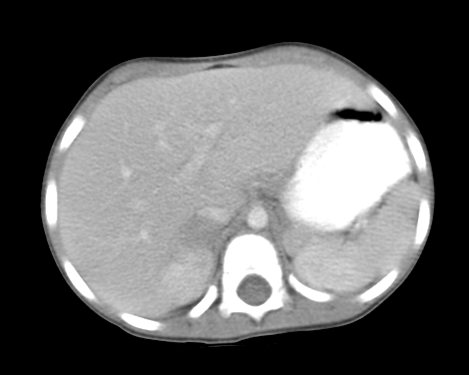
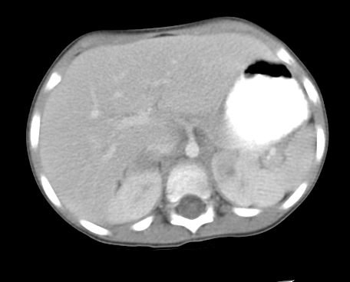
Finding? Differential?
Neuroblastoma, rhabdomyosarcoma, lymphoma

Slide 22
What type of scan? Findings?
Patient
Normal for comparison
I-123 MIBG scan. Multiple bony metastases. Absence of
normal uptake in heart and liver.

Slide 23
MIBG: follow-up response to therapy
Initial scan
After 6 weeks of therapy

Slide 24
Case # 3

Slide 25
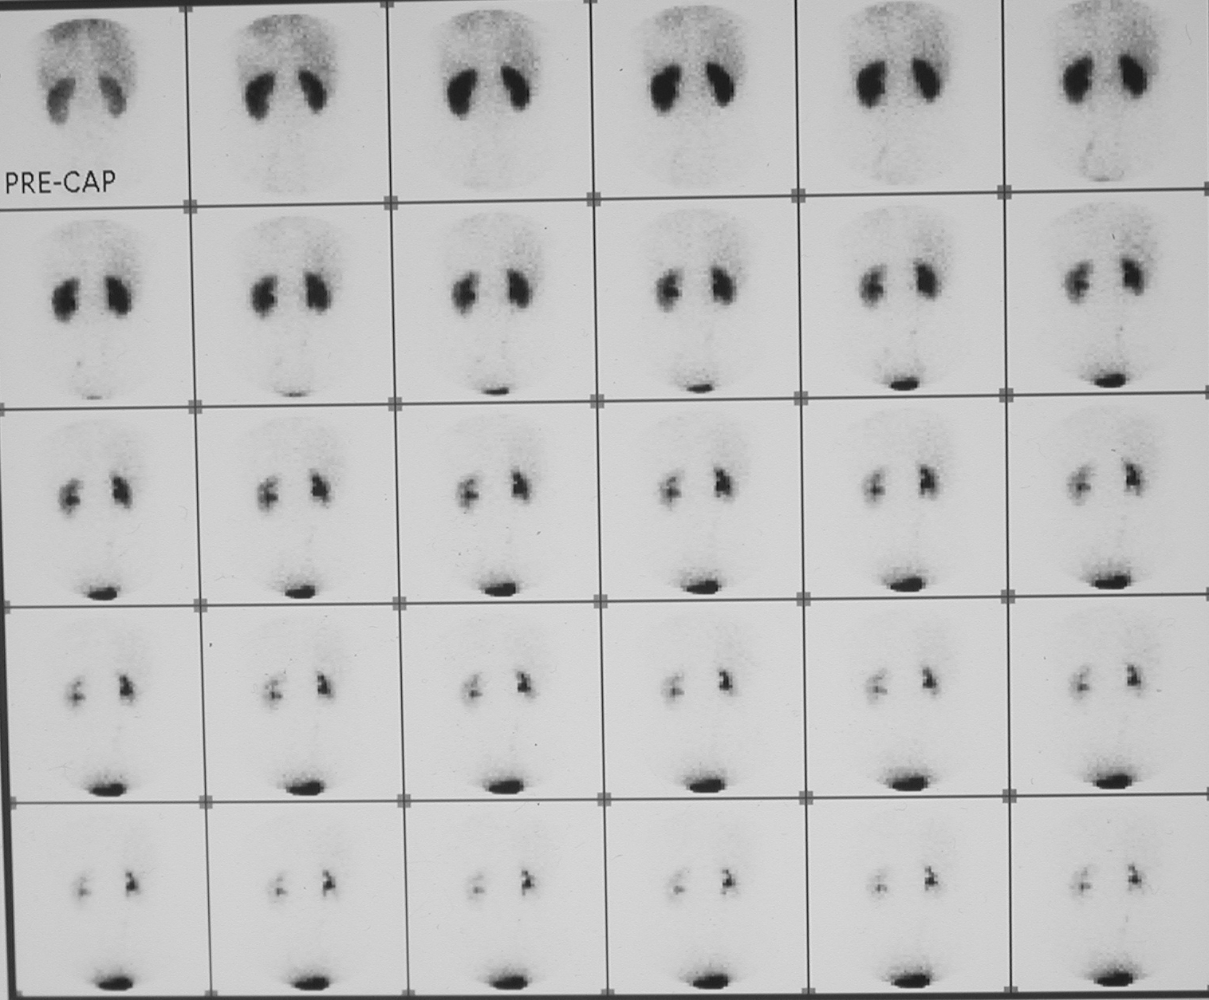
12 year old girl with hypertension
IIIIIIIIIIIIIIII
Mild hang-up in RT
collecting system,
otherwise normal.
Findings? What study should be done next?

Slide 26
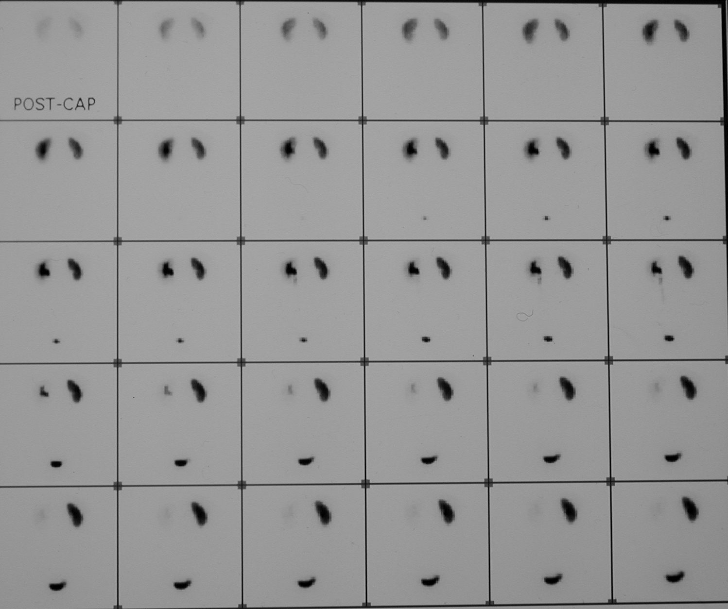
Findings? Diagnosis….
What study should be
done next to confirm
diagnosis?
Cortical retention of MAG-3 on the RT, c/w renal artery stenosis
Captopril p.o.
1mg/kg. wait 1 hour then inject MAG-3.

Slide 27
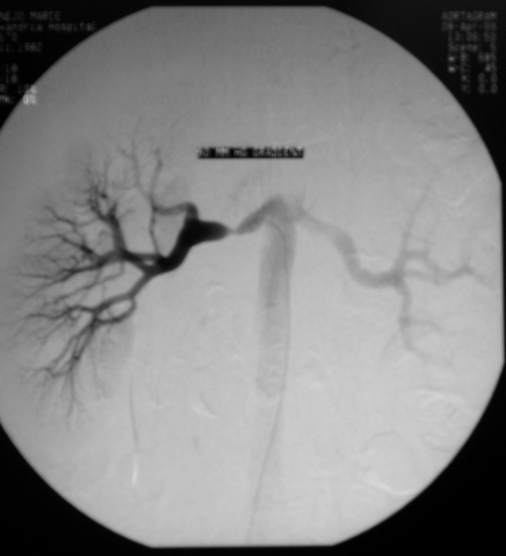
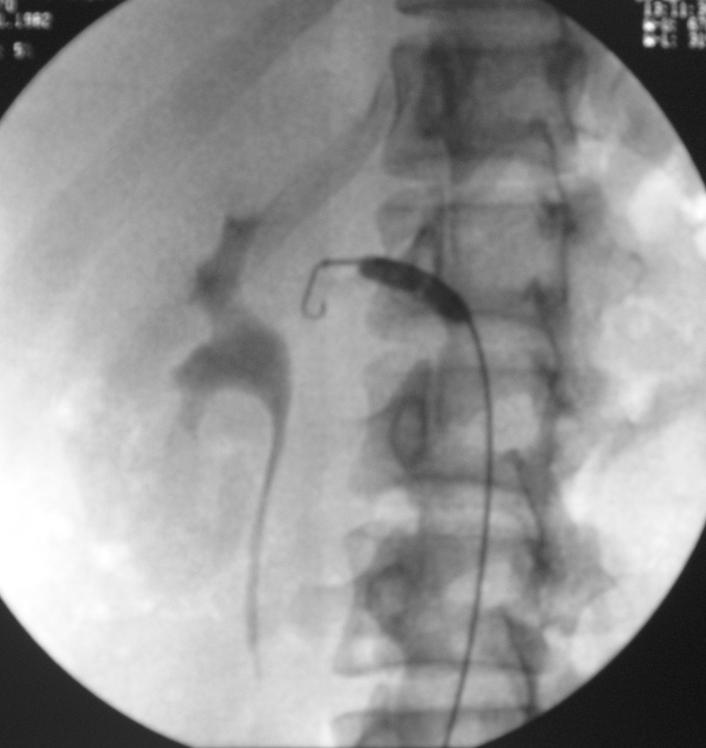
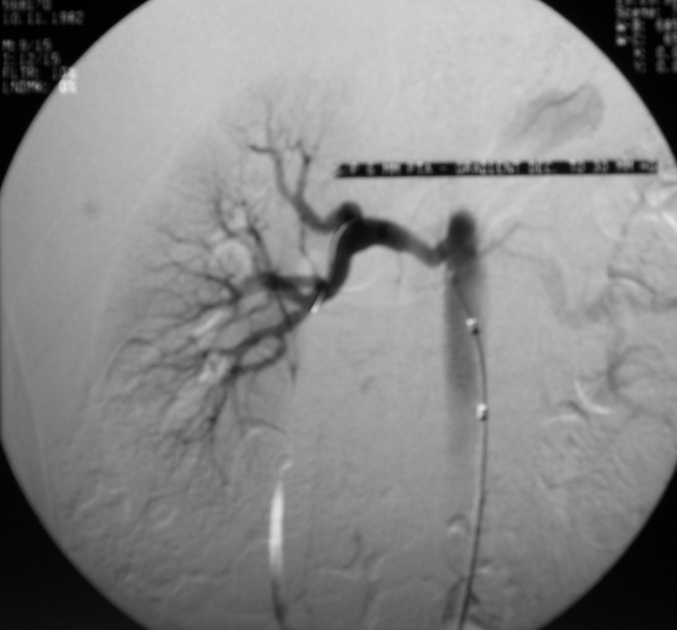
Pre-dilatation
Post-dilatation

Slide 28
Case # 4

Slide 29
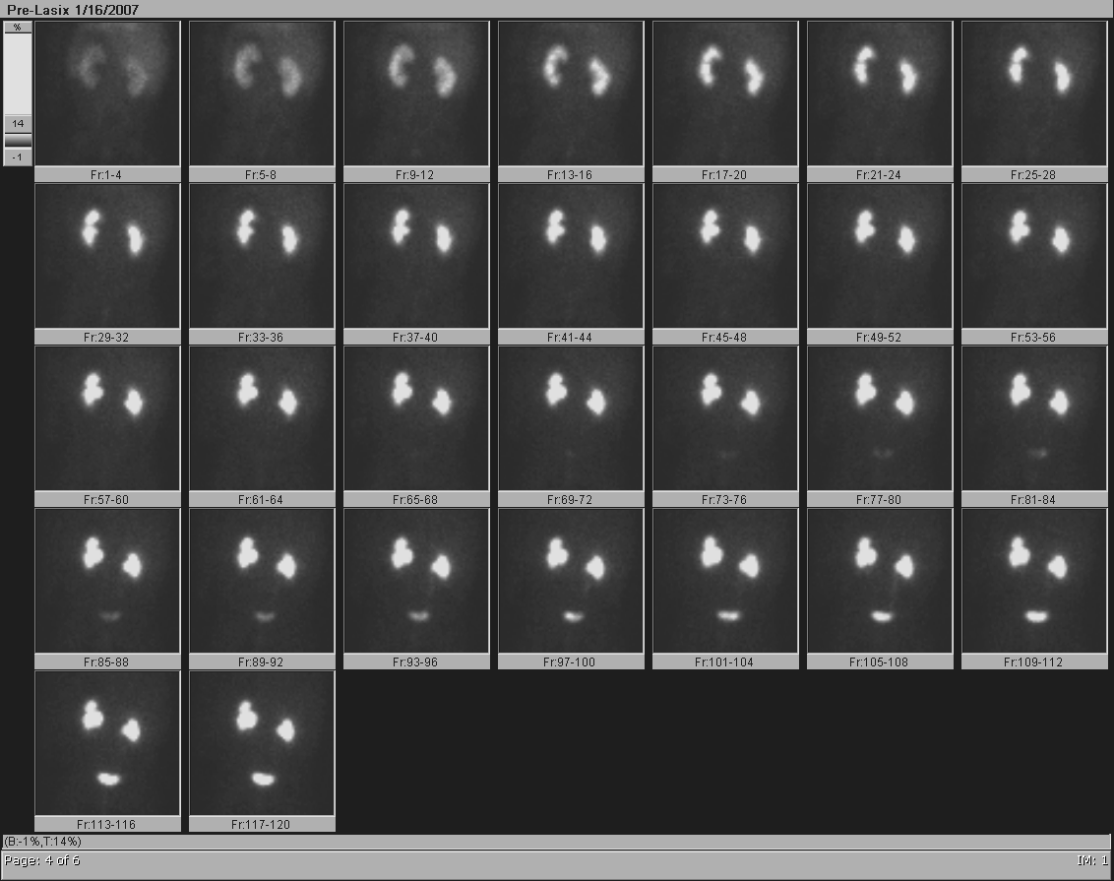
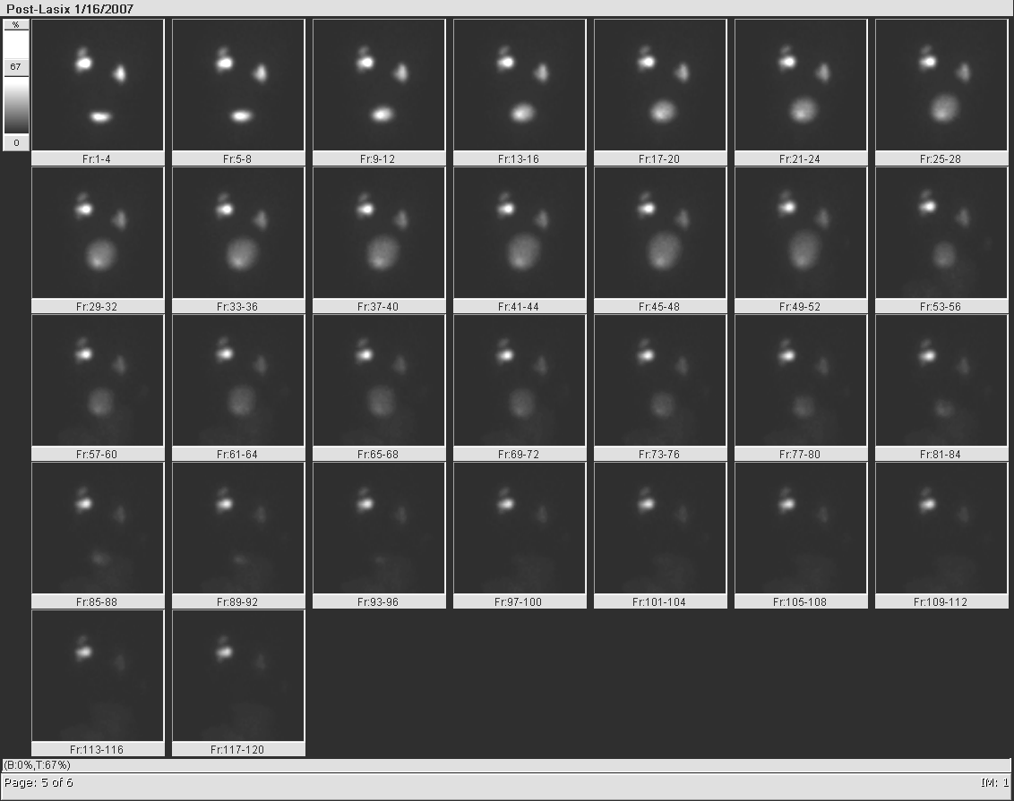
6 week old male w/ bilateral hydronephrosis.
Normal VCUG
Pre-Lasix
Post-Lasix
What should you ask the technologist to do next?
Dilated LT collecting system with residual post-Lasix

Slide 30
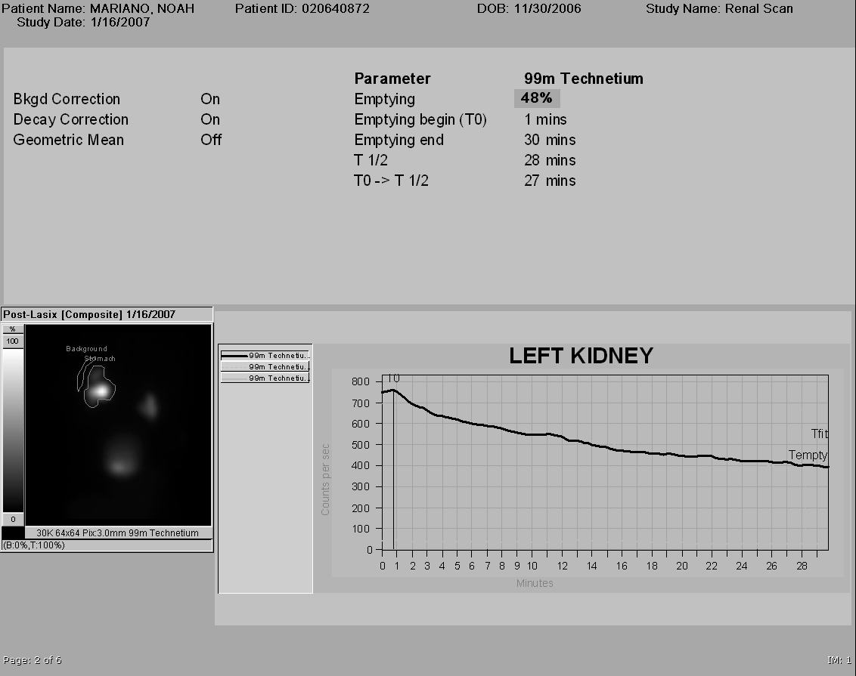
Poor drainage in supine position with good drainage (>50%)
in the upright position. Normal differential renal function.
Does this patient need f/u imaging?
Pre-upright
% Residual at 30 min= 52%
Post-upright
What should you ask the technologist to do next?

Slide 31
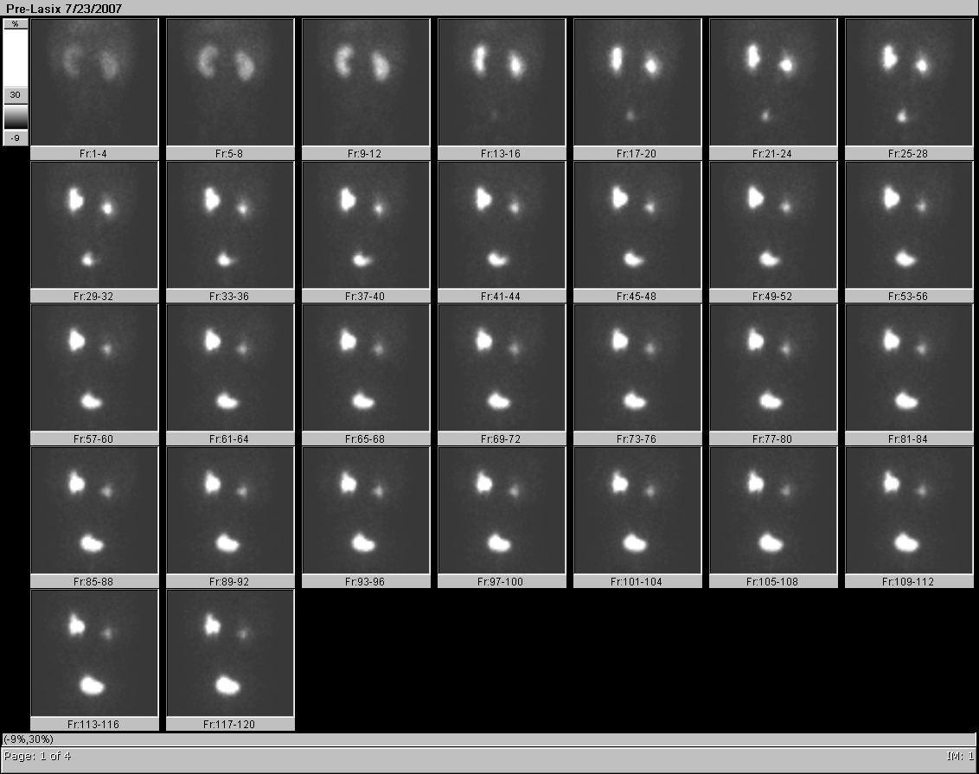
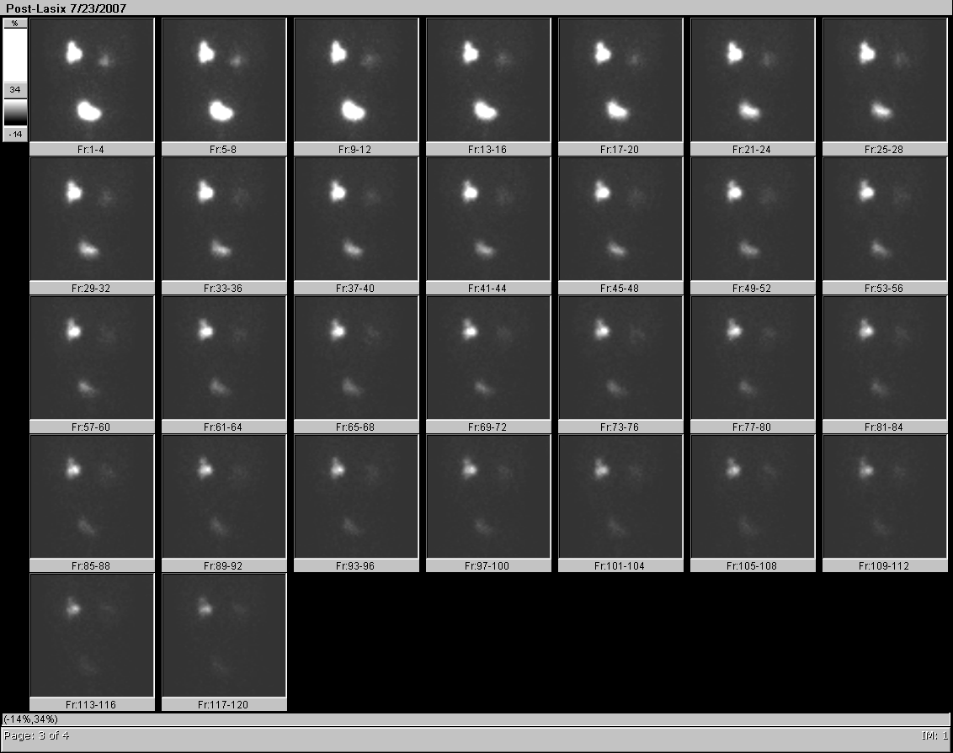
Same patient, 6 mos later—Improved LT drainage
Pre-Lasix
Post-Lasix

Slide 32
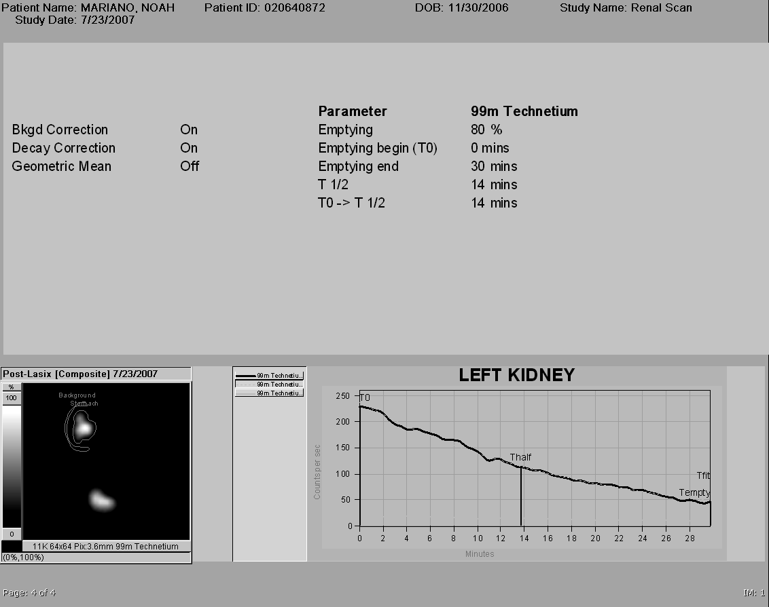
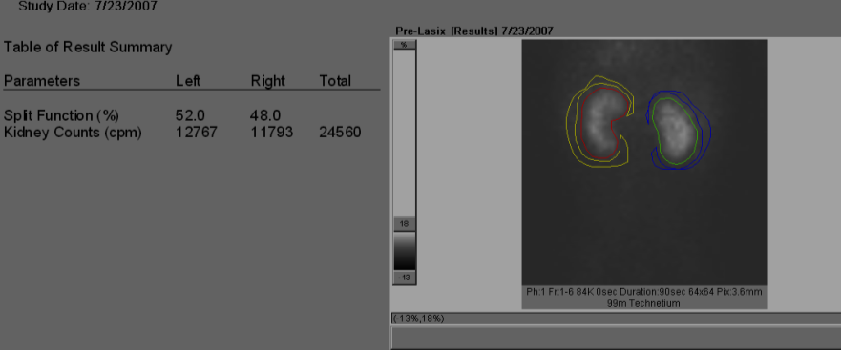
Same patient, 6 mos later—Improved LT drainage,
No evidence of high grade obstruction
% Residual at 30 min= 20%

Slide 33
Case # 5

Slide 34
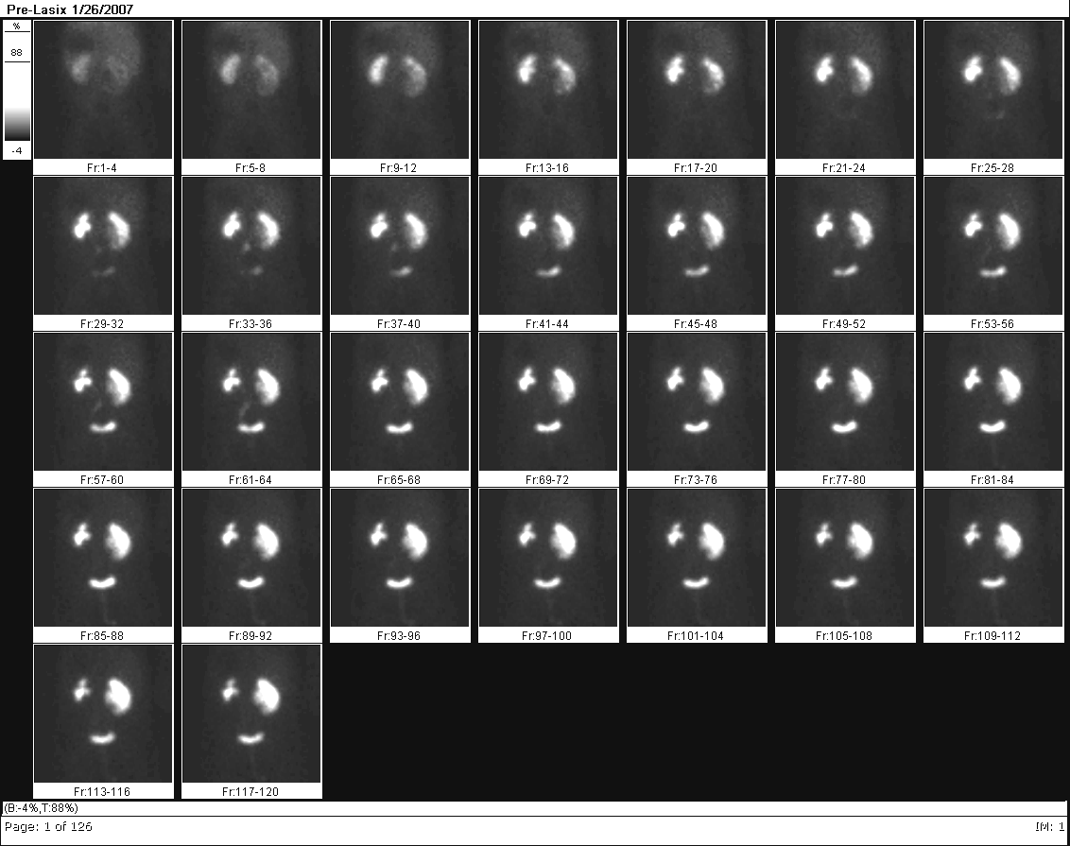
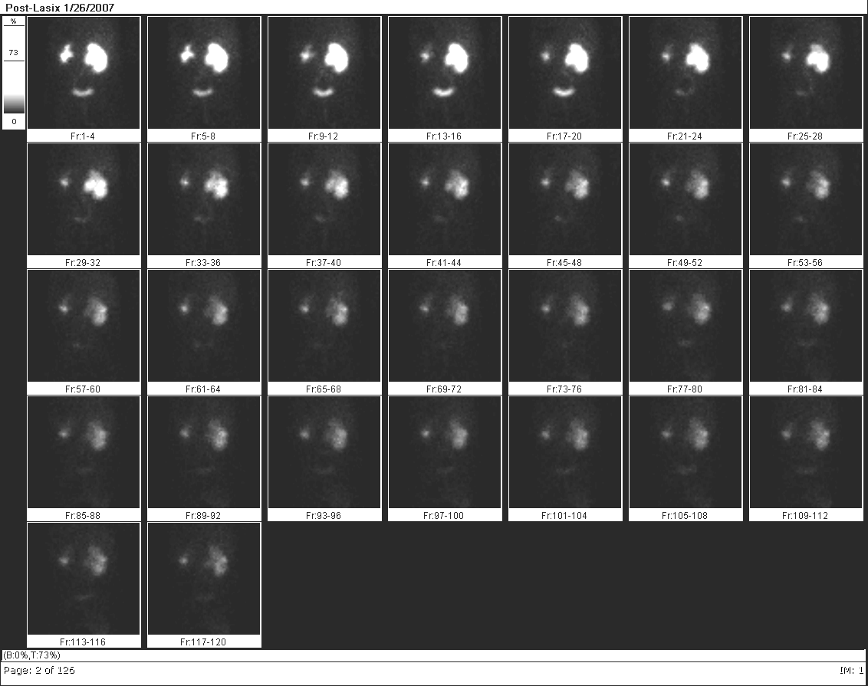
10 week old female w/ prenatal diagnosis of bilateral
hydronephrosis. Normal VCUG
Pre-Lasix
Post-Lasix

Slide 35
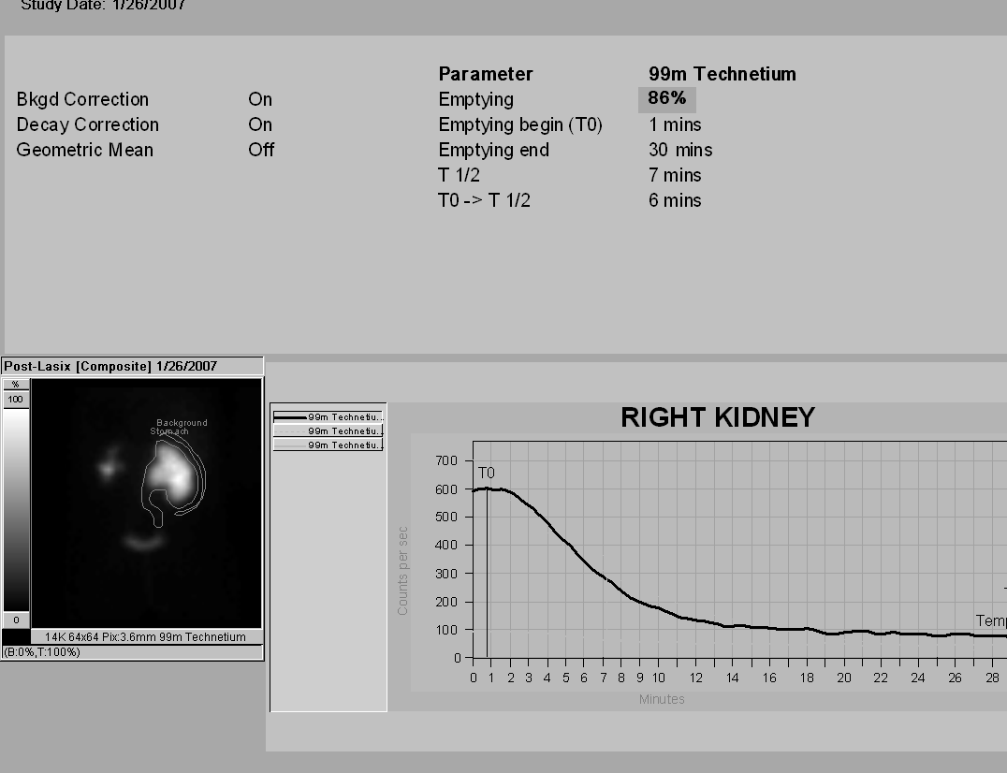
Non-obstructive hydronephrosis RT kidney. No postupright imaging needed: washout half-time is < 10 minutes
Does this patient need
f/u diuresis renogram?
Yes. Neonatal hydronephrosis is a dynamic phenomenon, may improve, remain stable or even worsen over time.
% Residual at 30 min= 14%

Slide 36
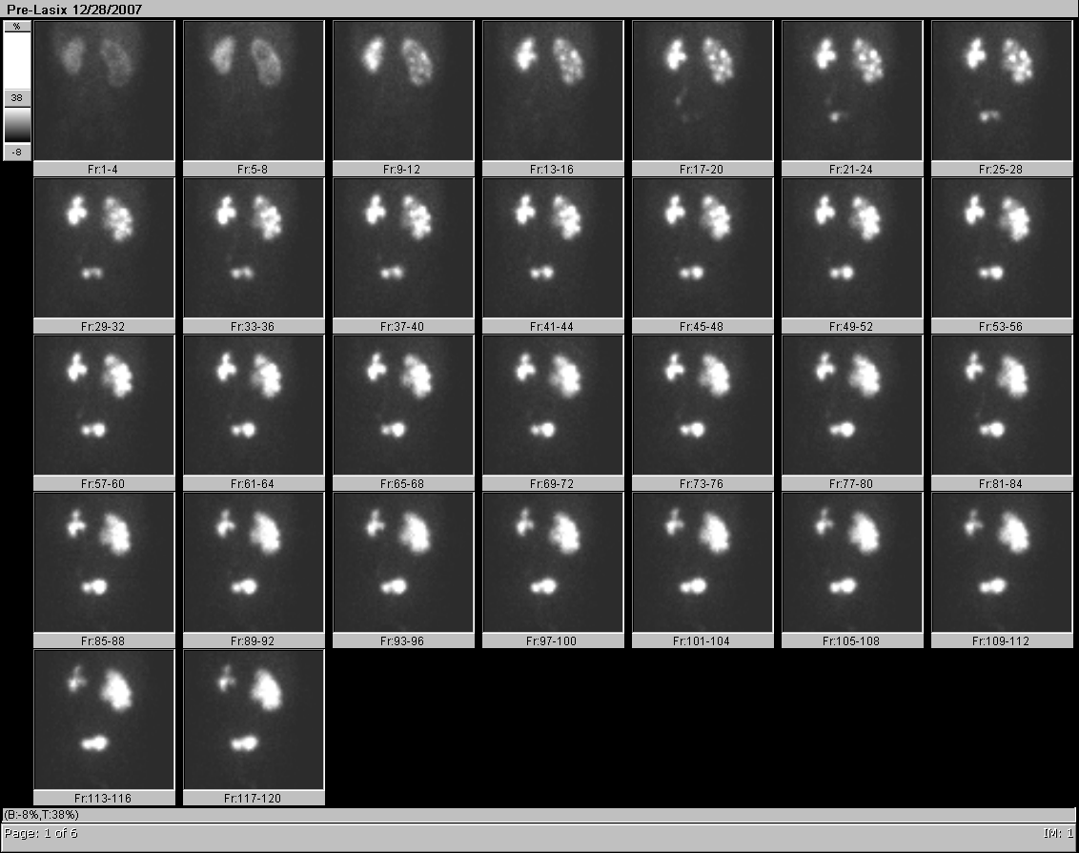
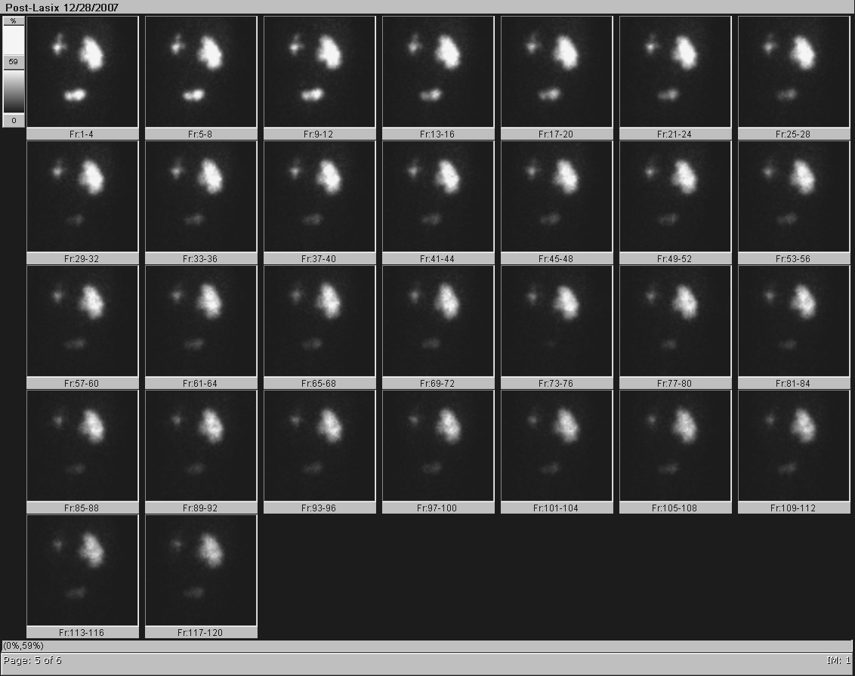
Same patient, f/u study 11 months later:
worsened drainage.
Pre-Lasix
Post-Lasix

Slide 37
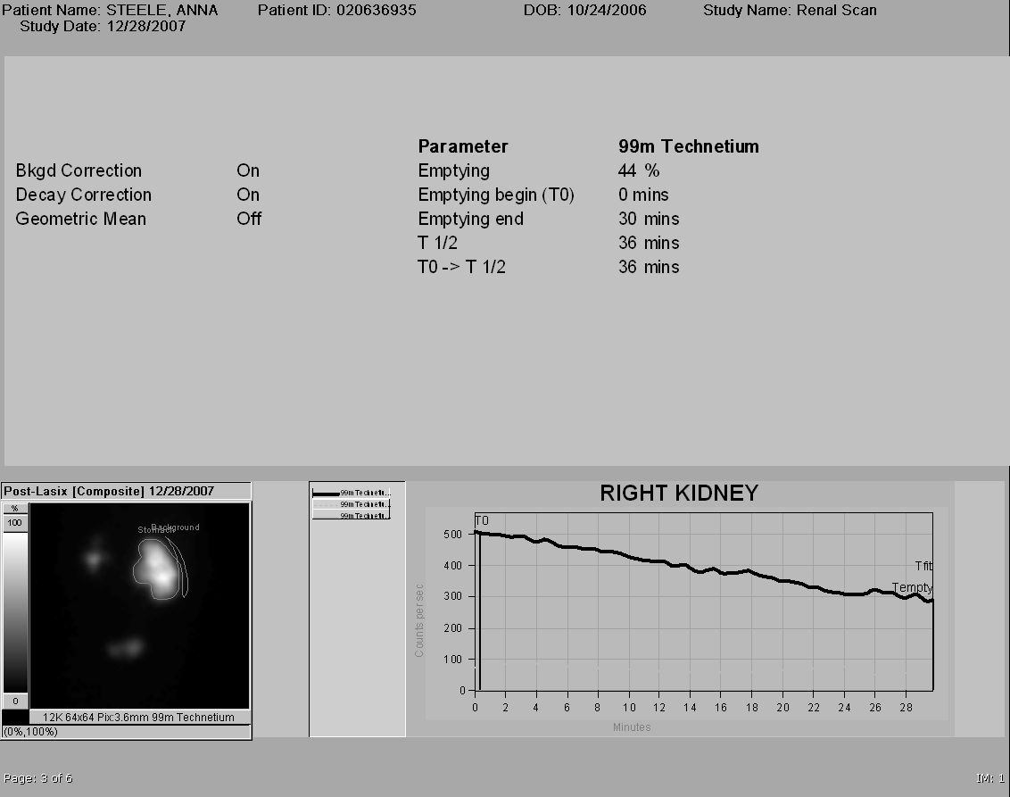
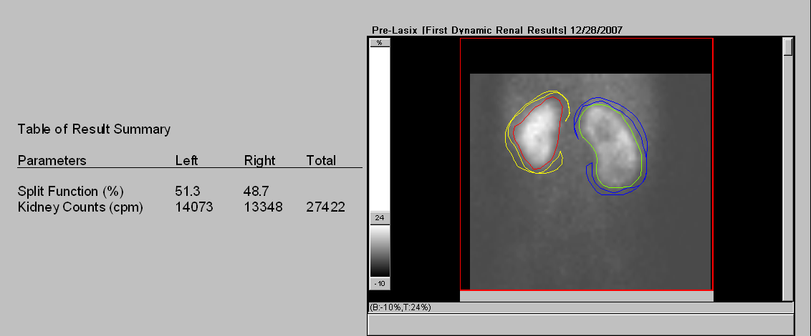
Worsened drainage: RT UPJ obstruction.
Patient went to pyeloplasty
% Residual at 30 min= 56%

Slide 38
Case # 6

Slide 39
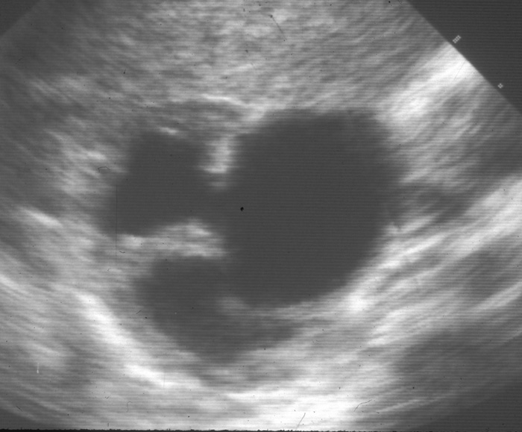
1st Patient: 2 month old with prenatal RT hydronephrosis
Findings??

Slide 40
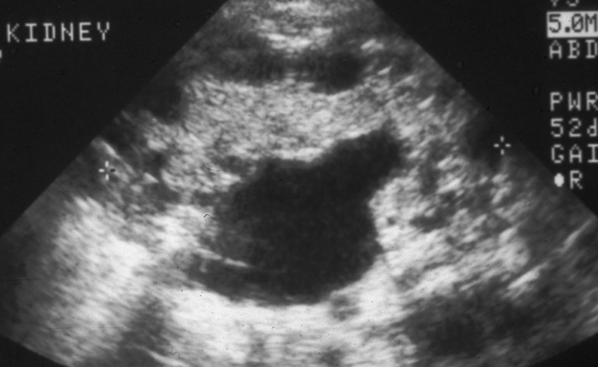
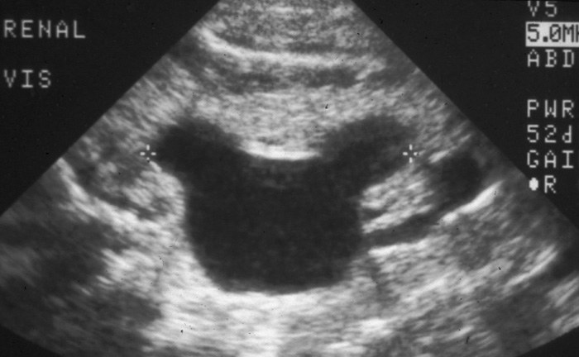
2nd Patient: Newborn with prenatal left hydronephrosis.
Normal right kidney
6.5 cm
LT
LONG
LT
TRANS
LT
LT
How do the findings in this patient differ from the first patient?
What study should be done next?

Slide 41
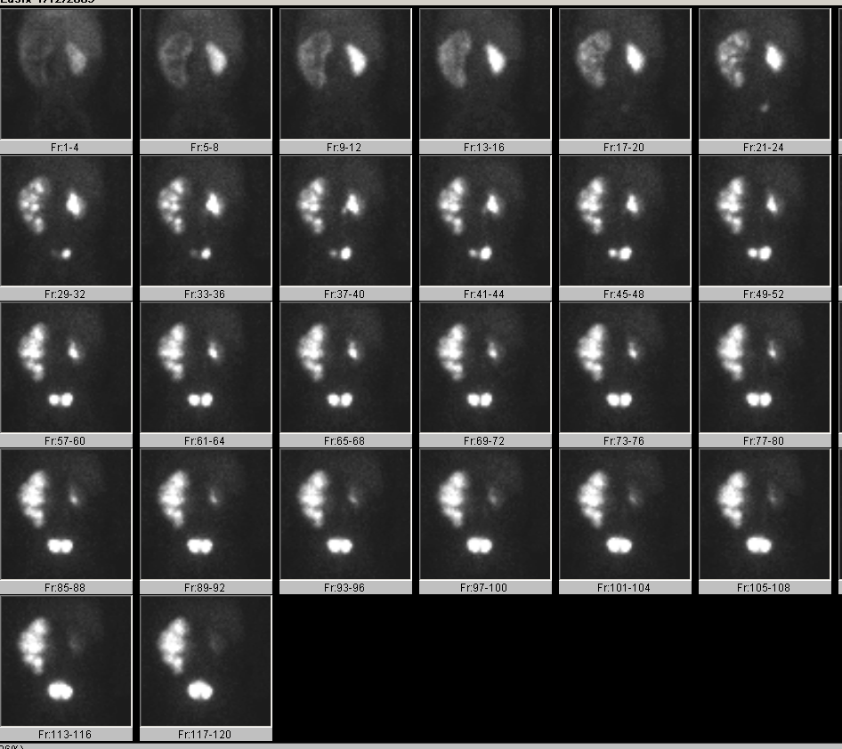
First patient
Second patient
Functioning LT kidney c/w UPJ obstruction
Non-function LT kidney
c/w MCDK

Slide 42
UPJ Obstruction vs UPJ type MCDK
First patient
Second patient

Slide 43
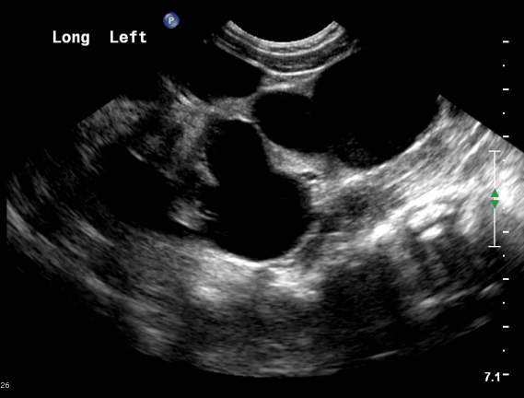
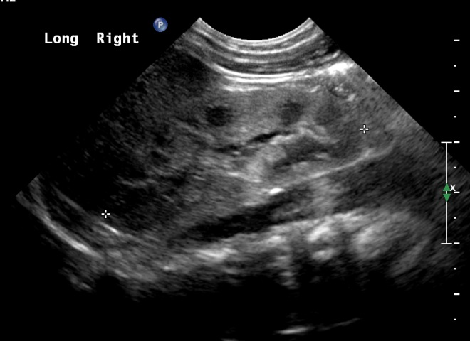
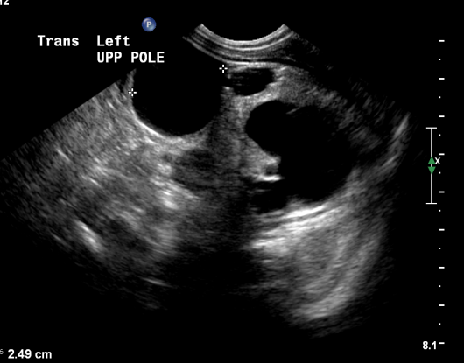
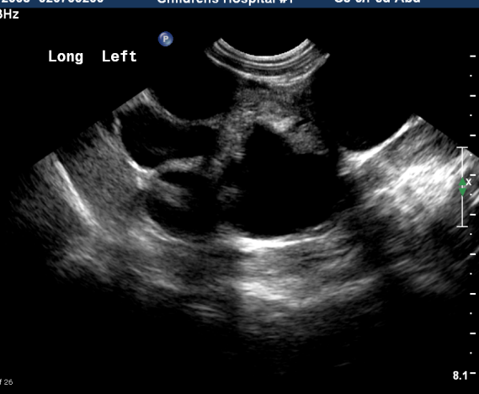
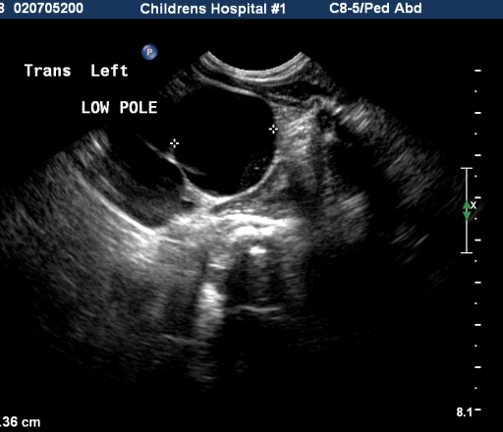
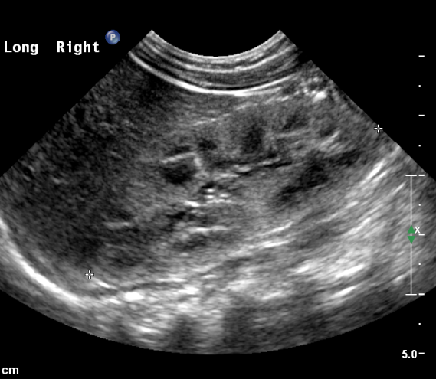
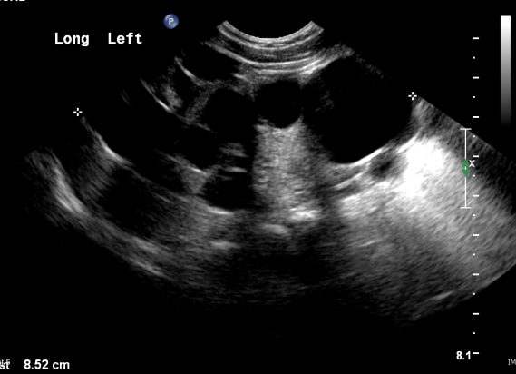
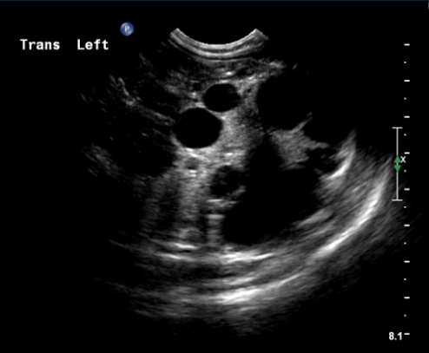
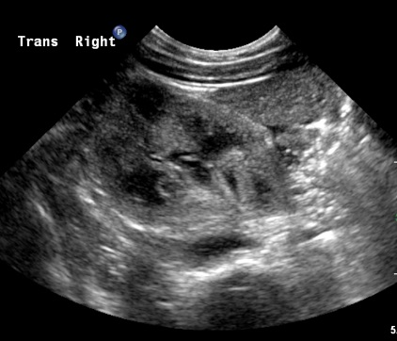
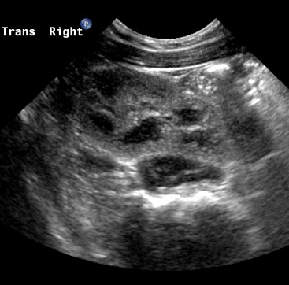
4 month old with Classic type MCDK
LEFT KIDNEY
RIGHT KIDNEY
5.3 cm

Slide 44
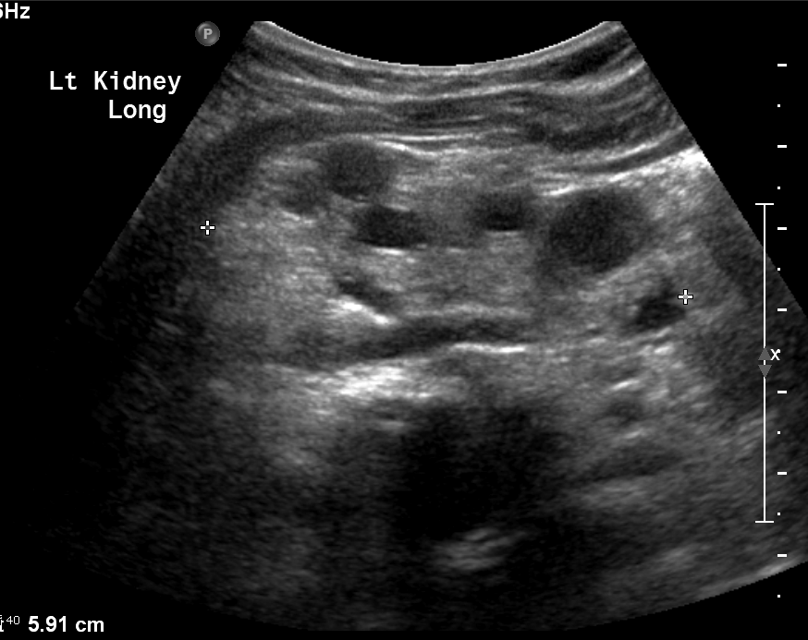
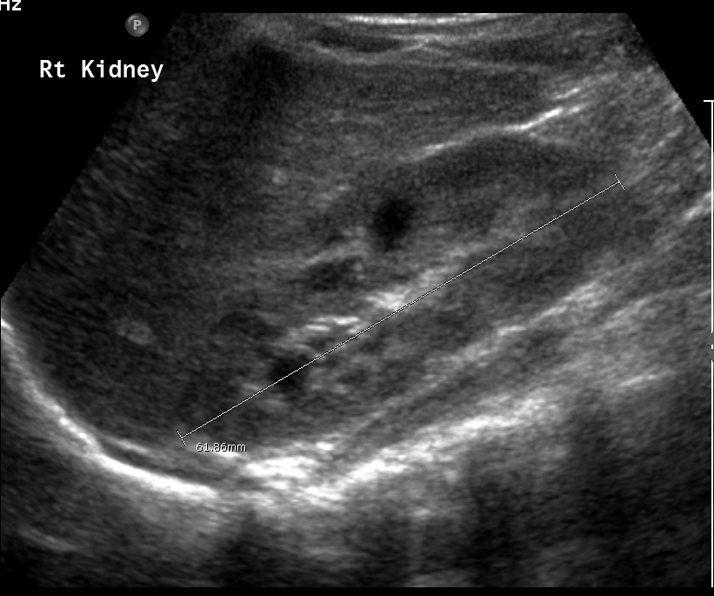
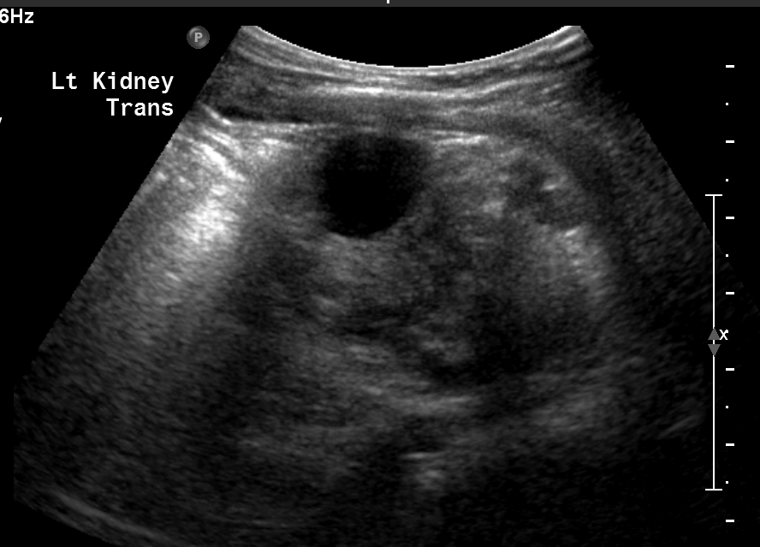
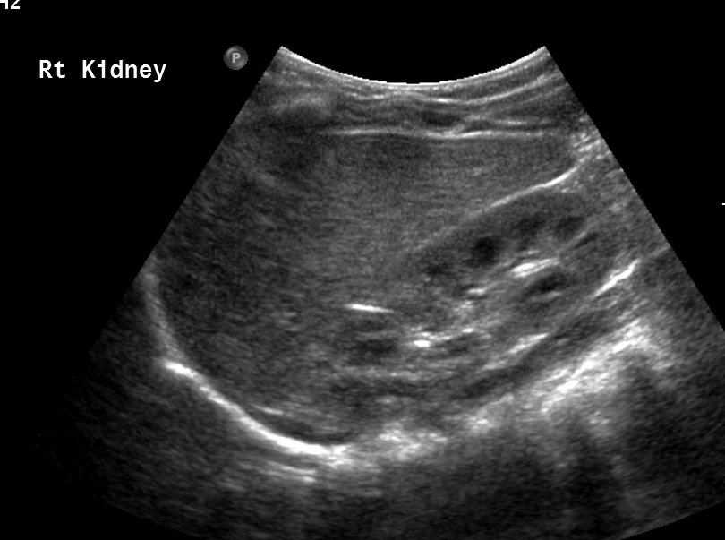
Follow-up US 6 months later
6.4 cm
LEFT KIDNEY
RIGHT KIDNEY

Slide 45
Case # 7

Slide 46
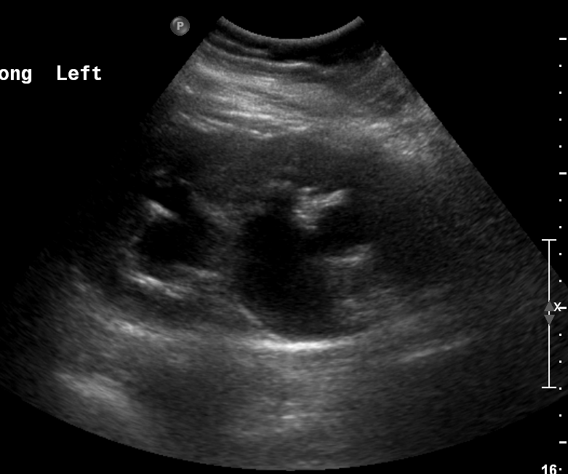
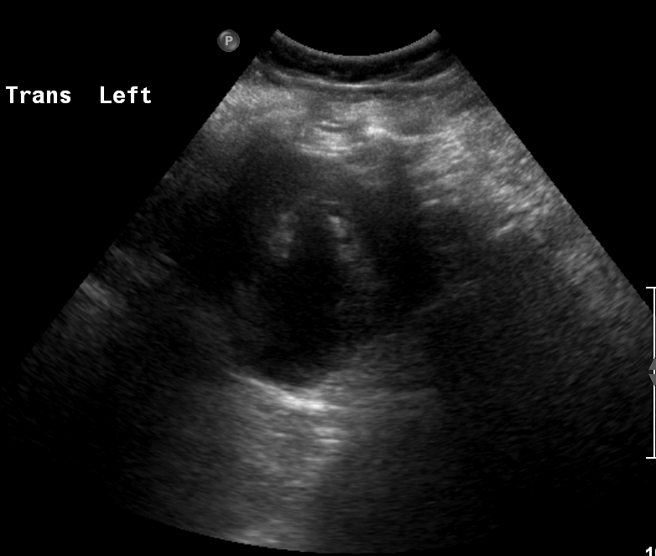
3 year old boy with LT hydronephrosis seen on US
done for abdominal pain.

Slide 47
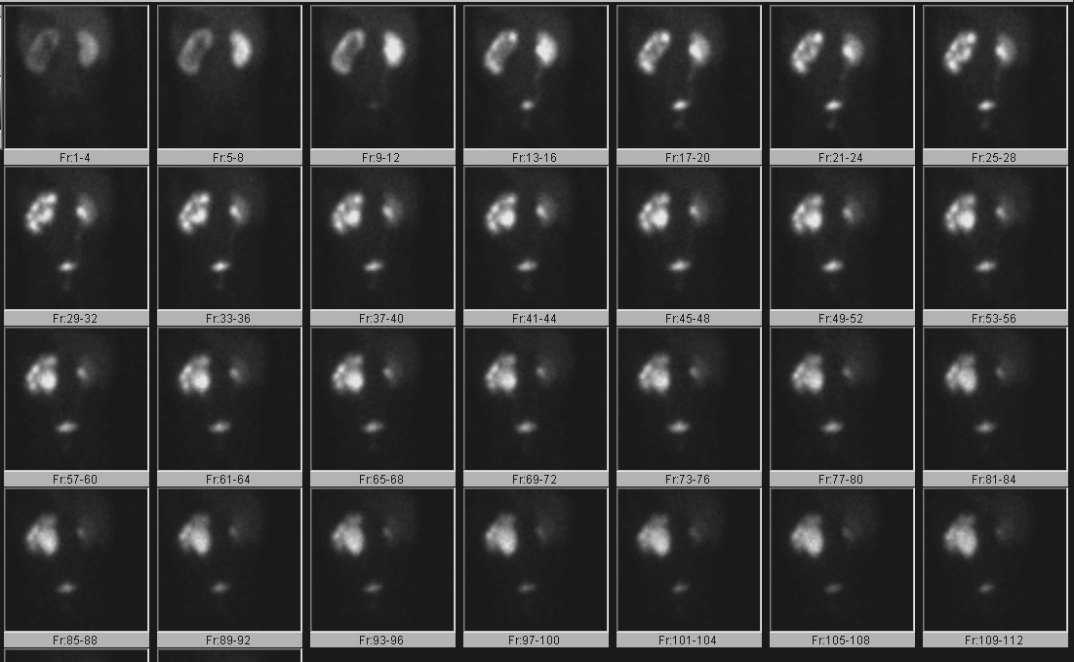
Findings?? What would you ask the tech to do next?
Notes:
47

Slide 48
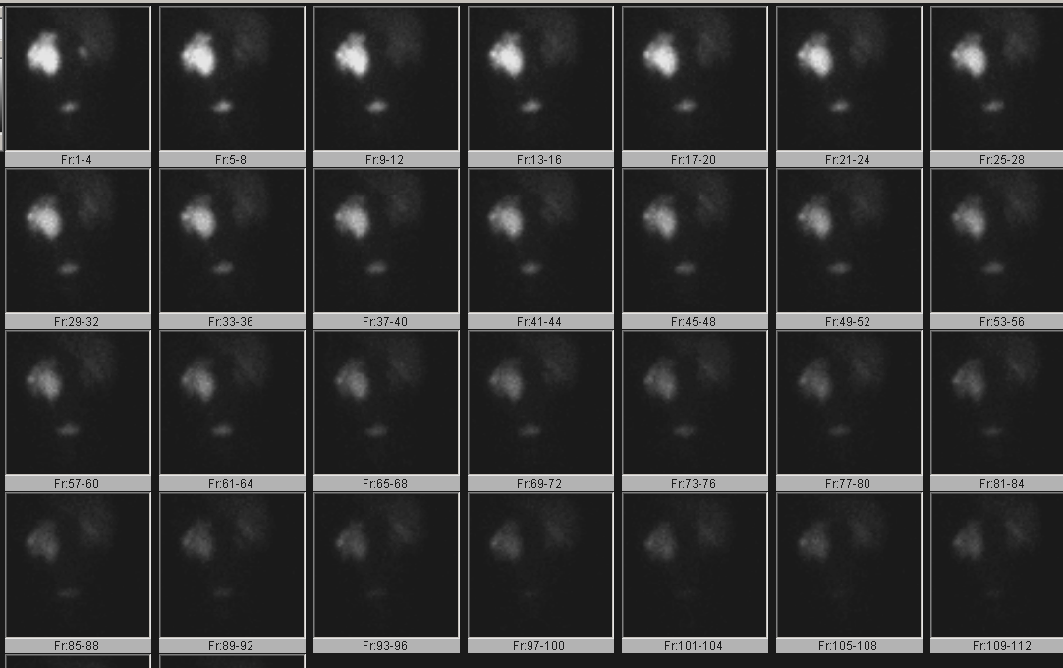
Post-Lasix
Findings?

Slide 49
Notes:
49

Slide 50
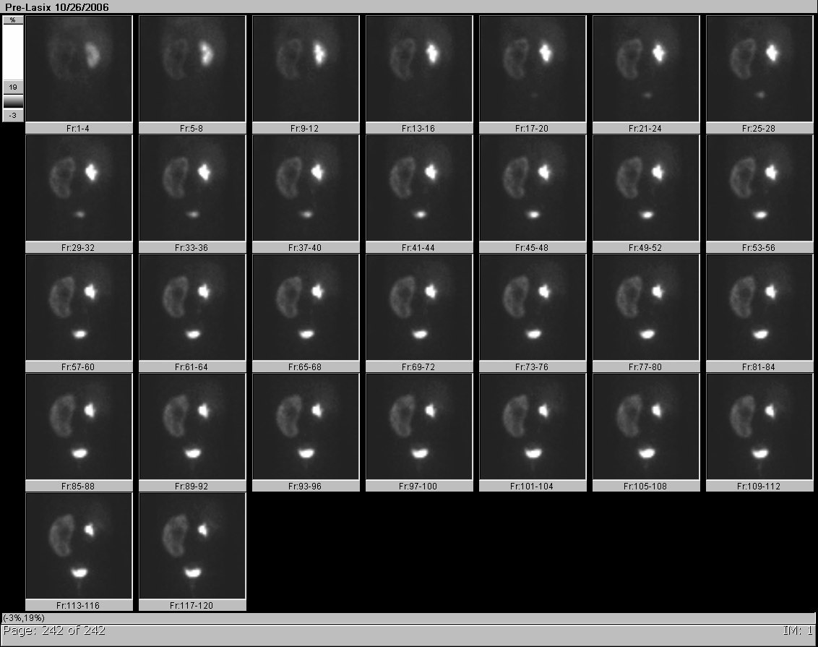
Pt. presents to urologist 9 mos later w/sx of abdominal
pain and vomiting. Repeat renal scan 2 days after onset of symptoms
Findings? Diagnosis?
Notes:
50

Slide 51
Acute UPJ
Obstruction—
Tracer retained in
the cortex
UPJ Obstruction—
Tracer retained in
collecting system
Notes:
51

Slide 52
Acute UPJ Obstruction: Dietl’s Crisis
A complication of underlying hydronephrosis, diagnosed or undiagnosed
Episodes of abdominal pain and vomiting
Precipitated by increased hydration status
Usually due to underlying crossing vessel at UP junction, or change in angle of overdistended pelvis
Indication for pyeloplasty
Window of opportunity for diagnosis by renal scan within 5 days of symptoms
Notes:
52

Slide 53
Mechanism of cortical retention on MAG-3 renal scan
Renal Cortex
Calyx
(collecting system)

Slide 54
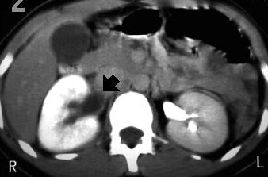
CT equivalent of acute obstruction
Acute RT UPJ Obstruction:
3 minute delay showing cortical retention
of contrast on the RT

Slide 55
Case # 8

Slide 56
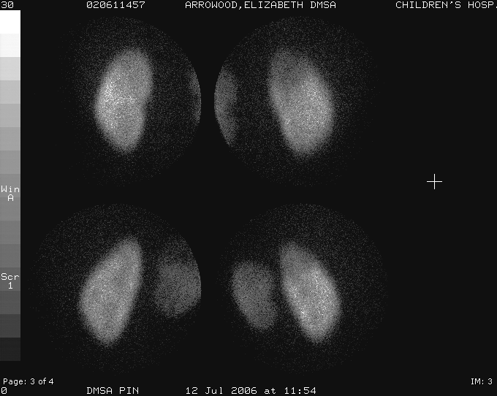
3 year old girl with febrile urinary tract infection.
DMSA renal scan was performed
Findings?
Differential?
LT post
RT post
LPO
RPO

Slide 57
Acute pyelonephritis
Scar
Photopenic defect without
volume loss
Photopenic defect with volume loss
What other study may be done on this patient?

Slide 58
Agent: 99mTc- pertechnetate
Catheterize bladder
Posterior imaging
Nuclear cystogram
Filling phase
Voiding phase
Bilateral reflux: moderate RT and mild LT

Slide 59
VCUG (Voiding cystourethrogram)—excellent resolution for anatomy and grading VUR. Intermittent imaging
Early filling
Full bladder
Compare VCUG to Nuclear cystogram
Bilateral obliques
RT Grade III VUR
LT Renal fossa
Urethra
Post-void bladder

Slide 60
Cannot assess urethra on nuclear cystogram; need to do
VCUG in a boy with a UTI
Normal urethra

Slide 61
RNC (Radionuclide Cystogram)—continuous imaging- very sensitive. Transient reflux; but less resolution

Slide 62
Grading of Reflux: RNC vs. VCUG
Mild
Gr II
Mod
Gr III
Mod
Gr IV
Severe
Gr V

Slide 63
Imaging in a child with UTI
How to image the kidneys: US, DMSA, CT, MRI??
In piglet studies, DMSA, CT and MRI found to have similar high sensitivities (87 to 92%) in detection of acute pyelonephritis (US w/power Doppler 74%)
Recent study comparing MRI and DMSA indicate similar sensitivities for detecting scar

Slide 64
PIGLET STUDY
MRI: Acute pyelonephritis
Coronal post-gadolinium fast multiplanar inversion recovery—hyperintense
lesions both kidneys
Contrast-enhanced CT:
Acute pyelonephritis
Hypodense lesions both
kidneys

Slide 65
Imaging in a child with UTI
Is cystography always necessary?
In DMSA-scan documented pyelonephritis, prevalence of reflux --24 to 39%
Evolving “Top Down” Approach
Image the kidneys first—DMSA
If any abnormality is present, acute pyelonephritis or scar, then do a cystogram to check for reflux—an additional risk factor for scarring.
If DMSA is normal, no cystogram is necessary

Slide 66
CT and US in Acute Pyelonephritis
US: non-invasive, no radiation, but low sensitivity and specificity
CT: high sensitivity and specificity but high radiation dose and need for iodinated contrast

Slide 67
DMSA vs MRI
Similar sensitivity and specificity with both modalities
Information about perinephric space with MRI
More frequent need for sedation with MRI
Availability and cost

Slide 68
Choice of DMSA vs MRI greatly depends on the availability of the imaging modality and the expertise of the physicians interpreting the studies.

Slide 69
Case # 9

Slide 70
2 year old with bright red blood per rectum
Focus of uptake appears at time of appearance of stomach, c/w heterotopic gastric mucosa.
Note the location in LLQ!
Uptake in meckel’s diverticulum or duplication cyst

Slide 71
Case # 10

Slide 72
3 wk old boy w/ prenatally detected RT hydro; LT kidney normal
LONG
What study should you do next?

Slide 73
Post-void
Is your study finished?

Slide 74
A few minutes later
What nuclear study might the baby have been scheduled for
after the VCUG, based on the US findings?
Mag 3 renal scan with Lasix
What nuclear study might you
recommend instead?
DMSA renal scan

Slide 75
DMSA renal scan: RT reflux nephropathy

Slide 76
Case # 11

Slide 77
2 year old with opsoclonus/myoclonus

Slide 78
What other study would be helpful?

Slide 79
I-123 MIBG scan

Slide 80
MIBG SPECT
Neuroblastoma

Slide 81
Case # 12

Slide 82
3 month old boy with RT hydronephrosis/hydroureter on US.
What study would you do next after this VCUG?

Slide 83
Mag-3 renal scan
RT hydronephrosis/hydroureter.
What should the tech do next?

Slide 84
After Lasix, some drainage from RT
Collecting system and ureter

Slide 85
RT hydronephrosis/hydroureter without high grade obstruction;
Improved drainage post-upright; preserved function
% Residual at 30 min= 38%

Slide 86
Case # 13

Slide 87
3 year old girl. Differential?
Retroperitoneal tumors
-neuroblastoma
-lymphoma/leukemia
-rhabdomyosarcoma
-malignant germ cell
tumor

Slide 88
What study?
I123 MIBG
What are the abnormal
findings?
Uptake in primary tumor LT
abdomen and in a met in
RT groin

Slide 89
Neuroblastoma with RT groin met

Slide 90
CASE # 14

Slide 91
3 yr old boy w/ limp, fever and blood culture growing
gram pos cocci
Hip is suspected
site of abnormality.
What study might be done
next?

Slide 92
RT
long
trv
LT
trv
long

Slide 93
T2 weighted
images
Axial
Coronal

Slide 94
Early
Delayed

Slide 95
Osteomyelitis
LT proximal tibial metaphysis
RT
LT
X-rays
LT leg: Normal
Anterior

Slide 96
CASE # 15

Slide 97
12 yr old sledded into a tree

Slide 98
What f/u study
would be helpful
to evaluate
kidney function?

Slide 99
Non-viable tissue LT midpole with good function upper and lower poles

Slide 100
CASE # 16

Slide 101
15 yr old male, competitive soccer player,
with one-year history of back pain, relieved by aspirin
5/17/02

Slide 102
9/6/01
11/26/01
5/17/02

Slide 103
Notes:
Comment on the small size of the nidus and large area of surronding scleorosis. Mention usefulness of intraoperative scintigraphy for minimizing bone resection.

Slide 104
OSTEOID OSTEOMA
CT scan—bone window: central lucent
nidus with much surrounding sclerosis
Spondylolysis
Notes:
Comment on the small size of the nidus and large area of surronding scleorosis. Mention usefulness of intraoperative scintigraphy for minimizing bone resection.

Slide 105
INTRAOPERATIVE SCINTIGRAPHY: can help limit resection to include nidus and min surrounding sclerotic bone
Before resection
Bone fragments
After resection
Notes:
Emphasize that resected bone primarily contains the nidus and

Slide 106
CASE # 17

Slide 107
What is the purpose of this study?

Slide 108
Evaluate for obstruction
These images show a good response to lasix- no obstruction

Slide 109
So our images and the post lasix curve show no obstruction on the right.
But there is still something wrong with this curve. What is it?

Slide 110
The T1/2 is < 10 min, but the curve flattens out. Why?

Slide 111
Look at the initial images next to the ROI for the curve

Slide 112
The ROI includes an area outside the collecting system
Of the right kidney.
What is it?

Slide 113
It’s the gallbladder. There is vicarious excretion, similar to IV contrast on a ct scan.
The technologist accidently included it in the ROI.
The image on the right is what the ROI should be.
It excludes the activity in the gallbladder.

Slide 114
OLD CURVE
NEW CURVE
Very subtle change in the curve, which in this instance did not give a
Give a false positive for obstruction.

Slide 115
A more obvious case
If the ROI had been drawn on the right, we could’ve called high grade obstruction!

Slide 116
A more obvious case
If the ROI had been drawn on the right, we could’ve called high grade obstruction!

Slide 117
CASE # 18

Slide 118
What study is this?

Slide 119
What study is this?
Radiotracer?

Slide 120
What study is this?
Radiotracer?
PET CT
18 F FDG

Slide 121
This patient has H/O Hodgkin’s lymphoma
PET/CT for Follow up
Prior PET/CT was negative
Look at the next few slides to determine a diagnosis

Slide 125
What are the findings?
Does this patient have recurrence?

Slide 126
What are the findings?
Does this patient have recurrence?
What is your diagnosis?

Slide 127
BROWN FAT
Areas of hypermetabolic activity in the supraclavicular
Regions correspond to low density normal fat

Slide 128
BROWN FAT
Areas of hypermetabolic activity in the supraclavicular
Regions correspond to low density normal fat

Slide 129
What can be done to prevent brown fat?
-Warming (blankets, feet in warm water,
heat the room up)
-Calm the patient
-Sedation
-Low carbohydrate meal the night before

Slide 130
CASE # 19

Slide 132
What is the radiotracer?

Slide 133
Salivary Glands
Liver
Myocardium
Bladder
What is the radiotracer?

Slide 134
Salivary Glands
Liver
Myocardium
Bladder
123 I MIBG

Slide 135
Abnormal findings?

Slide 136
Bony uptake

Slide 137
History of neuroblastoma with bony mets.
1 year follow up on next slide.

Slide 139
Same radiotracer?

Slide 140
Yes
Diffuse bony neuroblastoma mets
Almost looks like a bone scan

Slide 141
CASE # 20

Slide 142
5 mo F with UTI
Duplex right kidney with dilated upper moiety
Dilated right upper moiety ureter

Slide 143
Same patient, VCUG
Left reflux
Right lower moiety reflux

Slide 144
Hydronephrotic right upper moiety
Gradual accumulation into right upper collecting system
Radiotracer?
Obstructed right upper moiety with minimal function (5% of total)
Tc-99m-MAG3
Minimal drainage from right upper collecting system = obstructed
Symmetric renal function
Normal > 75%
Normal < 10 minutes
Minimal gravity dependent drainage (<50%)
Minimal function right upper moiety

Slide 145
CASE # 21

Slide 146
2 month-old female febrile UTI
No reflux
Duplicated left kidney with dilated lower
-typically the upper moiety obstructs and the lower refluxes with duplications

Slide 147
Left lower hydronephrosis
Left lower obstruction
Tc-99m-MAG3
After lasix given
Symmetric function
Good function from dilated left lower moiety
No significant gravity-dependent drainage

Slide 148
CASE # 22

Slide 149
2 mo M with reflux
emesis
Radiotracer?
Tc-99m given PO
frequent reflux into upper esophagus
Swallowing appears normal
60 min imaging after feeding
Initial swallowing images
Sonographically normal pylorus
Delayed gastric emptying (<70% @ 3 hours)
overestimated due to emesis
Concerning for pyloric stenosis (age, symptoms, delayed emptying)

Slide 150
CASE # 23

Slide 151
2.5 yo M s/p R renal mass resection, starting nephrotoxic chemo
Normal left kidney
Right kidney surgically absent
Normal GFR from solitary left kidney
Radiotracer?
Tc-99m DTPA
How is GFR calculated?
Measure Tc-99m DTPA activity in blood at different time points
Findings?

Slide 152
6 mo F with idiopathic bone marrow failure, preparing for marrow transplant
GFR is low (<55)
Findings?
Right kidney is missing
CT shows congenital absence of R kidney
Liver
L kidney

Slide 153
CASE # 24

Slide 154
4 mo M with R hydronephrosis???
Sonographically normal left kidney
VCUG shows mild R reflux?

Slide 155
These are cysts, not hydronephrosis
Probably an atretic right ureter
Multicystic Dysplastic Kidney (MCDK)
Normal left kidney
Urinary bladder
Left ureter
Tracer?
Tc-99m MAG3
Findings?
No uptake in the right renal fossa
Dx?
Dysplastic right kidney

Slide 156
CASE # 25

Slide 157
17yo female with low TSH, elevated free T4, positive thyroid stimulating antibodies
Radiotracer?
Iodine-123 (I-123)
Diffuse increased radioiodine uptake throughout the thyroid gland
Findings?
Measured I-123 uptake: 100% at 4 hrs; 100% at 24 hrs
Diagnosis?
Graves’ Disease
Treatment options?
Thyroid blocking medications (inhibit TPO); I-131
Difference between I-123 and I-131?
I-123 is a gamma emitter (imaging only) I-131 is ß emitter which can destroy tissue
Pre I-131 requirements?
Hcg neg, Iodine uptake > 50%, off medications, NPO 4 hrs
80-200 uCi/gram tissue* thyroid size 24 hr uptake
200uCi/g*50g 1
I-131 dose?
=10 mCi
Instructions following I-131?
separate bed/bath, no pregnancy x3 months, NPO 2 hrs

Slide 158
CASE # 26

Slide 159
5yo female with recurrent UTI
VCUG at 5 years old
VCUG at 5 months old
No reflux
R reflux

Slide 160
4 years old
5 years old
Right upper scar
Additional scar
Recent pyelonephritis
Radiotracer?
Worsening right relative renal function
Tc-99m DMSA
Right renal function decreased relative to left
Tubular Binding (cortical imaging)
Findings?

Slide 161
CASE # 27

Slide 162
15 mo F recent febrile UTI
Radiotracer?
Tc-99m pertechnetate via bladder catheter followed with normal saline
Findings?
Late, mild left vesicoureteral reflux
Yes, >100 mL (age in yrs +2)x30mL
Is 105 mL appropriate bladder filling volume for 15 mo?

Slide 163
Different 16mo female with febrile UTI
No evidence of vesicoureteral reflux

Slide 164
19mo with known left VUR
Severe left VUR during early bladder filling

Slide 165
CASE # 28

Slide 166
17yo male with frequent nausea/vomiting
Tracer?
Tc-99m Sulfur Colloid in egg substitute given PO
Why anterior and posterior images?
Correct for anterior movement in the stomach before emptying
How is geometric mean calculated?
√(ant cnt x post cnt)
What are normal minimum values?
>10% at 1 hr, > 40% at 2 hrs, >70% at 3 hrs, >90% at 4 hours
Accuracy at 3hr (>70%)?
91% compared to 4hr¹
What is a normal maximum?
<70% at 1 hour (>70% indicates rapid gastric emptying)
Normal liquid emptying?
Faster, ~50% at 50 minutes
Very important to use standardized meal for which normal values established
¹Zeissman HA, J Nucl Med, April 2007, 48:568-572

Slide 167
CASE # 29

Slide 168
3yo female with recurrent LPA stenosis
Tracer?
Tc-99m MAA (lodges in ~0.1% of pulmonary capillaries)
Allows estimation of relative lung perfusion, also can separate into relative perfusion of each lobe

Slide 169
CASE # 30

Slide 170
11yo male with intermittent swelling left leg for several years
Tracer?
Tc-99m sulfur colloid
Findings?
Asymmetric nodal uptake
Dermal backflow pattern
Left leg lymphedema
Diagnosis?

Slide 171
17 yo male recurrent right leg cellulitis
Findings?
Asymmetric nodes
Early bladder activity
Diagnosis?
Right leg lymphatic obstruction (lymphedema) with chyluria
Dermal backflow pattern

Slide 172
CASE # 31

Slide 173
12yo female with refractory epilepsy
Tracer?
F-18 FDG
Findings?
Possible ictal focus
Asymmetric hypometabolism right posterior parietal corresponding to cortical grey matter lesion on MRI

Slide 174
Case # 32
15 yo F with Left flank pain for several months, starting in summer

Slide 177
Vertical orientation
Tongue of activity across lower pole?
Both kidneys secrete promptly. Some drainage is seen on the right by the end of 30 minutes but there is retention of radiotracer bilaterally particularly on the left.

Slide 178
Ri
Right sagittal
Left sagittal

Slide 179
Note band of parenchymal tissue at inferior poles,
suggestive of a horseshoe kidney.
No corresponding radiotracer uptake seen in this area, there fore non-functioning isthmus

Slide 180
Vertical orientation
Tongue of activity across lower pole?
The dilated left renal pelvis is quite anteriorly situated as seen on the CT. Therefore, the patient was The dilated left renal pelvis is quite anteriorly situated as seen on the CT. Therefore, the patient was placed in prone positioning to further fill the pelvis.

Slide 181
Post Lasix: Left collecting system drains with a half-time of 93 minutes and 79 % residual at 30 minutes (21 % emptying). The right collecting system drains with a half-time of 9 minutes and 8 % residual at 30 minutes (92 % emptying).

Slide 182
Post upright clearance left kidney

Slide 183
Case # 33
6 yo M with refractory epilepsy s/p craniotomy with electrocorticography for resection of insular cortical dysplasia

Slide 184
Pre-surgery
Post-surgery

Slide 185
Interictal PET performed and fused to post-surgical MR

Slide 186
Fusion PET-MR

Slide 187
There is hypometabolism along anterior right perisylvian frontal lobe including previously described residual cortical dysplasia posterior and superior to the resection cavity., also including immediately adjacent cerebral cortex which appears normal on MR images
Fusion PET-MR

Slide 188
CASE # 34

Slide 189
Prenatal Hydronephrosis
Findings:
Grade 2 hydronephrosis
Suggestion of duplex collecting system (arrow)

Slide 190
Prenatal Hydronephrosis
Findings:
- Classic “drooping lily” appearance of reflux into the lower pole of a duplex collecting system

Slide 191
Prenatal Hydronephrosis
PRE-LASIX

Slide 192
Prenatal Hydronephrosis
POST-LASIX

Slide 193
Prenatal Hydronephrosis
Duplex collecting system
US: hydronephrosis with suggestion of anatomic anomly
VCUG: “drooping lily” indicating reflux into the lower pole moiety; no ureterocele
Lasix renogram: No evidence of obstruction.
Contributed by Matthew Winfeld, MD

Slide 194
CASE # 35

Slide 195
Right pelvic kidney 2/10/12
Right kidney deep to the bladder
Severe pelvi-caliectasis

Slide 196
F/u ultrasound 10/10/14
No right kidney seen

Slide 197
DMSA 10/16/14
No scintigraphic evidence of a function right kidney. Normal left kidney

Slide 198
Renal involution
Obstructive renal dysplasia vs. hydronephrotic subtype of MCDK; not possible to distinguish now since functional evaluation was not sought initially
DMSA can be used to “find” a missing kidney!
Contributed by Matthew Winfeld, MD

Slide 199
CASE # 36

Slide 200
2.5 mo with jaundice

Slide 201
Hepatobiliary Scan: Findings
Prompt blood pool clearance and liver uptake
Bowel activity seen, excluding biliary atresia
Poor clearance from liver suggesting cholestasis

Slide 202
Neonatal Jaundice DDx
Biliary atresia
Neonatal hepatitis
Choledochal cyst (compression)
Cholestasis
TPN (our case)
Increased bilirubin load (hemolysis, hemorrhage, increased enterohepatic circulation due to bowel abnormality such as atresia/stenosis)
Contributed by Matthew Winfeld, MD

Slide 203
CASE # 37

Slide 204
17F TOF (repaired in infancy)

Slide 205
Findings
Quantitative lung perfusion scan
Significant differential in perfusion between left and right lung (79%/21%) suggesting some degree of pulmonic stenosis

Slide 206
CXR 9 days later
Interval placement of pulmonary artery stents
Contributed by Matthew Winfeld, MD

Slide 207
CASE # 38

Slide 208
Type of study? Any abnormal findings?
Notes:
Bin Wang, DO. Walter Reed nuclear medicine fellow.

Slide 209
MIBG scan, diagnosis of neuroblastoma. left retroperitoneal, left thoracic paraspinal mass, supraclavicular area, foci of uptake seen in the chest, abdomen, pelvis, and bilateral upper and lower extremities
Notes:
Bin Wang, DO. Walter Reed nuclear medicine fellow.

Slide 210
CASE # 39

Slide 211
10-year-old female with history of hypercalcemia of unknown origin.
Notes:
Bin Wang, DO. Walter Reed nuclear medicine fellow.

Slide 212
What type of study is this? Any abnormal findings?
Notes:
Bin Wang, DO. Walter Reed nuclear medicine fellow.

Slide 213
Bone scan, MDP -early whole-body images demonstrate radiotracer accumulation across the elbow, wrist, knee and ankle joints bilaterally, compatible with synovitis/arthritis. -significant cortical retention within bilateral kidneys, consistent with renal dysfunction/nephritis. -No conclusive diagnosis, however, lab results were supportive of sarcordosis.
Notes:
Bin Wang, DO. Walter Reed nuclear medicine fellow.

Slide 214
CASE # 40

Slide 215
History: 6 year old male with ALL needs baseline GFR function for upcoming bone marrow transplant.
Notes:
Bin Wang, DO. Walter Reed nuclear medicine fellow.

Slide 216
What radiotracer is used? Any abnormal findings?
Notes:
Bin Wang, DO. Walter Reed nuclear medicine fellow.

Slide 217
Tc99m DTPA, Normal GFR scan
Notes:
Bin Wang, DO. Walter Reed nuclear medicine fellow.

Slide 218
CASE # 41

Slide 219
History:32 month-old female with history of Down syndrome and left pulmonary artery stenosis status post pulmonary artery sling.
Notes:
Bin Wang, DO. Walter Reed nuclear medicine fellow.

Slide 220
What type of study is this and what radiotracer is used?
Notes:
Bin Wang, DO. Walter Reed nuclear medicine fellow.

Slide 221
Tc99m MAA, Pulmonary perfusion scan Any abnormal findings?
Notes:
Bin Wang, DO. Walter Reed nuclear medicine fellow.

Slide 222
. Overall decreased perfusion of the left lung with no focal perfusion defects.

Slide 223
CASE # 42

Slide 224
What type of study is this? What radiotracer is used? Any abnormal findings?
Notes:
Bin Wang, DO. Walter Reed nuclear medicine fellow.

Slide 225
Notes:
Bin Wang, DO. Walter Reed nuclear medicine fellow.

Slide 226
-Myocardial stress test -technetium 99m tetrofosmin (Myoview), -mild decreased counts in the anterior wall on both rest and stress images, most compatible with soft tissue (breast) attenuation artifact. No abnormal findings.
Notes:
Bin Wang, DO. Walter Reed nuclear medicine fellow.

Slide 227
CASE # 42

Slide 228
History: 28-year-old female with diagnoses of rhabdomyosarcoma. Evaluating for sentinel lymph node. What type of study is this? What radiotracer is used? What are the findings?
Right thigh region
Notes:
Bin Wang, DO. Walter Reed nuclear medicine fellow.

Slide 229
-Lymphoscintigraphy -Tc99m SulfurColloid -Sentinel lymph node identified in the left inguinal region.
Notes:
Bin Wang, DO. Walter Reed nuclear medicine fellow.

Slide 230
CASE # 43

Slide 231
12-year-old female for evaluation of brain death after prolonged cardiac arrest.
Notes:
Bin Wang, DO. Walter Reed nuclear medicine fellow.

Slide 232
What type of study is this? What radiotracer is used? What are the findings?
Notes:
Bin Wang, DO. Walter Reed nuclear medicine fellow.

Slide 233
-Brain perfusion scan -Tc 99m pertechnetate -Findings compatible with brain death in the appropriate clinical setting
Notes:
Bin Wang, DO. Walter Reed nuclear medicine fellow.

Slide 234
CASE # 44

Slide 235
What type of study is this?
Notes:
Bin Wang, DO. Walter Reed nuclear medicine fellow.

Slide 236
Hepatobiliary scan
Notes:
Bin Wang, DO. Walter Reed nuclear medicine fellow.

Slide 237
Any abnormal finding?
Notes:
Bin Wang, DO. Walter Reed nuclear medicine fellow.

Slide 238
No identifiable excretion through the gastrointestinal system. Findings compatible with biliary atresia in the appropriate clinical setting.
Notes:
Bin Wang, DO. Walter Reed nuclear medicine fellow.

Slide 239
CASE # 45
Notes:
Eman Mahdi, Pediatric fellow

Slide 240
8 year old with history of congenital heart disease and concern for LPA stenosis.
What type of study is this?
What radiotracer is used?
What are the findings?
Notes:
Eman Mahdi

Slide 241
Tc99m MAA, Lung perfusion scan
Notes:
Eman Mahdi

Slide 242
Overall decrease left lung perfusion with focal area of decreased perfusion in the lateral aspect of left upper lobe.
Notes:
Eman Mahdi

Slide 243
CASE # 46
Notes:
Eman Mahdi, Pediatric fellow

Slide 244
2 month old with history of left buttock mass
Notes:
Eman Mahdi, Pediatric fellow

Slide 245
MRI 8/30/2016
T2W images
Notes:
Eman Mahdi, Pediatric fellow

Slide 246
Post contrast images
Notes:
Eman Mahdi, Pediatric fellow

Slide 247
PET 9/15/2016
Notes:
Eman Mahdi, Pediatric fellow

Slide 248
Findings
1. Heterogeneous FDG uptake in a large sacrococcygeal mass extending into the left buttock 2. Compression of the left distal ureter by the mass causing secondary obstruction of the kidney with hydronephrosis and hydroureter.
D.DX: 1. Sacrococygeal teratoma.
2. Neuroblastoma.
3. Rhabdomyosarcoma.
4. Undifferentiated sarcoma
5. Lymphoma.
Pathology: Small round cell tumor, not neuroblastoma.
Notes:
Eman Mahdi, Pediatric fellow

Slide 249
CASE # 47
Notes:
Eman Mahdi, Pediatric fellow

Slide 250
1 month old, Ex FT Pierre Robin sequence direct hyperbilirubinemia, acholic stools, evaluate for biliary atresia. Off TPN for 18 days
GB
What's the study?
What's the tracer?
What are the findings?
Notes:
Eman Mahdi, Pediatric fellow

Slide 251
HIDA Hepatobiliary scan. TC99m Mebrofenim.
Bowel activity
Notes:
Eman Mahdi, Pediatric fellow

Slide 252
Findings:
1. No evidence of biliary atresia.
2. Good liver parenchymal uptake with mild cholestasis, could be related to TPN cholestasis.
Notes:
Eman Mahdi, Pediatric fellow

Slide 253
CASE # 48
Notes:
Eman Mahdi, Pediatric fellow

Slide 254
7-year-old female with known history of horseshoe kidney. Two febrile UTI's during the past couple of months
What's the study?
What's the tracer?
What are the findings?
Notes:
Eman Mahdi, Pediatric fellow

Slide 255
Renal cortical scan TC99 DMSA SCAN
deep wedge-shaped photopenic defect within the upper pole of right kidney with volume loss, consistent with cortical scar.
Photopenic area within the mid portion of the isthmus, consistent with fibrous tissue in the midportion of the isthmus.
Normal left kidney.
Notes:
Eman Mahdi, Pediatric fellow

Slide 256
Corresponding US images: demonstrates connecting tissue across the midline between the lower poles of both kidneys.
Notes:
Eman Mahdi, Pediatric fellow

Slide 257
Notes:
Eman Mahdi, Pediatric fellow

Slide 258
VCUG of the same day: Grade 4 reflux into the right moiety of a horseshoe kidney
Notes:
Eman Mahdi, Pediatric fellow

