Slide 1
CASE # 49
CNMC 021474211
Notes:
Contributed by Richard Becker, peds radiology fellow Sep 2018

Slide 2
11 m/o female with fever
Notes:
Contributed by Richard Becker, peds radiology fellow Sep 2018

Slide 3
What is the broad differential diagnosis?
Lung, paraspinal or mediastinal mass (w/effusion)
Airspace disease should not have this much mass-effect
Notes:
Contributed by Richard Becker, peds radiology fellow Sep 2018

Slide 4
Notes:
Contributed by Richard Becker, peds radiology fellow Sep 2018

Slide 5
After pleurocentesis and US-guided biopsy, this test was ordered. What is the radiotracer?
Age, location and MIBG avidity are most consistent with neuroblastoma.
I-123 MIBG
What is the diagnosis?
Notes:
Contributed by Richard Becker, peds radiology fellow Sep 2018

Slide 6
I-123 MIBG
(I-131 is also used uncommonly)
What is the normal distribution of the radiotracer?
Salivary glands, thyroid, myocardium, liver, adrenal glands have the most avidity. Skeletal muscle, nasal mucosa, lungs and colon have milder uptake. Primary excretion into urinary tract. May have excretion to the gallbladder.
What patient prep steps are important to remember?
Manage any sympathomimetic medications.
Administer thyroid blockade – SSKI 1 day prior and for 2 days after radiotracer injection.
Void prior to imaging (cath if not potty-trained)
Notes:
Contributed by Richard Becker, peds radiology fellow Sep 2018

Slide 7
SPECT with CT confirms uptake is definitely within this mass.
CT adds radiation dose. What are the benefits of the CT?
Notes:
Contributed by Richard Becker, peds radiology fellow Sep 2018

Slide 8
Allows for better anatomic localization of radiotracer activity, particularly with co-registered/fused images.
CT attenuation data allows for attenuation correction of the SPECT data for more accurate measurement of activity.
Notes:
Contributed by Richard Becker, peds radiology fellow Sep 2018

Slide 9
I-123 MIBG
What is the administered dose in millicuries, and a typical effective whole body radiation dose in mSv for MIBG?
0.14mCi/kg (no less than 1mCi).
5.2 mSv
At what time after injection are images acquired?
24 hrs. Repeat at 48hrs if needed to increase tumor:background ratio.
Notes:
Contributed by Richard Becker, peds radiology fellow Sep 2018

Slide 10
SPECT also shows there is no radiotracer uptake in a large portion of the mass. What could be the reason for this?
Notes:
Contributed by Richard Becker, peds radiology fellow Sep 2018

Slide 11
Hypo-enhancing, hypo-attenuating, probably necrotic tissue
Using a diagnostic CT chest with IV contrast for comparison, it is evident that the areas not taking up MIBG are not enhancing and hypo-attenuating, likely due to central necrosis.
Enhancing/viable tissue
Notes:
Contributed by Richard Becker, peds radiology fellow Sep 2018

Slide 12
Enhancing/viable tissue near the apex where I-123 MIBG activity is greatest
Notes:
Contributed by Richard Becker, peds radiology fellow Sep 2018

Slide 13
No FDG uptake, necrotic tissue
Non-enhancing necrotic tissue
Enhancing/viable tissue
Notes:
Contributed by Richard Becker, peds radiology fellow Sep 2018

Slide 14
I-123 MIBG
Does all neuroblastoma tissue take up MIBG?
Sensitivity is ~90%. De-differentiation during treatment can also be a cause for lack of MIBG uptake. F-18-FDG PET would be used if not MIBG-avid.
At what time after injection are images acquired?
24 hrs. Can do additional delayed imaging.
Notes:
Contributed by Richard Becker, peds radiology fellow Sep 2018

Slide 15
Metastatic disease in this same patient?
No - Similar to F-18 FDG, brown fat can take up I-123 MIBG.
Notes:
Contributed by Richard Becker, peds radiology fellow Sep 2018

Slide 16
Can you determine the stage for this patient?
Final staging is done with surgical and pathological data (INSS*). However, pre-operative/pre-treatment clinical staging based on imaging is used to determine initial treatment (INRGSS*).
* International Neuroblastoma Staging System
* International Neuroblastoma Risk Group Staging System
Notes:
Contributed by Richard Becker, peds radiology fellow Sep 2018

Slide 17
INRG Staging System
(International Neuroblastoma Risk Group)
Stage L1: Locoregional tumor without IDRFs*
Stage L2: Locoregional tumor with one or more IDRFs
Stage M: Distant metastatic disease (except Ms)
Stage Ms: INRG Stage L1 or L2 tumor with metastatic disease confined to skin and/or liver and/or bone marrow; age <= 18mo (different from INSS <= 12 mo)
* Image Defined Risk Factors (see next slide)
Notes:
Contributed by Richard Becker, peds radiology fellow Sep 2018

Slide 18
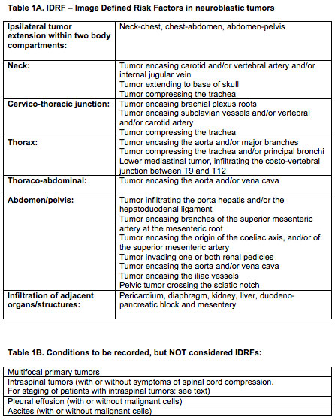
J. Clin. Oncol., 27:298-303, 2009
Notes:
Contributed by Richard Becker, peds radiology fellow Sep 2018

Slide 19
When the patient is scheduled or at the latest before the patient leaves the department after initial injection…..
Child and parents and/or ward staff should receive detailed information about the entire procedure, including the importance of thyroid blockade. Good hydration and frequent urination is strongly encouraged to lower the radiation burden.
Notes:
Contributed by Richard Becker, peds radiology fellow Sep 2018

Slide 20
References
131-I/123-I-Metaiodobenzylguanidine (mIBG) scintigraphy: procedure guidelines for tumour imaging, E Bombardieri et al, Eur J Nucl Med Mol Imaging (2010) 37:2436–2446
Guidelines for radioiodinated MIBG scintigraphy in children. P Olivier et al, Eur J Nucl Med Mol Imaging 2003;30:B45–50
The International Neuroblastoma Risk Group (INRG) staging system: an INRG Task Force report. T Montclair et al, J. Clin. Oncol., 27:298-303, 2009
MIBG in Neuroblastoma Diagnostic Imaging and Therapy, S Sharp et al, RadioGraphics 2016; 36:258–278 (read this one!)
Notes:
Contributed by Richard Becker, peds radiology fellow Sep 2018

Slide 21
CASE # 50
CNMC 021139551
Notes:
Contributed by Richard Becker, peds radiology fellow Sep 2018

Slide 22
14 yr old with Type 1 DM, with persistent, intermittent non-pitting bilateral feet to knees swelling. Abdominal X-ray negative for obstruction. Concern for lymphedema praecox.
What is the study?
Extremity Lymphoscintigraphy
(Lower extremity in this case)
Notes:
Contributed by Richard Becker, peds radiology fellow Sep 2018

Slide 23
What is the radiotracer?
How is it administered?
Tc99m-sulfur colloid
2-8 mCi in 6 aliquots are injected into each of the first 3 web spaces of the bilateral toes, creating a wheal at each site
Notes:
Contributed by Richard Becker, peds radiology fellow Sep 2018

Slide 24
Initial images confirm radiotracer in the injection site. What structures are appreciated on the 6 min images?
Is this normal?
Primary lymphatic trunks of the lower extremities at the level of the groin.
Yes, but larger field of view is needed to exclude an abnormal drainage pathway.
Notes:
Contributed by Richard Becker, peds radiology fellow Sep 2018

Slide 25
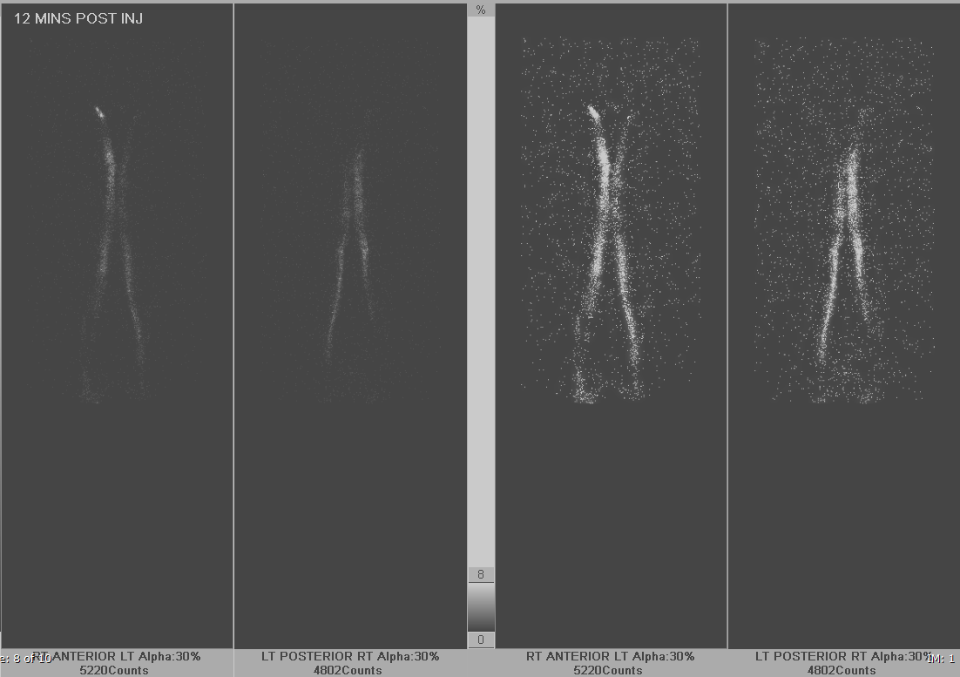
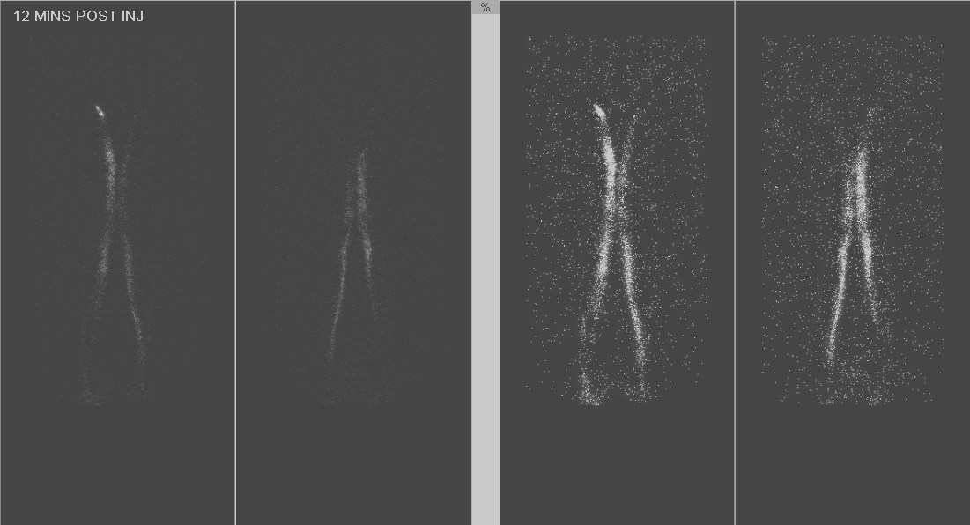
Notes:
Contributed by Richard Becker, peds radiology fellow Sep 2018

Slide 26
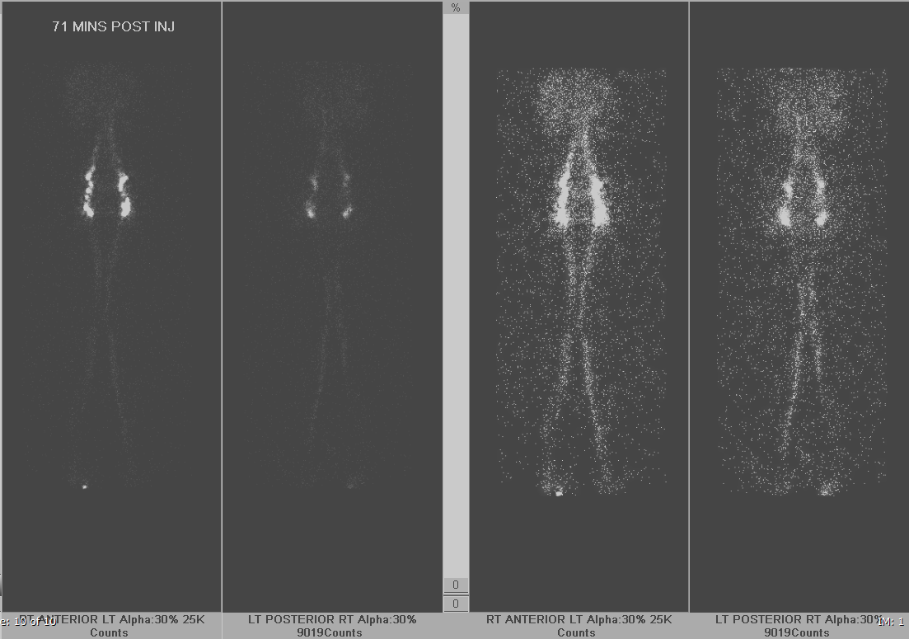
Notes:
Contributed by Richard Becker, peds radiology fellow Sep 2018

Slide 27
Diagnosis?
What is the normal range of drainage time?
-Knees 10 min
-Ilioinguinal ~ 1hr
-Liver/spleen ~ 1hr
Normal lower extremity lymphoscintigraphy
Notes:
Contributed by Richard Becker, peds radiology fellow Sep 2018

Slide 28
In addition to timing, what are other normal observations?
* 3-5 trunks per leg, 1-2 trunks per thigh
* 1-3 popliteal and 2-10 ilioinguinal nodes
Normal lower extremity lymphoscintigraphy
Notes:
Contributed by Richard Becker, peds radiology fellow Sep 2018

Slide 29
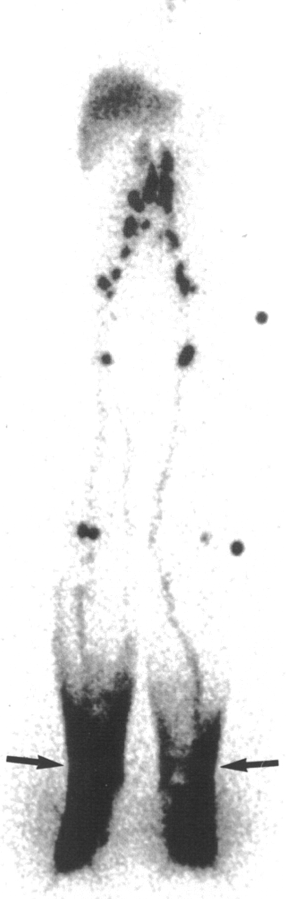
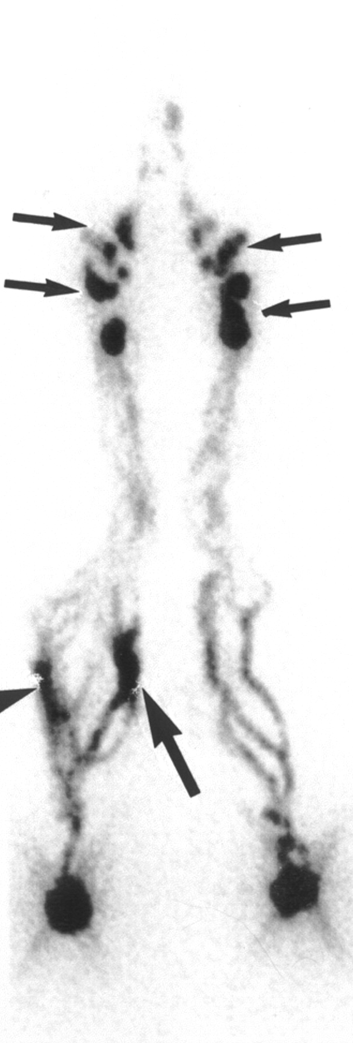
What are other abnormal observations (not all depicted in these images)?
Delayed drainage
Too many collaterals
Dermal backflow
Focal accumulation
No ilioinguinal nodes
Large caliber trunks
AJR 2002;178: 405-412
AJR 2002;178: 405-412
Notes:
Contributed by Richard Becker, peds radiology fellow Sep 2018

Slide 30
Lymphedema Basics
Primary (mostly inherited)
  Congenital
  Precox: adolescent/young adult females
  Tarda (after age 35)
Secondary – Lymphatic obstruction (tumor, parasitic infection), or destruction (trauma/surgery, radiation)
Stage 1 = reversible with elevation
Stage 2 = non-reversible with elevation
Stage 3 = Massive enlargement and skin hardening
Notes:
Contributed by Richard Becker, peds radiology fellow Sep 2018

Slide 31
Extremity lymphoscintigraphy
How sensitive and specific is this test?
~92% sensitive, 100% specific
If normal, based on a recent study, what is the clinical recommendation?
Primary lymphedema is more likely to be falsely negative than secondary lymphedema, so if this is the clinical suspicion, treatment and re-imaging may be advisable (Plast Reconstr Surg Glob Open. 2017 Jul; 5(7): e1396)
Notes:
Contributed by Richard Becker, peds radiology fellow Sep 2018

Slide 32
References
Using Lymphoscintigraphy to Evaluate Suspected Lymphedema of the Extremities, M Moshiri et al, American Journal of Roentgenology. 2002;178: 405-412.
Diagnostic Accuracy of Lymphoscintigraphy for Lymphedema and Analysis of False-Negative Tests, A Hassanein et al (Boston Children’s), Plast Reconstr Surg Glob Open. 2017 Jul; 5(7): e1396.
Role of lymphoscintigraphy in diagnosis and management of patients with leg swelling of unclear etiology, Tek Chand Kalawat et al, Indian J Nucl Med. 2012 Oct-Dec; 27(4): 226–230.
Notes:
Contributed by Richard Becker, peds radiology fellow Sep 2018

Slide 33
CASE # 51
CNMC 020557015
Notes:
Contributed by Richard Becker, peds radiology fellow Sep 2018

Slide 34
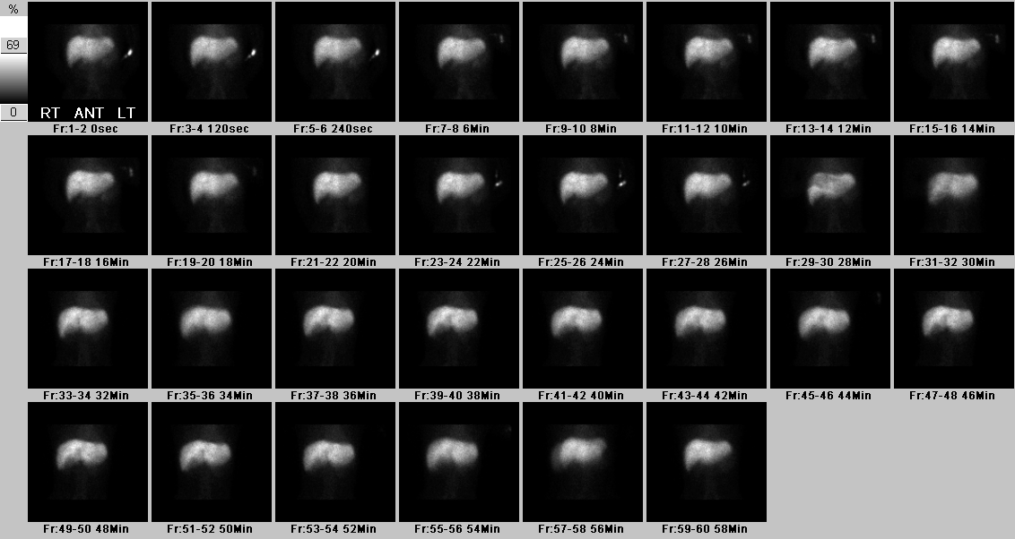
15 y/o male with history of PSC, here with worsened RUQ pain. Ultrasound shows dilated gallbladder with wall thickening and possibly tiny stones.
What is the study?
Extremity Lymphoscintigraphy
(Lower extremity in this case)
Notes:
Contributed by Richard Becker, peds radiology fellow Sep 2018

Slide 35
What study is this?
What is the radiotracer?
What is the dose of morphine?
Hepatobiliary scan
Tc99m-BrIDA (mebrofenin)
0.04mg/kg…..
but not indicated! No bowel activity is present.
Notes:
Contributed by Richard Becker, peds radiology fellow Sep 2018

Slide 36
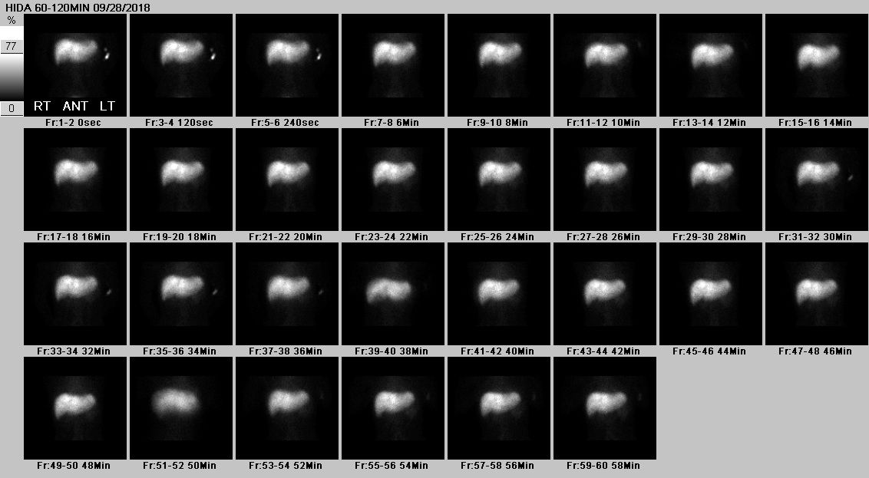
What is the differential diagnosis?
What is the next step?
Biliary obstruction and/or cystic duct obstruction
Wait. Neither bowel activity or gallbladder are seen.
Notes:
Contributed by Richard Becker, peds radiology fellow Sep 2018

Slide 37
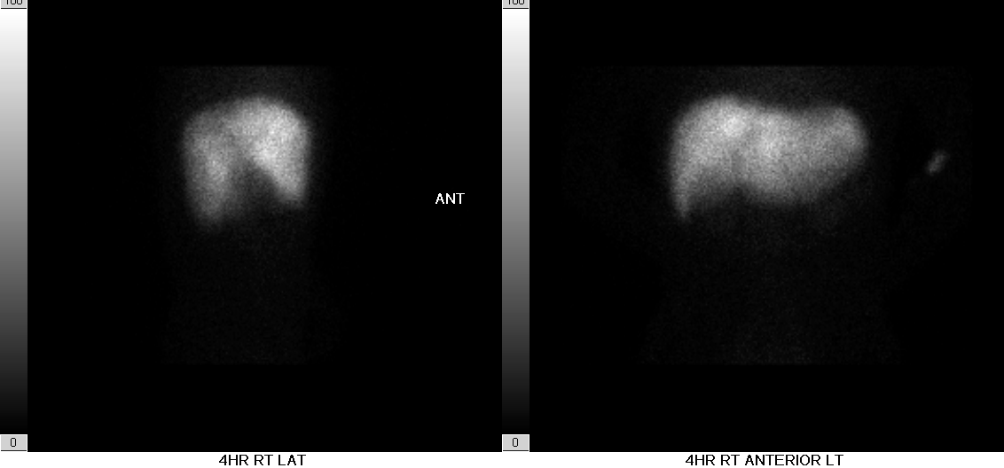
Notes:
Contributed by Richard Becker, peds radiology fellow Sep 2018

Slide 38
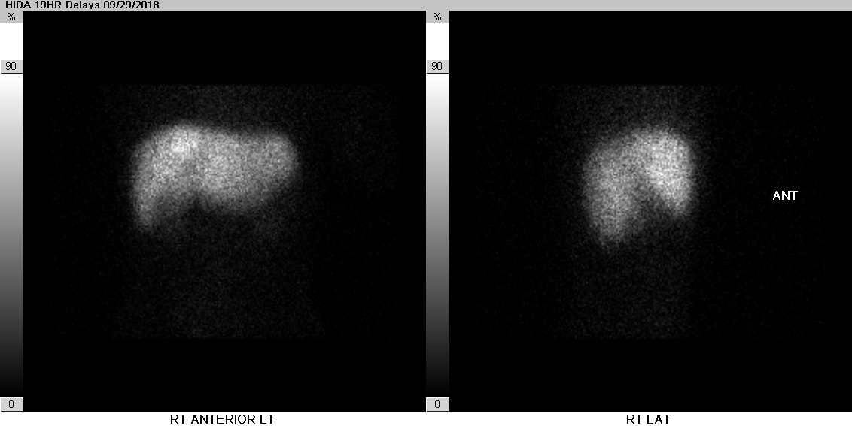
Notes:
Contributed by Richard Becker, peds radiology fellow Sep 2018

Slide 39
Diagnosis?
Adequate liver uptake without tracer in the gallbladder or bowel after 19hrs -> Biliary obstruction and cystic duct obstruction
Notes:
Contributed by Richard Becker, peds radiology fellow Sep 2018

Slide 40
Gallbladder hydrops and wall thickening.
Common bile duct stone
Notes:
Contributed by Richard Becker, peds radiology fellow Sep 2018

Slide 41
Gallbladder hydrops and wall thickening.
Common bile duct stone
Notes:
Contributed by Richard Becker, peds radiology fellow Sep 2018

Slide 42
Gallbladder hydrops and wall thickening.
Diffuse biliary dilatation upstream from CBC stone
Cyst
Distal CBD normal

Slide 43
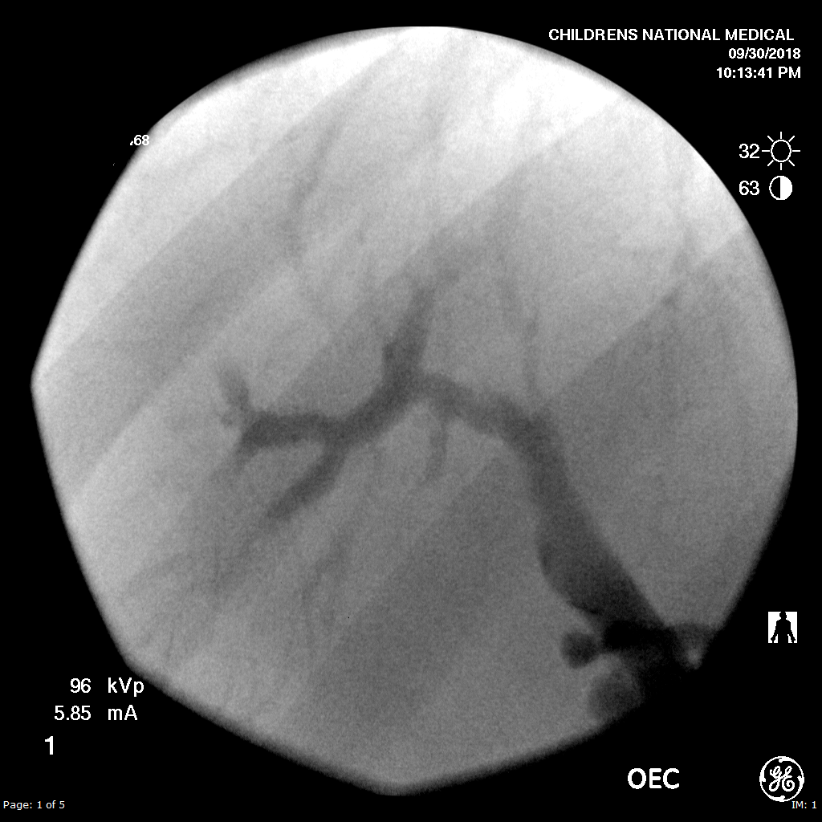
Post-cholecystectomy cholangiogram

Slide 44
Hepatobiliary scan
What is the administered dose and the estimated effective radiation dose to the patient?
0.05mCi/kg
1.1mSv/mCi
How long should the patient be NPO?
2-4 hrs for children
Need to empty the gallbladder first with fatty po intake or CCK
What if the patient has been NPO for 24hrs or more?
What is the one indication for this exam which a technologist may be called in after hours?
Suspected bile leak post-cholecystectomy
Notes:
Contributed by Richard Becker, peds radiology fellow Sep 2018

Slide 45
References
SNM Practice Guideline for Hepatobiliary Scintigraphy 4.0., M Tulchinsky et al, J Nucl Med Tech 38:4 Dec 2010
Notes:
Contributed by Richard Becker, peds radiology fellow Sep 2018

Slide 46
CASE # 52
CNMC 020860711
Notes:
Contributed by Richard Becker, peds radiology fellow Sep 2018

Slide 47
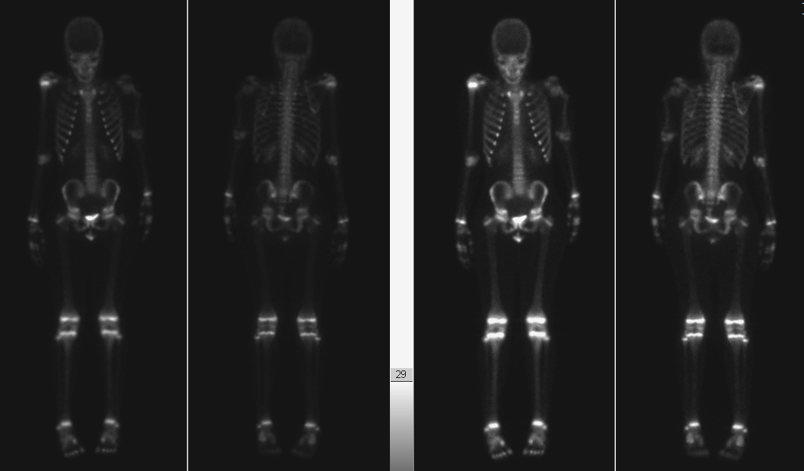
10 y/o female with Gorham Stout dz of left humerus on sirolimus. Please evaluate disease progression.
What is the study?
Extremity Lymphoscintigraphy
(Lower extremity in this case)
Notes:
Contributed by Richard Becker, peds radiology fellow Sep 2018

Slide 48
What is the radiotracer?
What is the administered dose and estimated effective radiation dose?
Tc99m-MDP
0.25-0.30 mCi/kg
~0.9mSv/mCi
This 44kg child 11mCi, 10mSv
Notes:
Contributed by Richard Becker, peds radiology fellow Sep 2018

Slide 49
What are the normal findings?
What are the abnormal findings?
Focal uptake at the physes.
Short left humerus with abnormal angulation deformity and decreased uptake at the physis
Notes:
Contributed by Richard Becker, peds radiology fellow Sep 2018

Slide 50
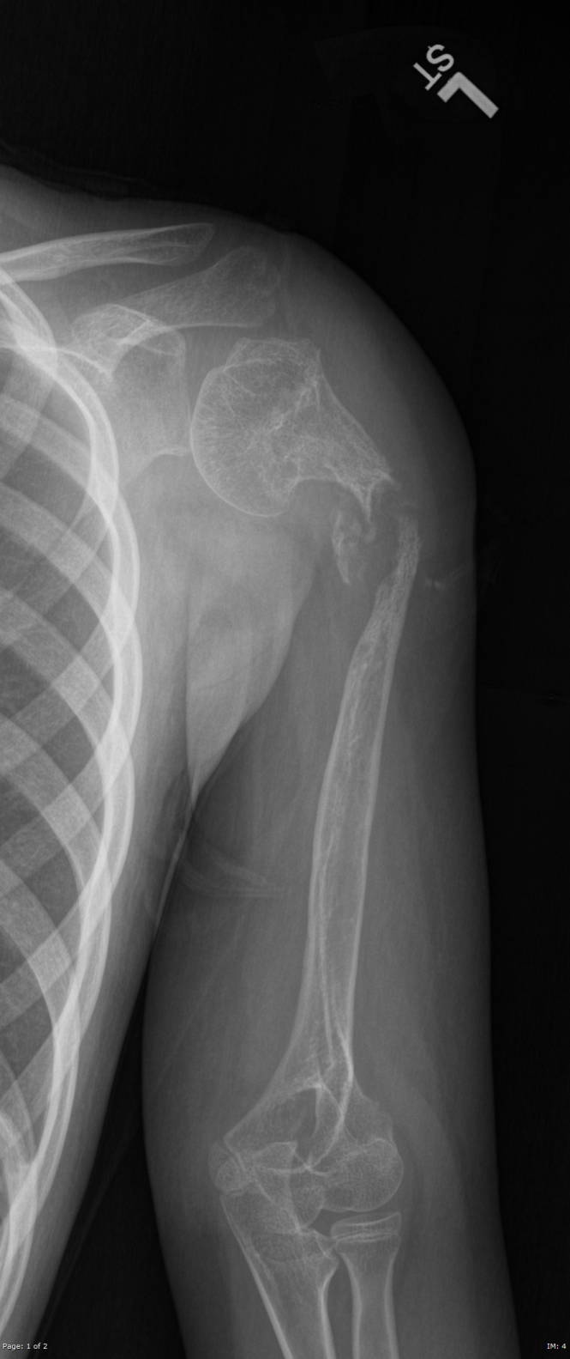
Recent radiograph
Findings are consistent with the patient’s history of Gorham Stout disease affecting the left humerus with chronic nonunion of pathologic fracture.
Notes:
Contributed by Richard Becker, peds radiology fellow Sep 2018

Slide 51
Gorham Stout Disease
“Vanishing bone disease” – rare disease of as yet undetermined etiology
Destruction of osseous matrix and benign proliferation of surrounding vascular structures(primarily lymphatics)
Can involve one or multiple bones and onset at any age, but typically <40 y/o
Diagnosis of exclusion and made by biopsy
Progressive osteolysis, may spontaneously remit
Treated with bisphosphonates and/or α-2b interferon
Notes:
Contributed by Richard Becker, peds radiology fellow Sep 2018

Slide 52
Gorham Stout Disease
Are the findings what you would expect?
Yes
Is bone scan a typical modality for followup?
No. More typically by MRI.
Notes:
Contributed by Richard Becker, peds radiology fellow Sep 2018

Slide 53
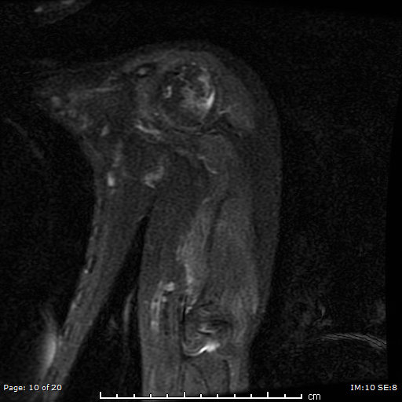
3 yrs prior MRI
Recent MRI
Notes:
Contributed by Richard Becker, peds radiology fellow Sep 2018

Slide 54
References
Society of Nuclear Medicine Procedure Guideline for Bone Scintigraphy v 3.0, approved June 20, 2003 K Donohoe et al
Vanishing bone disease (Gorham-Stout syndrome): A review of a rare entity, V Nikolaou, World J Orthop. 2014 Nov 18; 5(5): 694–698.
Gorham-Stout Disease: Case Report and Suggested Diagnostic Evaluation of a Rare Clinical Entity, D Lam et al, AACE CLINICAL CASE REPORTS Vol 4 No. 2 March/April 2018 e166.
Notes:
Contributed by Richard Becker, peds radiology fellow Sep 2018

