Slide 1
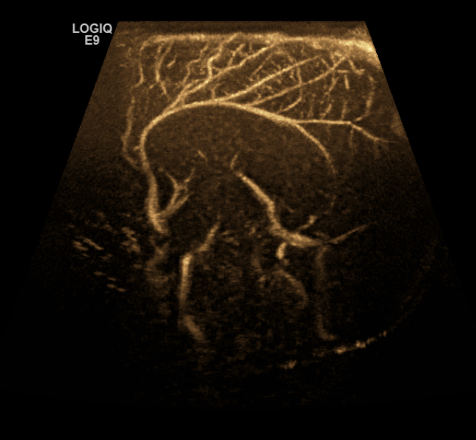
NICU Doppler of Anterior Cerebral Artery as a predictor of elevated ICP

Slide 2
Fontanelle compression alters hemodynamic response in newborns and can be used as a noninvasive tool to predict progressive or persistently elevated intracranial pressure.
This information has been valuable in helping neurosurgery determine if shunt placement would be helpful in cases of post hemorrhagic hydrocephalus and ventriculomegaly.
Brief pressure is applied during ACA Doppler interrogation (due to the close to zero angle of insonation in midline sagittal imaging)
Three cycles are recorded for baseline flow and then pressure is applied for three additional cycles (three to five seconds).
If elevated ICP is present, the diastolic component will decrease or show complete reversal.

Slide 3
