Slide 1
Ultrasound Diagnostic Challenge December 2017 LAST CASE OF THE YEAR

Slide 2
History
15 y/o Caucasian female - unremarkable family or past medical history -presenting with word finding difficulties and sensory deficit that started and worsened over the course of 2 months.
Increased word finding difficulty and short term memory loss to the point where unable to remember the beginning of conversations.
Per parents, she also just seemed "not herself“, flat, and more easily confused than baseline.

Slide 3
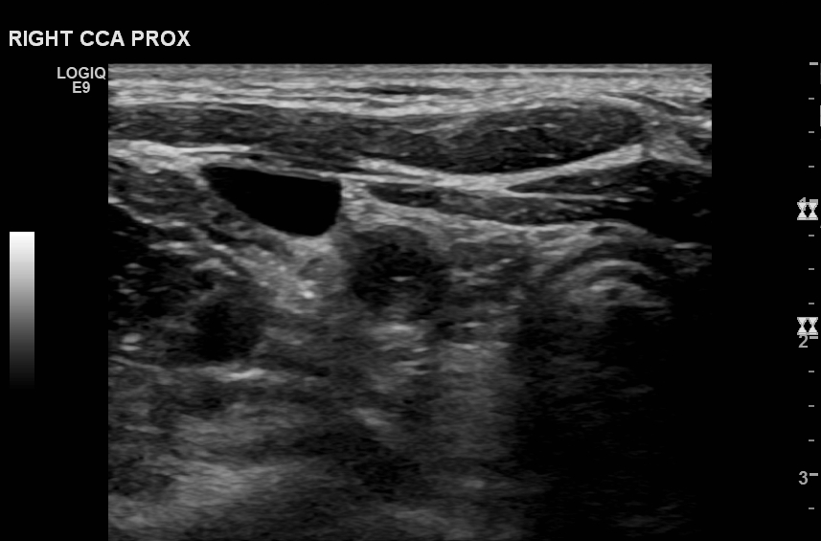
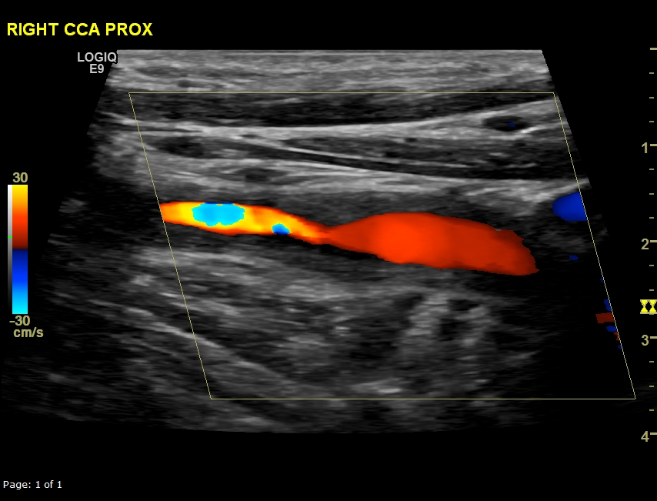
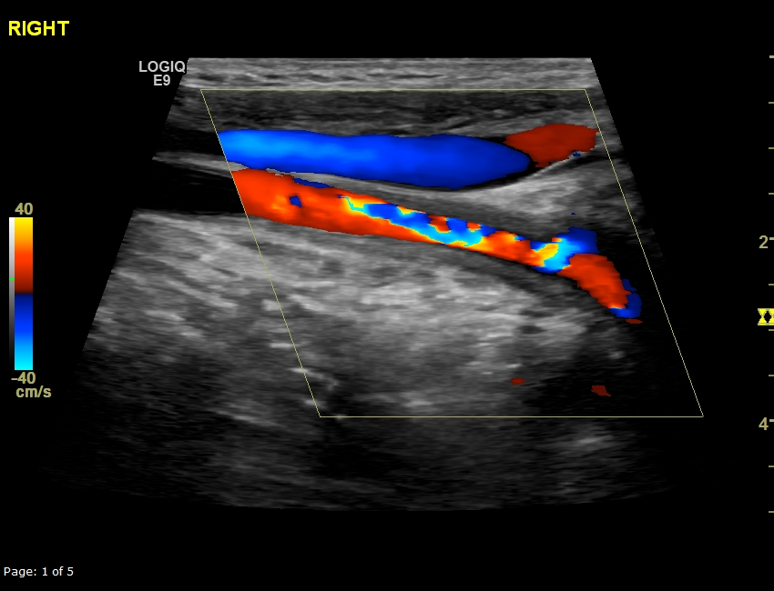
transverse
long
CCA long

Slide 4
CINE
PLAY

Slide 5
CINE
PLAY

Slide 6
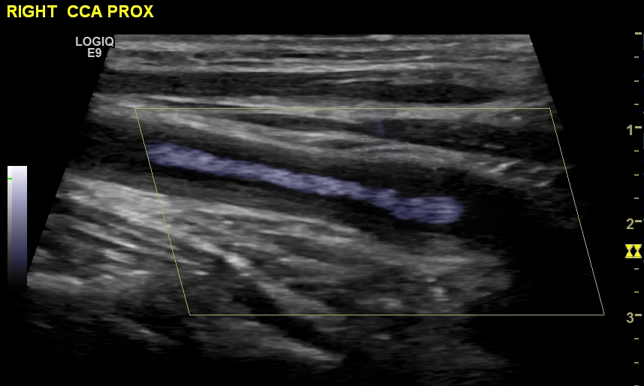
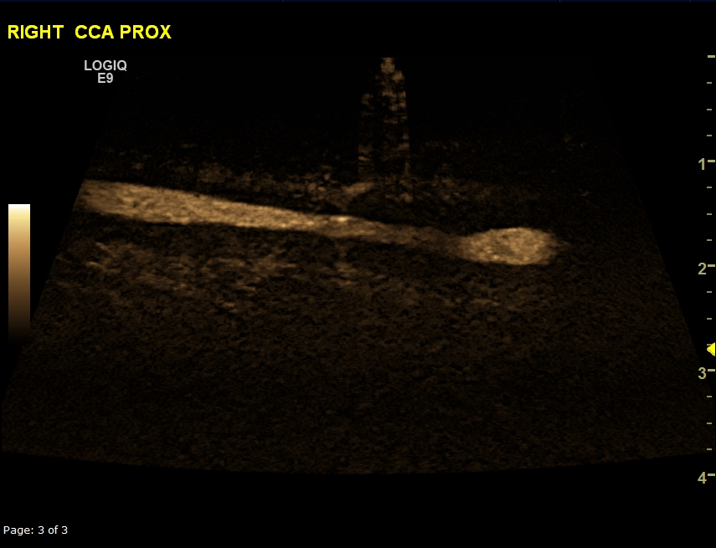

Slide 7
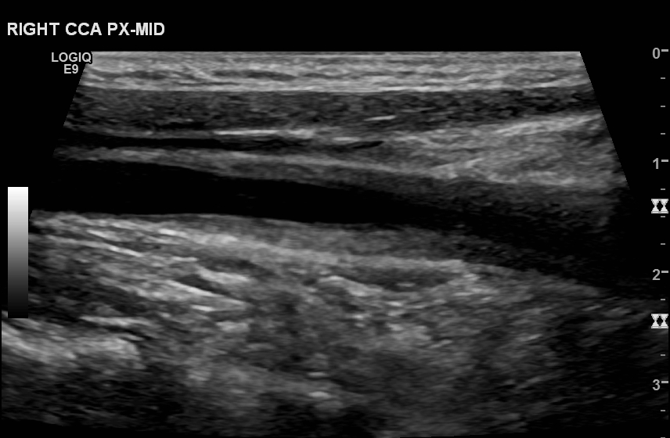
LONG

Slide 8
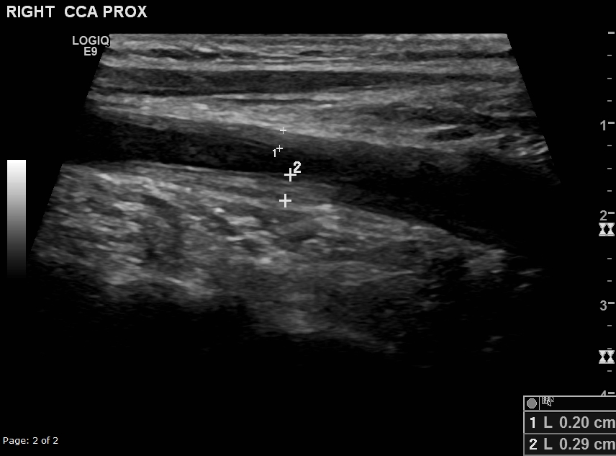
LONG

Slide 9
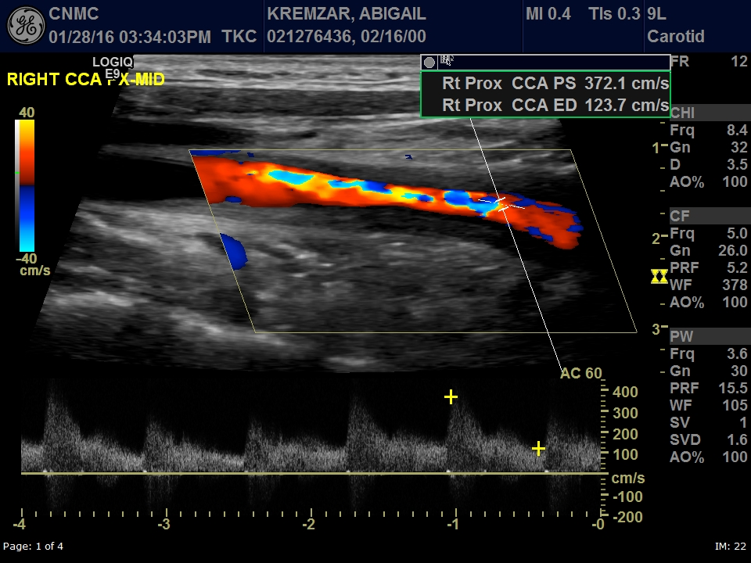
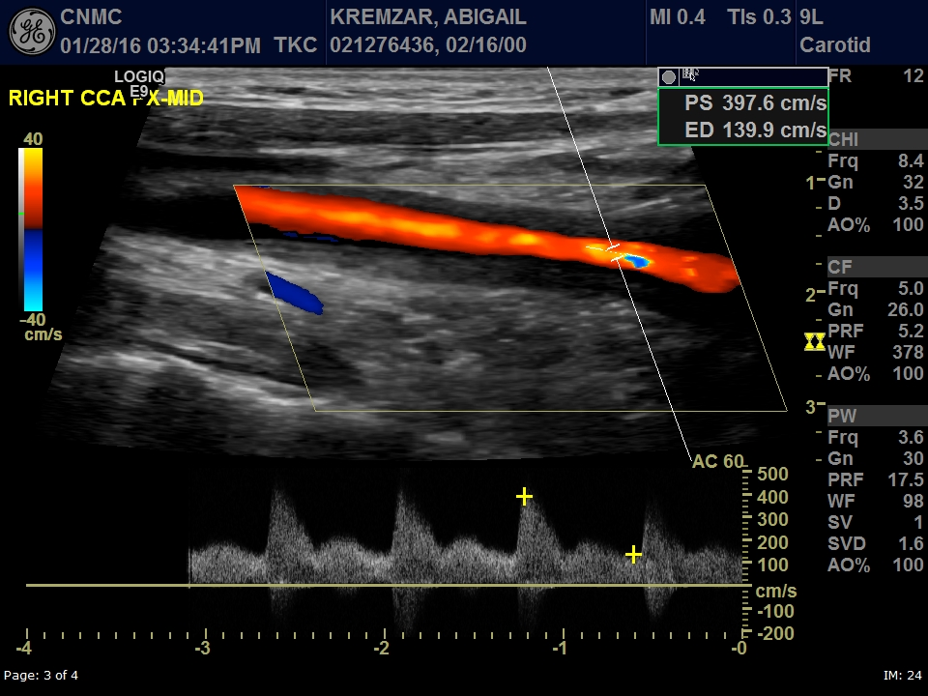
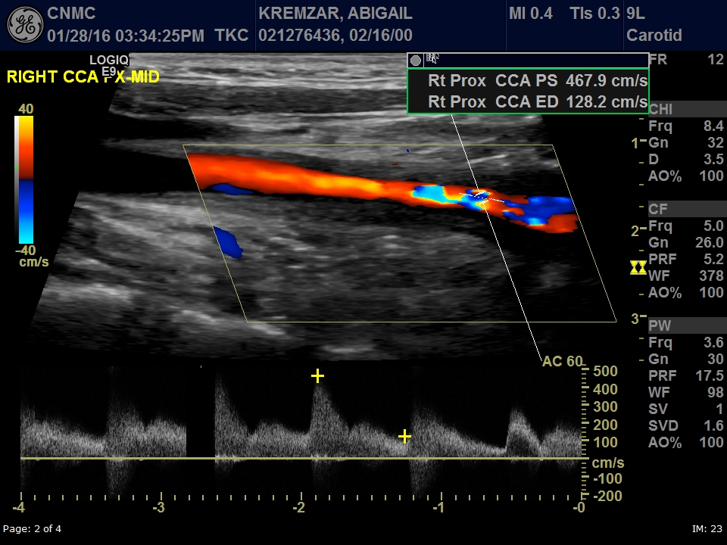
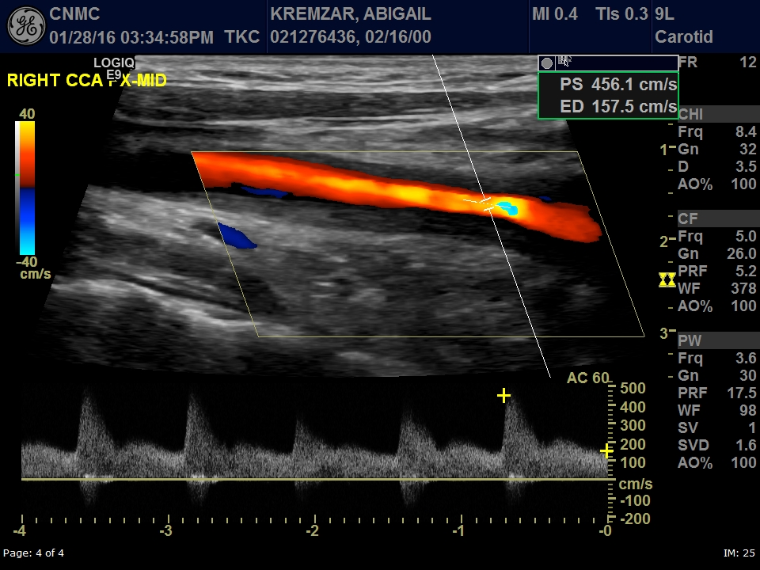

Slide 10
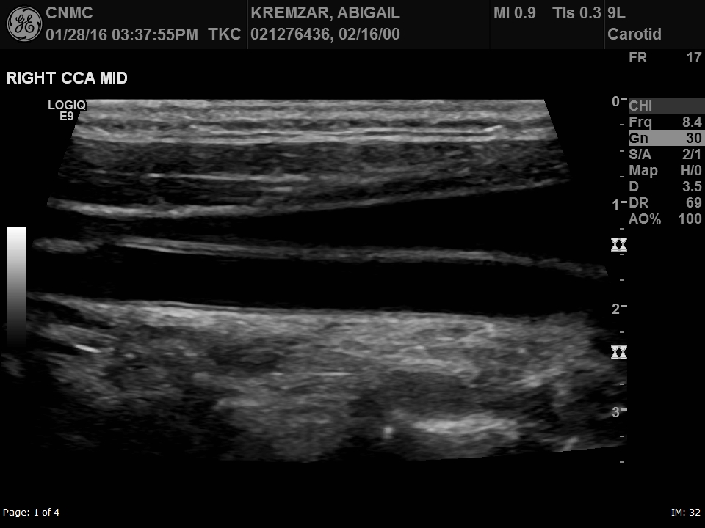
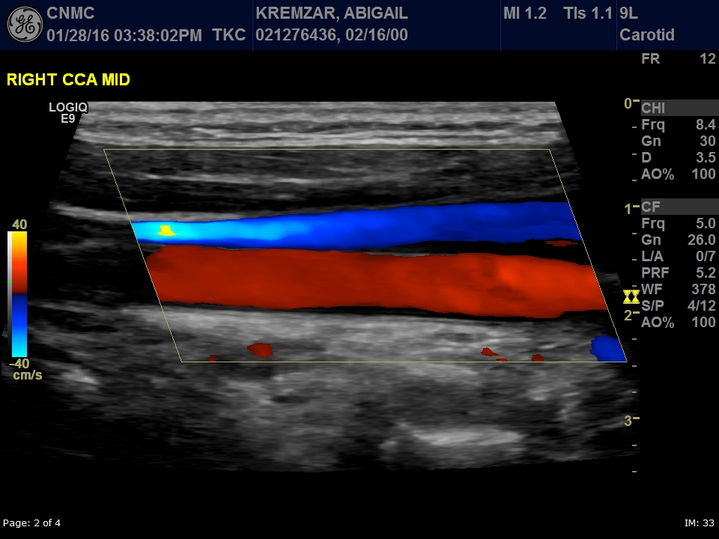
LONG
LONG

Slide 11
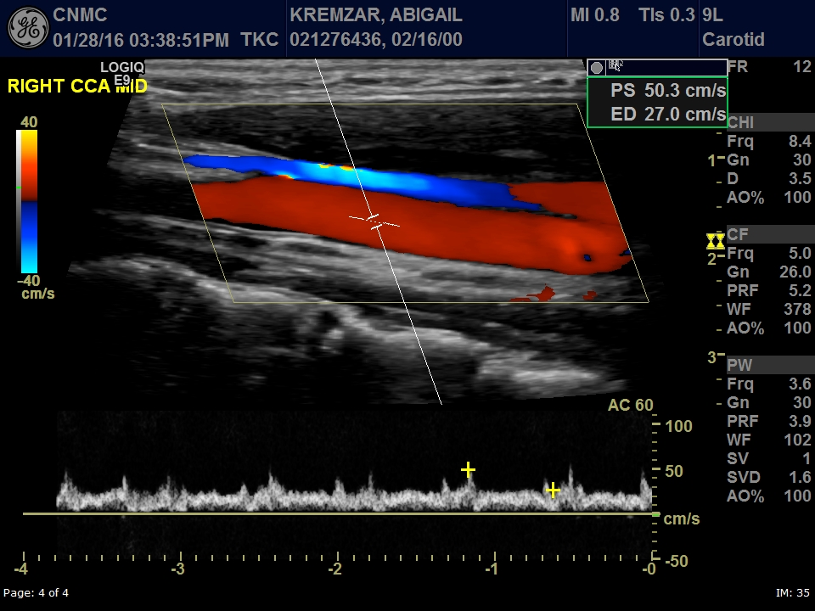
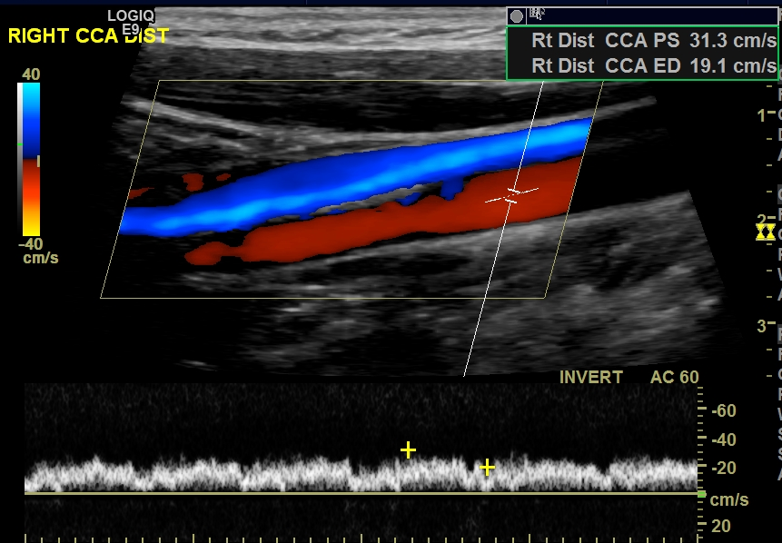

Slide 12
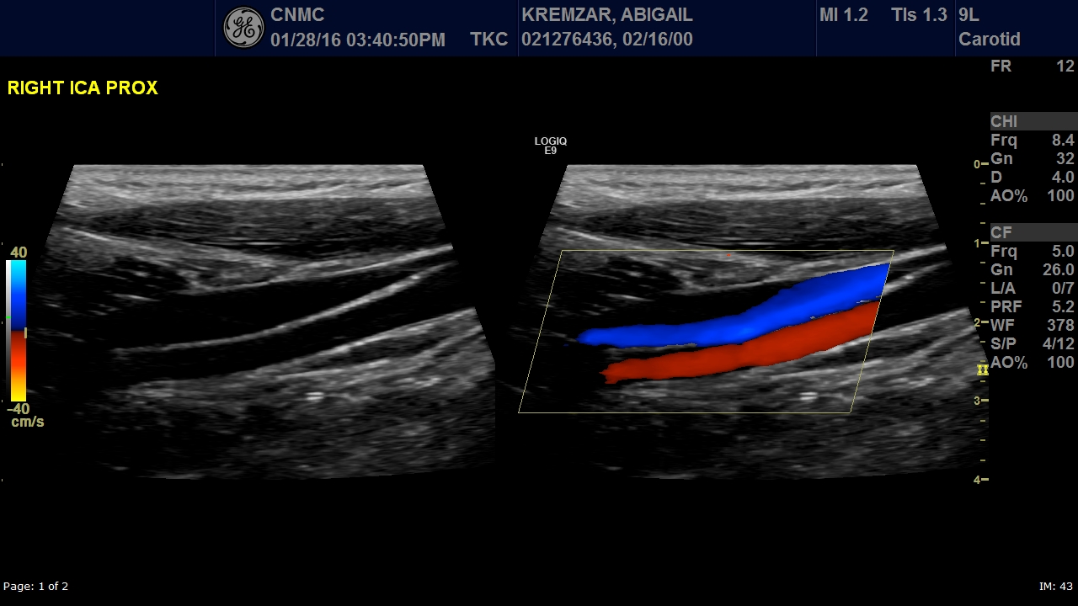
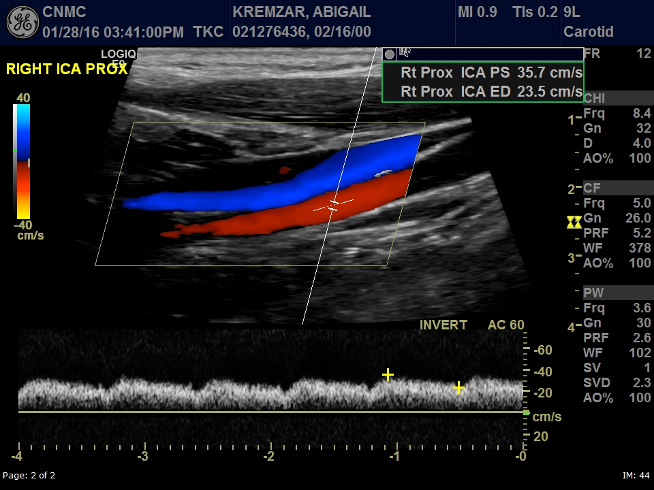

Slide 13
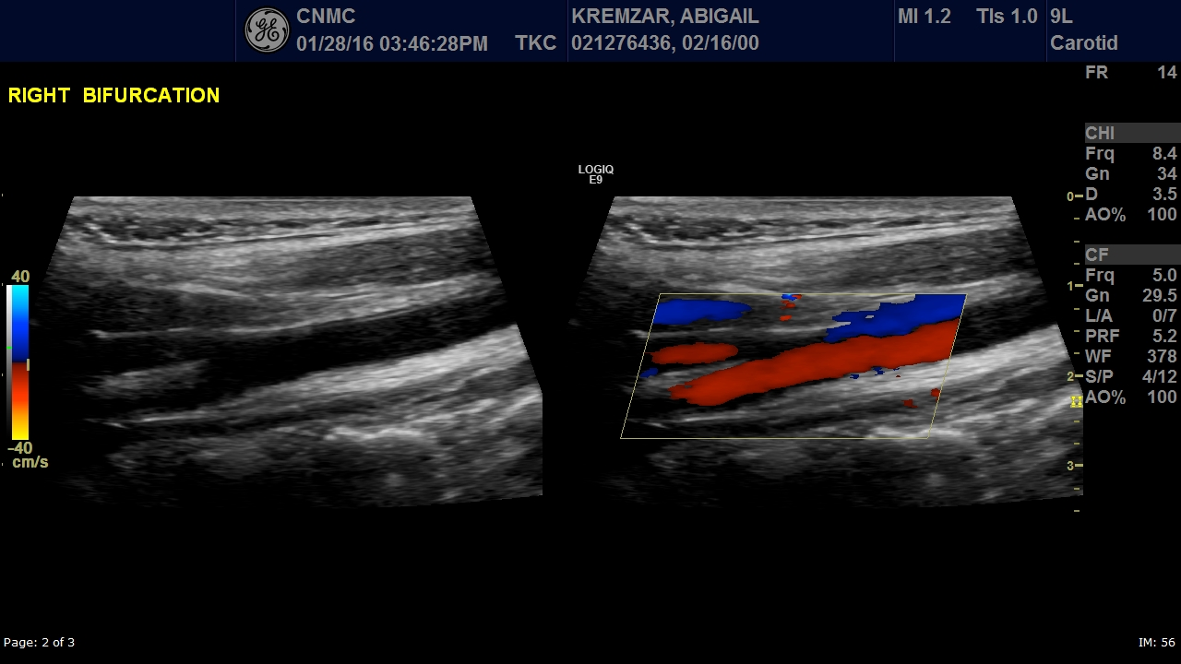
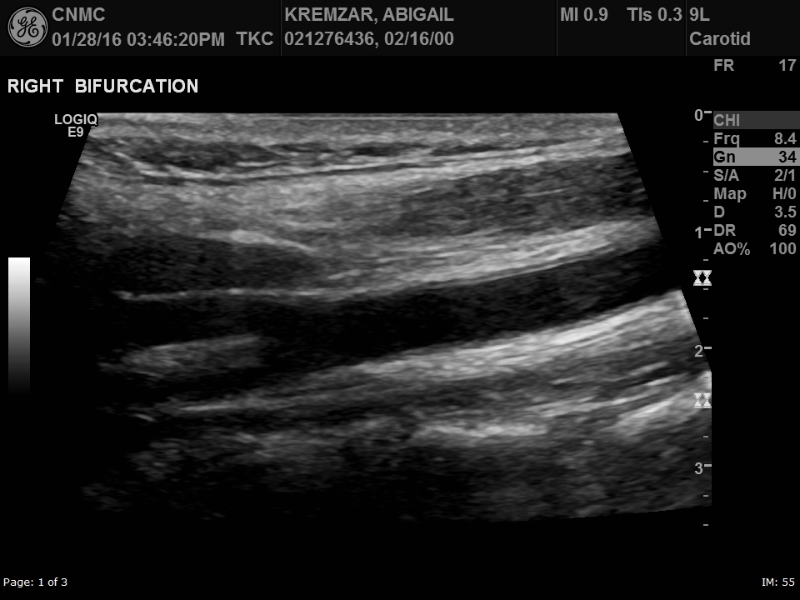

Slide 14
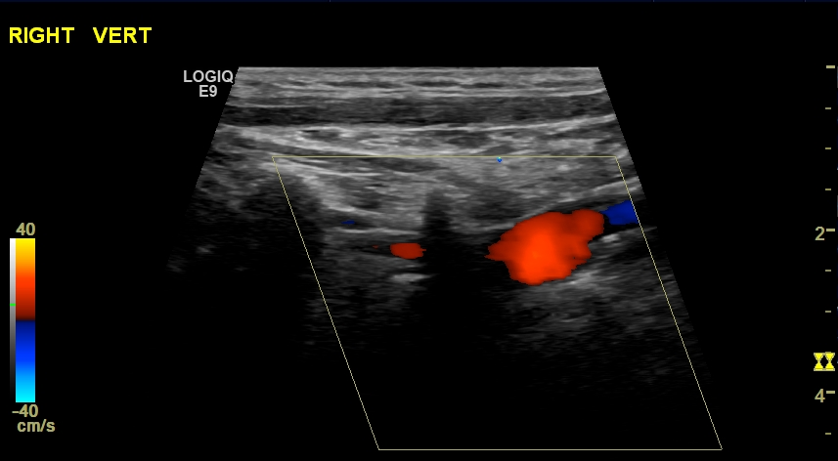
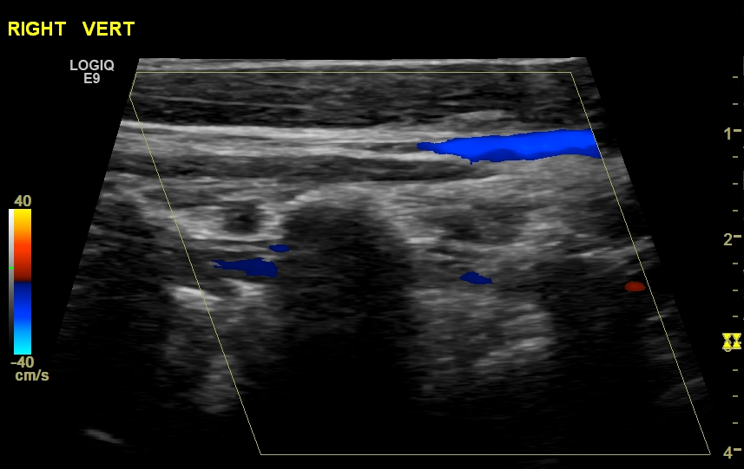

Slide 15
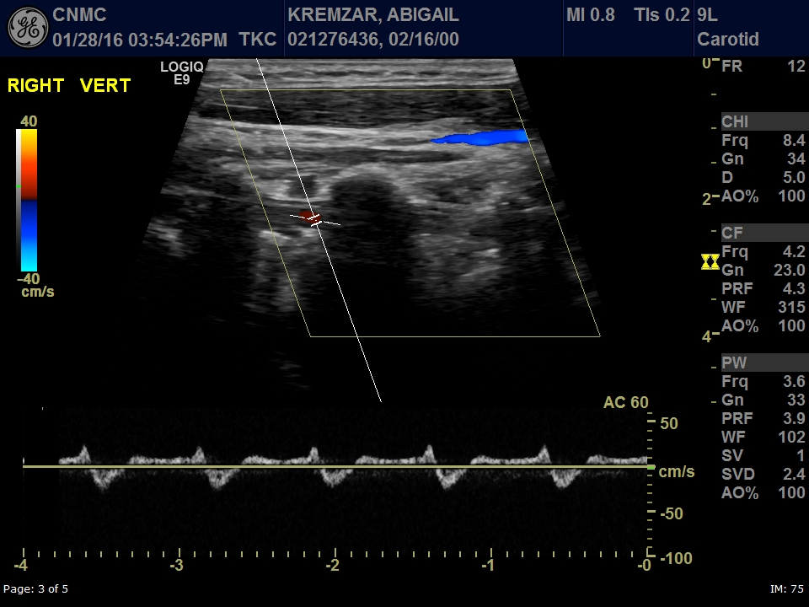

Slide 16
CINE
PLAY

Slide 17
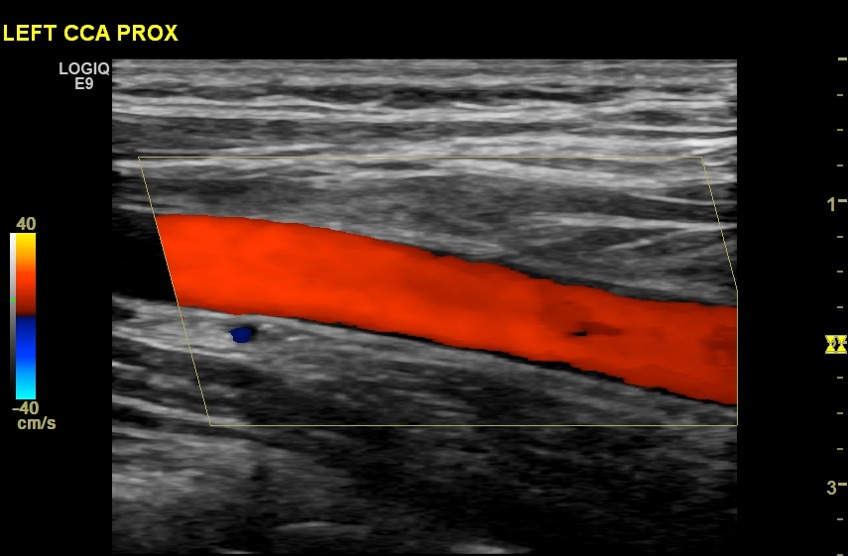
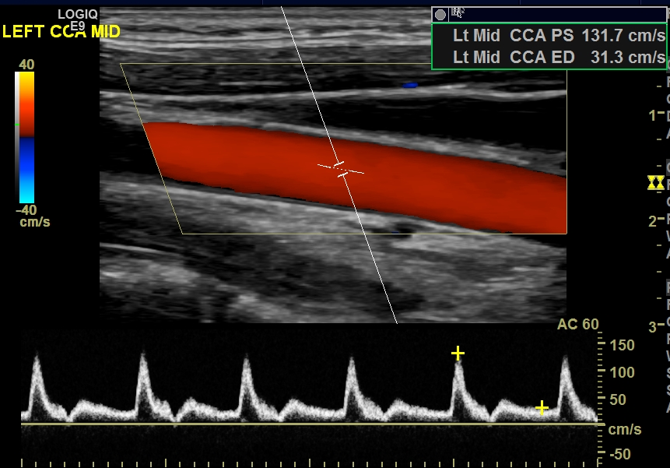
Contralateral side

Slide 18
CINE
PLAY

Slide 19
Questions
What is your impression?
How is this treated?

