Slide 1
Ultrasound
Diagnostic Challenge
February 2018

Slide 2
History
8 y/o female
Per US report:
“Heterogeneous, echogenic mass occupying the superior portion of the left lobe of the liver. There is central calcification and overall increased vascularity. There is mass effect with the left hepatic vein draping over the mass medially. Clinical correlation requested.”

Slide 3
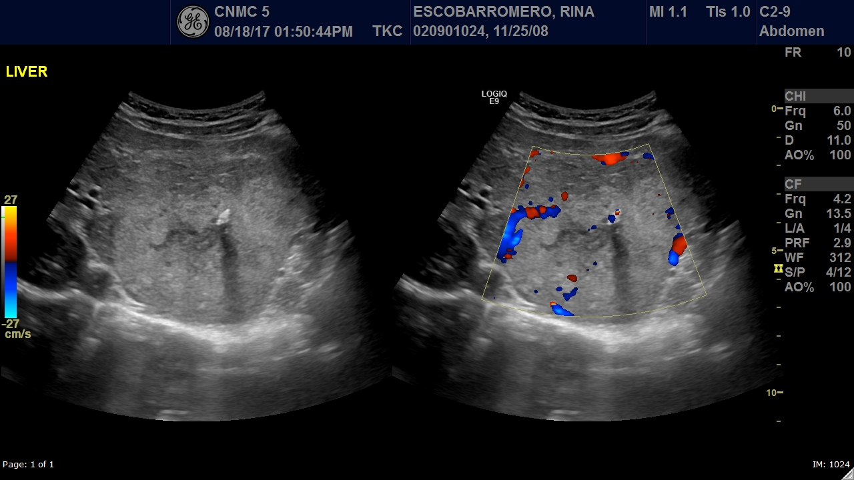
Pre-Contrast US

Slide 4
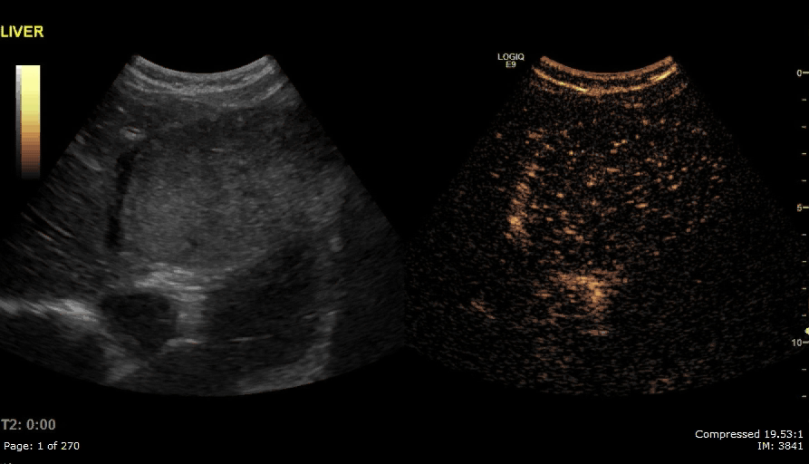
CINE – NOTE THE TIMER
Timer

Slide 5
Questions
Describe the contrast pattern does this lesion shows.
Based on the enhancement pattern, is this lesion most likely benign or malignant?

