Slide 1
Ultrasound
Diagnostic Challenge
January 2018

Slide 2
History
2 y/o healthy boy with decreased urine output over one week.
No family history of renal disorders.
Patient has been having trouble passing urine; would pass urine once or twice per day, crying while doing so.
Patient was seen in an urgent care:
- urine test was negative for infection
Continued course of abd pain when passing urine - with full bladder (>300mL) on exam, PMD attempted cath and was unsuccessful.
Patient sent to CNMC and renal/bladder ultrasound was requested through the ED.

Slide 3
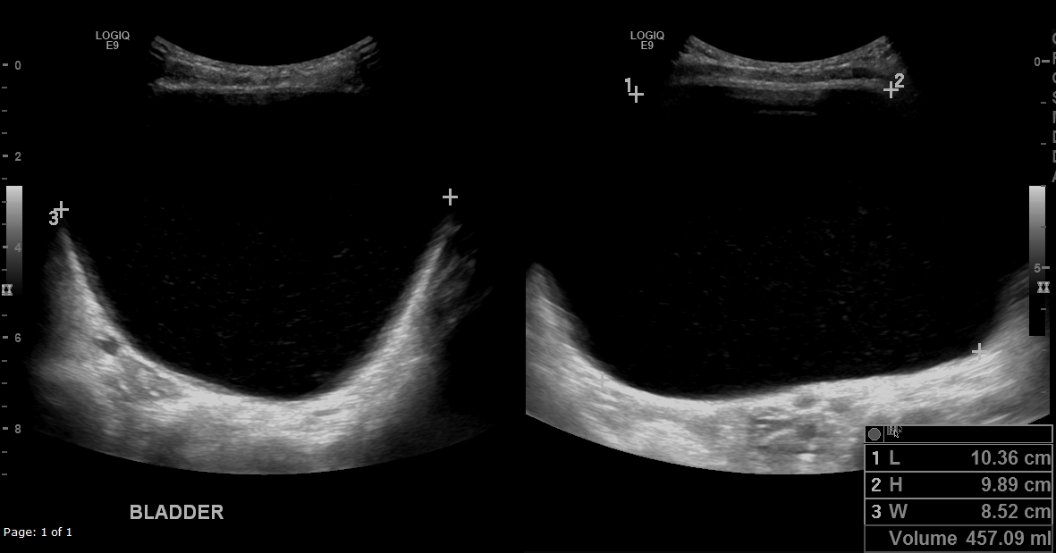

Slide 4
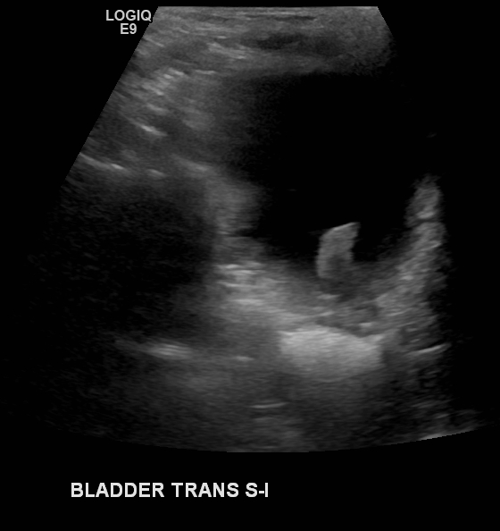
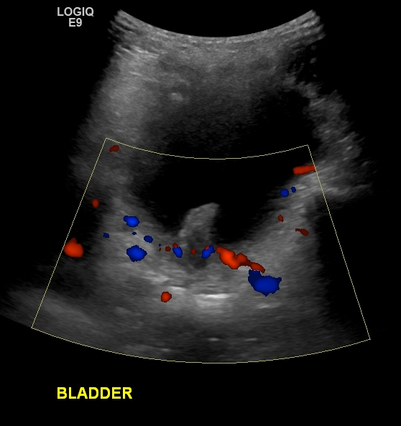
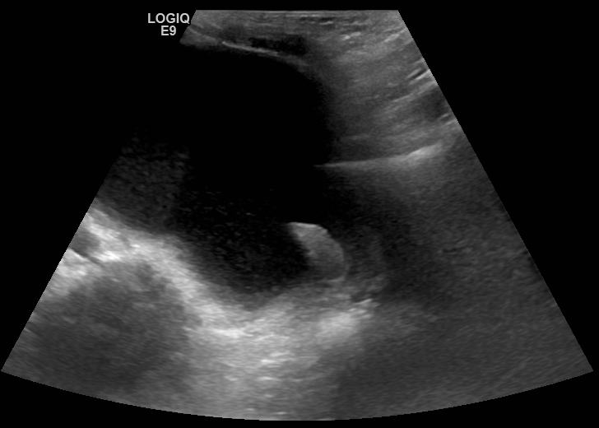
Bladder Neck
Bladder Neck LONG

Slide 5
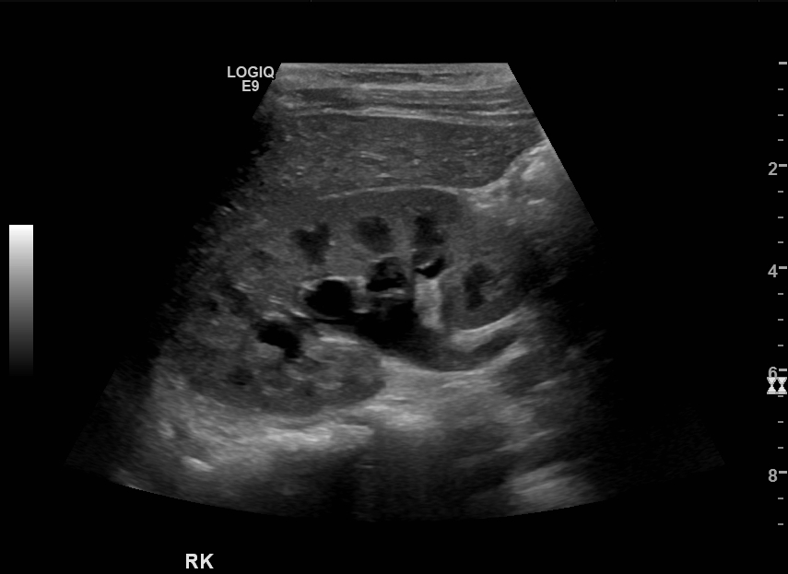

Slide 6
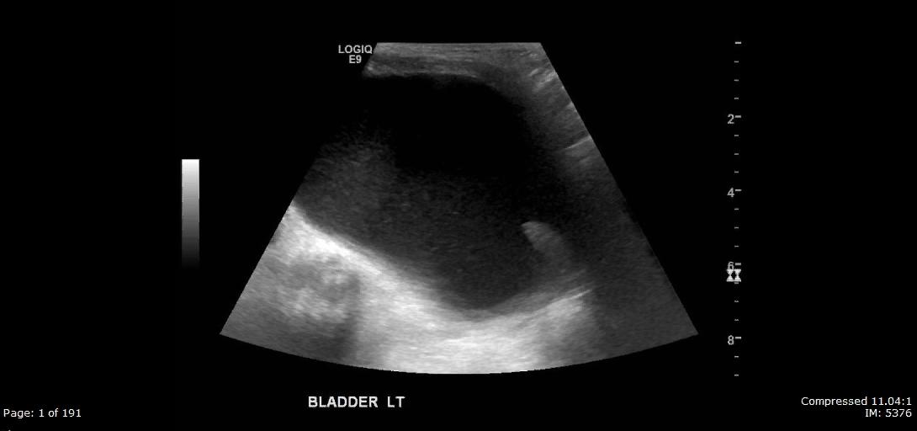
CINE – Bladder Neck LONG
PLAY

Slide 7
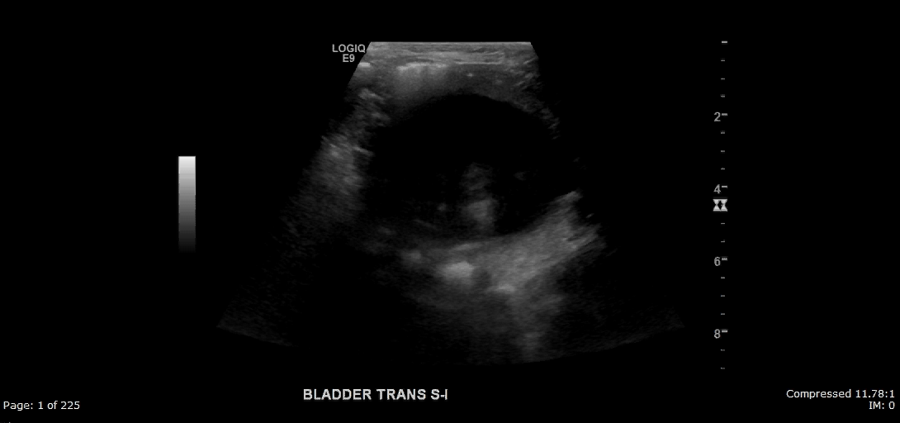
CINE Bladder Neck TRANS
PLAY

Slide 8
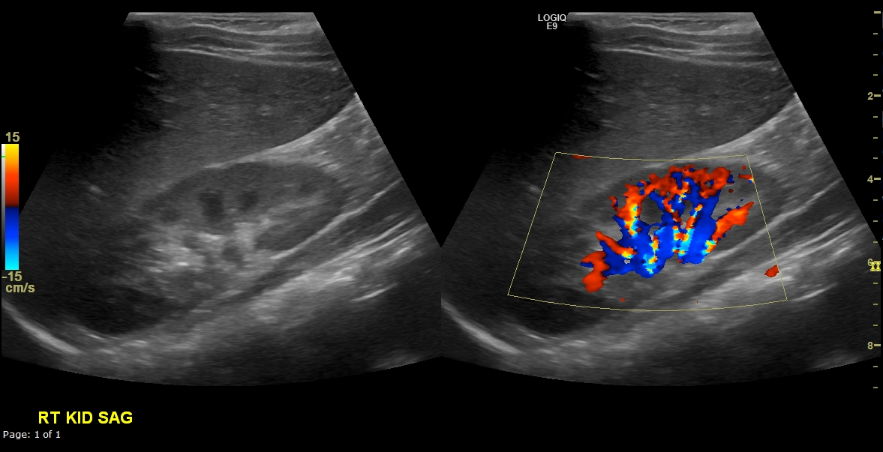
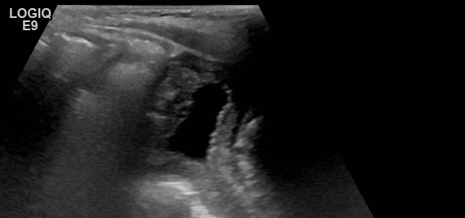
Post Procedure FOLLOW UP
(1 month after initial exam)
Bladder neck LONG

Slide 9
Questions
What is your impression?
HINT: think benign process
How is this treated?

