Slide 1
Ultrasound
Diagnostic Challenge
July 2018

Slide 2
History
3 year old male.
Presented to the ED with urinary incontinence x 6 months.
Mom notes he finished potty training over a year ago, then approximately 6 months ago started wetting himself again and urinating more frequently.
Patient urinates >8x a day.
ED requested scrotal ultrasound for suspicion of mass felt on physical exam.

Slide 3
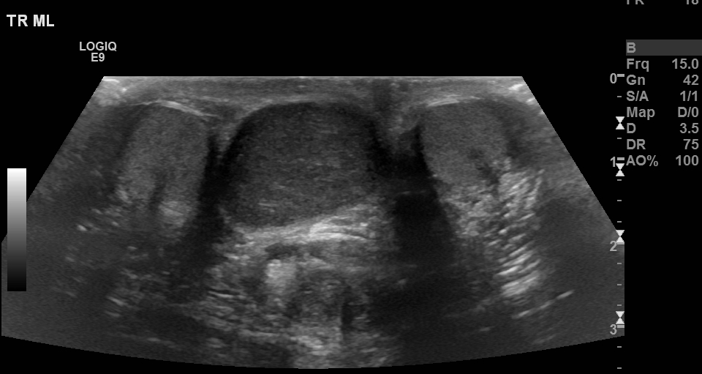
Right testicle
Left testicle

Slide 4
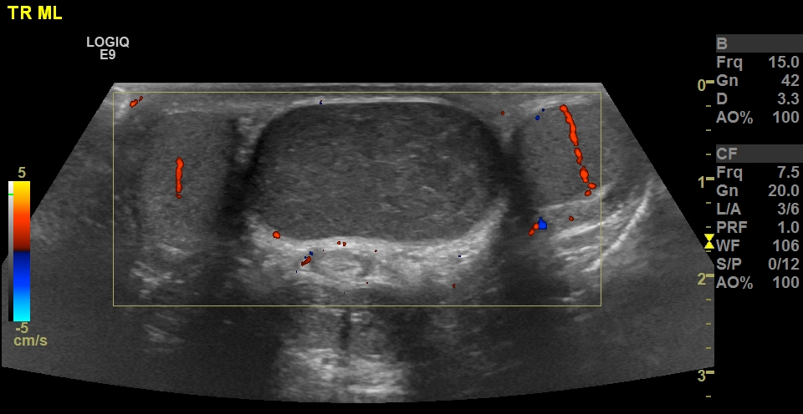

Slide 5
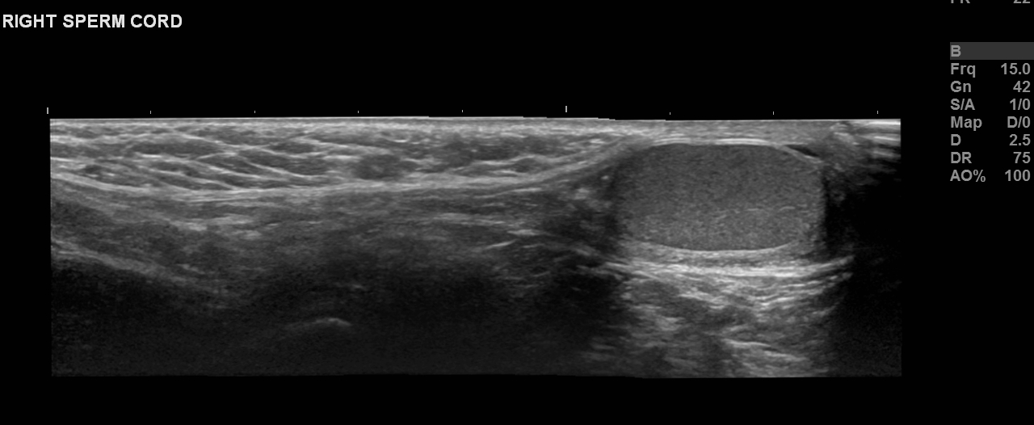

Slide 6
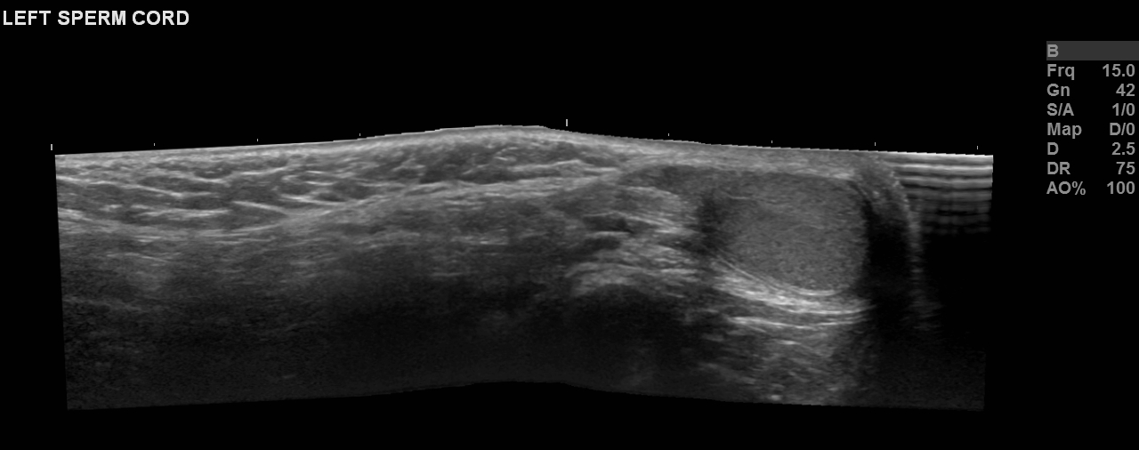

Slide 7
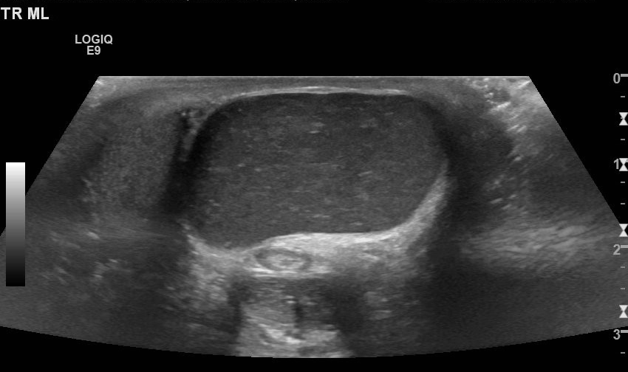

Slide 8
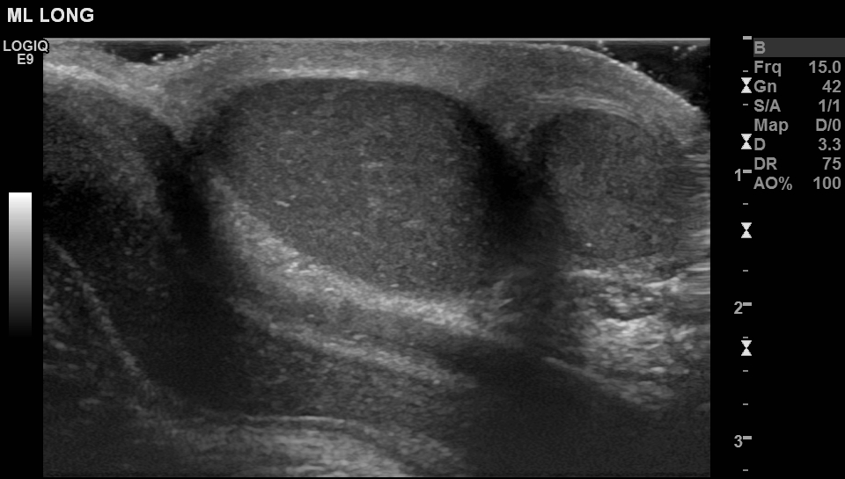
Region of interest
Left testicle

Slide 9
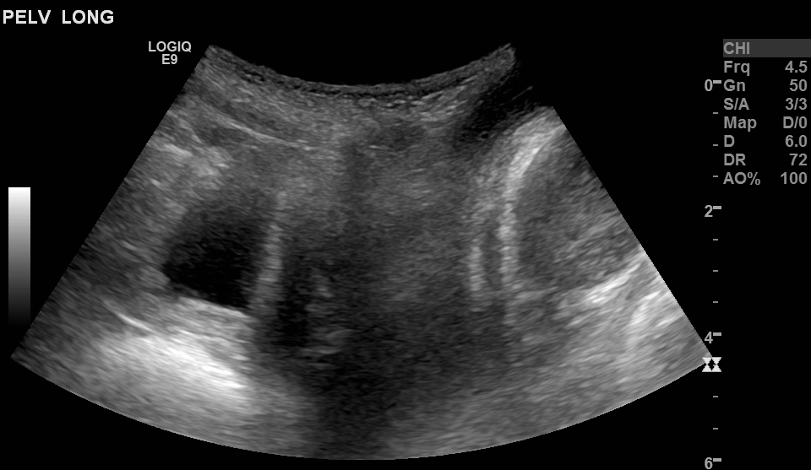
Bladder
Region of interest

Slide 10
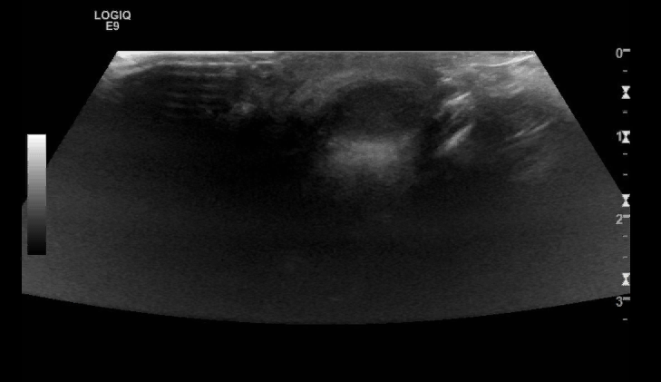
Cine
(press play!)

Slide 11
What is your interpretation?
How is this treated?

