Slide 1
Ultrasound Diagnostic Challenge March 2018

Slide 2
History
18 year old male
Hx of Hemophilia A
Presented with swelling of R lower extremity after injury where he was kicked while playing soccer 10 days ago. He had swelling at the time, took a dose of Advate and the swelling improved.
Two days ago he noted swelling to his right calf/ankle, which was significantly worse upon waking up today with worsening pain with ambulation.
Reports cool distal toes, and mild numbness.

Slide 3
Right lateral calf

Slide 4
CINE
Right lateral calf
Play

Slide 5
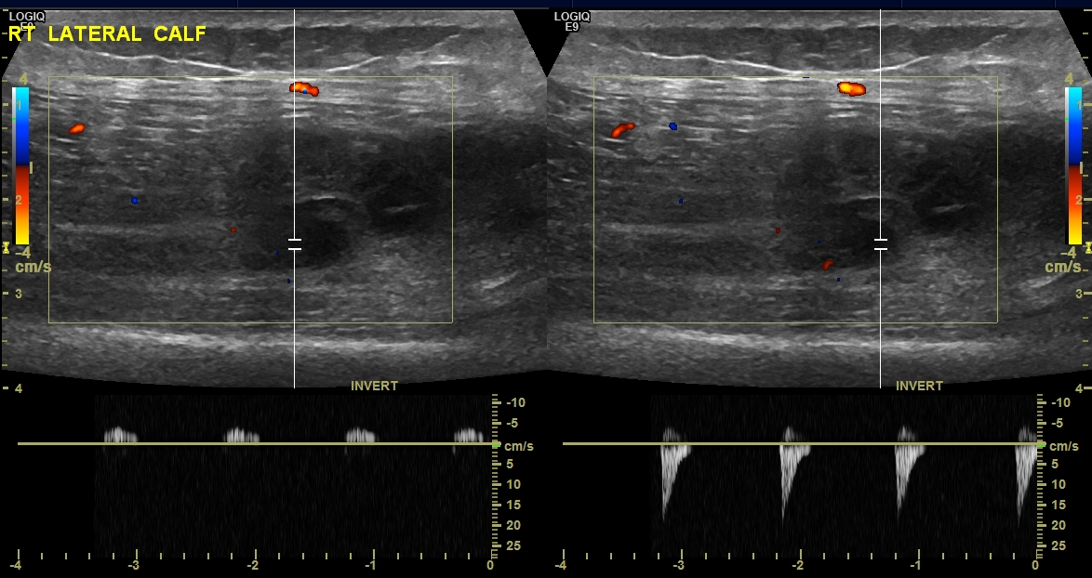

Slide 6
CINE
Right lateral calf
Play
Level of
anterior
tibial
vessels

Slide 7
What is your interpretation?
How is this treated?

