Slide 1
Ultrasound
Diagnostic Challenge
September 2017
Presented by:
Lesley Demshur, RDMS

Slide 2
History
Chief Complaint :
Thyroid nodule
History of Present Illness:
19 year old female seen in the thyroid nodule clinic with her sibling for further management of a thyroid nodule. Patient reports that she has noted a swelling on the left side of the neck for a year and had seen her PCP in this regard. PCP obtained an neck US after suspecting a thyroid nodule.
Neck :
Supple
Non-tender
No lymphadenopathy
Full range of motion
Midline trachea
Left thyroid nodule palpable

Slide 3
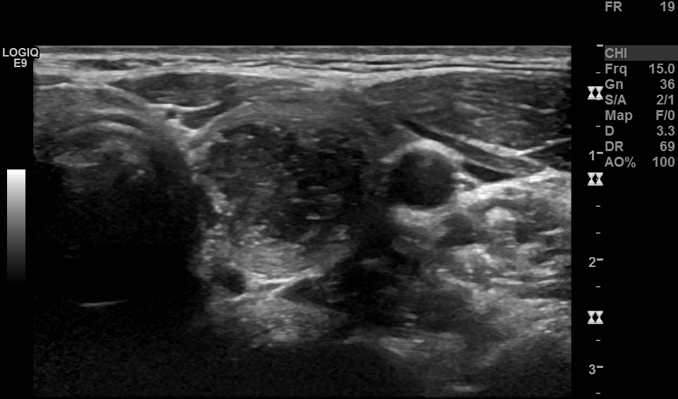
LEFT LOBE TRANS

Slide 4
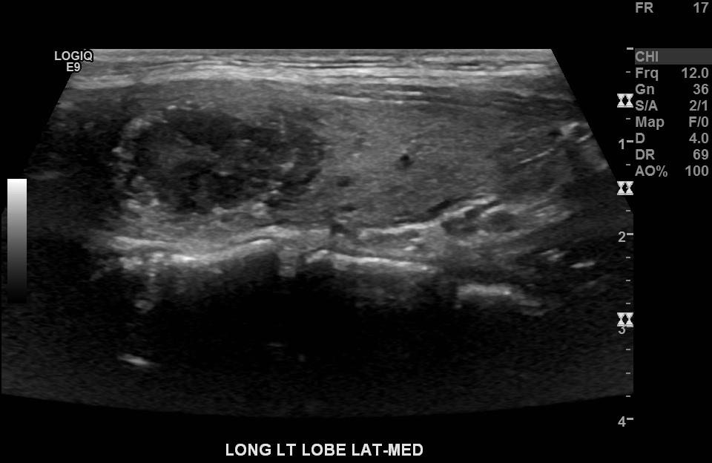

Slide 5
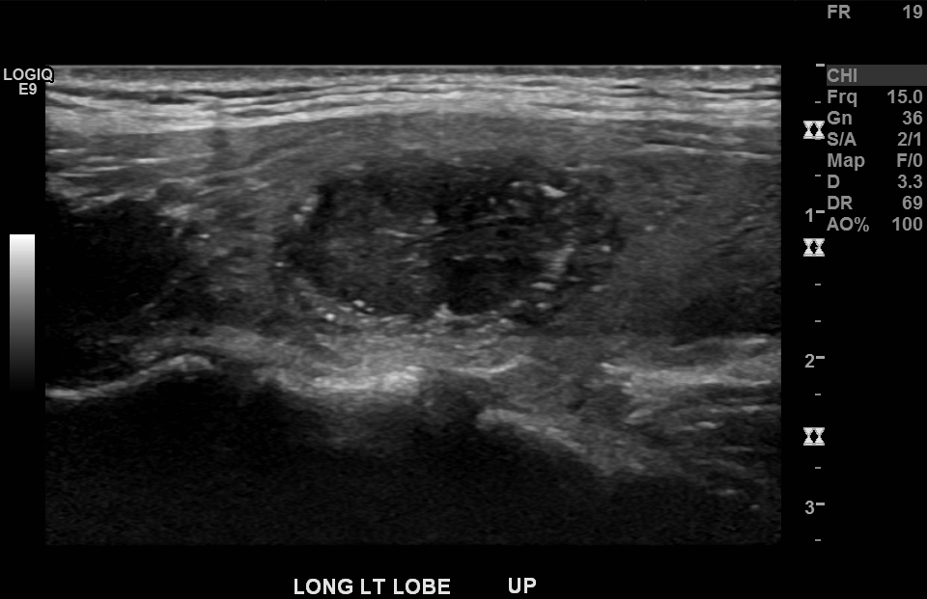

Slide 6
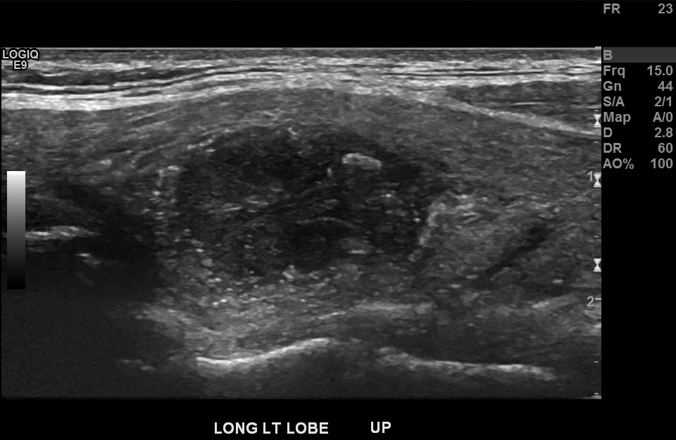

Slide 7
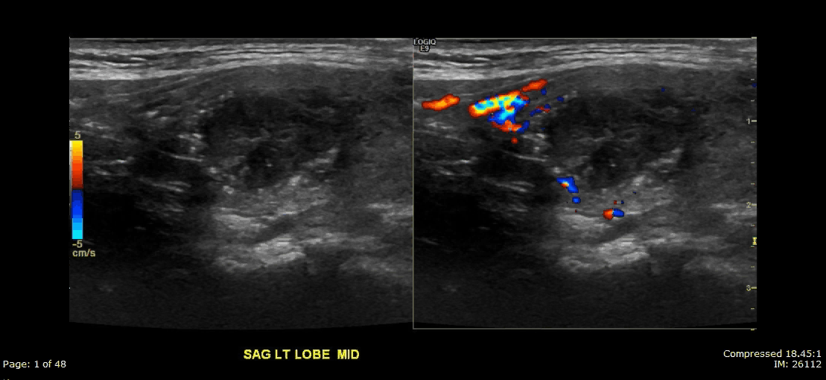
CINE

Slide 8
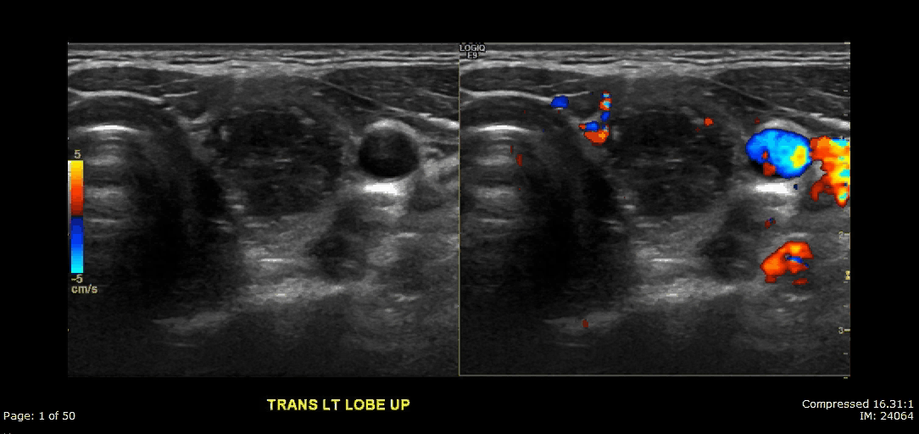
CINE

Slide 9
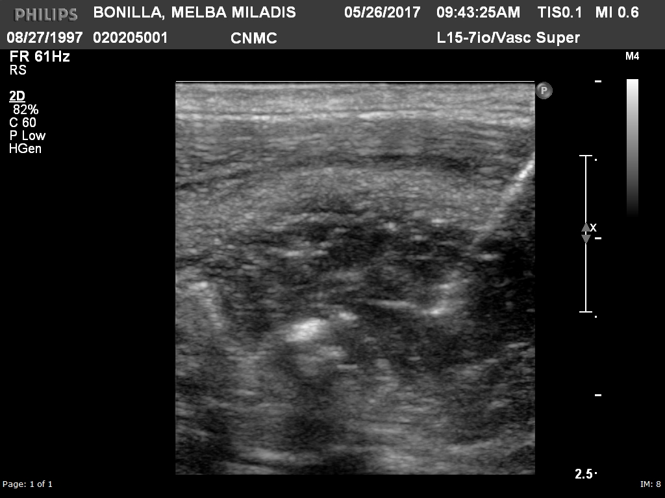
CINE
LEFT LOBE
BX

Slide 10
Questions
What is your impression?
How is this treated?

