Slide 1
Imaging of
Transplanted Organs
And complications
Tahani Alturkistani, M.B.B.S, DABR

Slide 2
Outlines
Review of Doppler imaging principles
Imaging of transplanted kidney
Post renal transplant complications
Imaging of transplanted liver
Post liver transplant complications

Slide 3
Principles of Doppler Imaging
Hemodynamic
how blood flow with effects of pulstile flow and elastic vessels and branching.
Doppler effect
→ Determine velocity

Slide 4
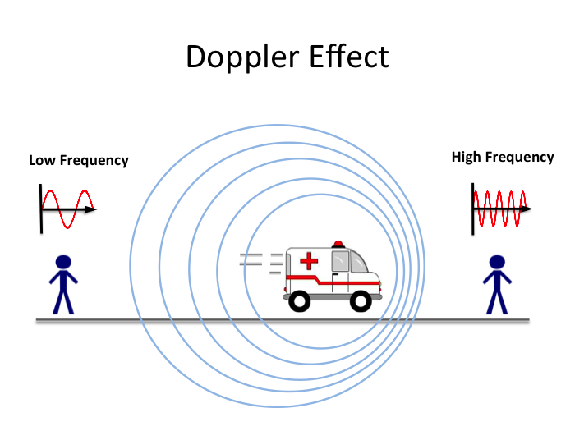

Slide 5

Part 1
Imaging of renal transplant and complications

Slide 6
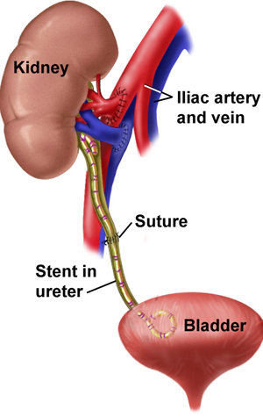
How renal transplant done?

Slide 7
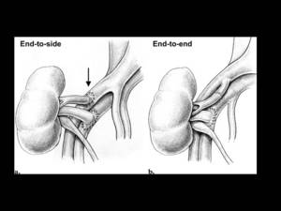
Types of vascular anastmosis
Living doner
Cadaveric

Slide 8
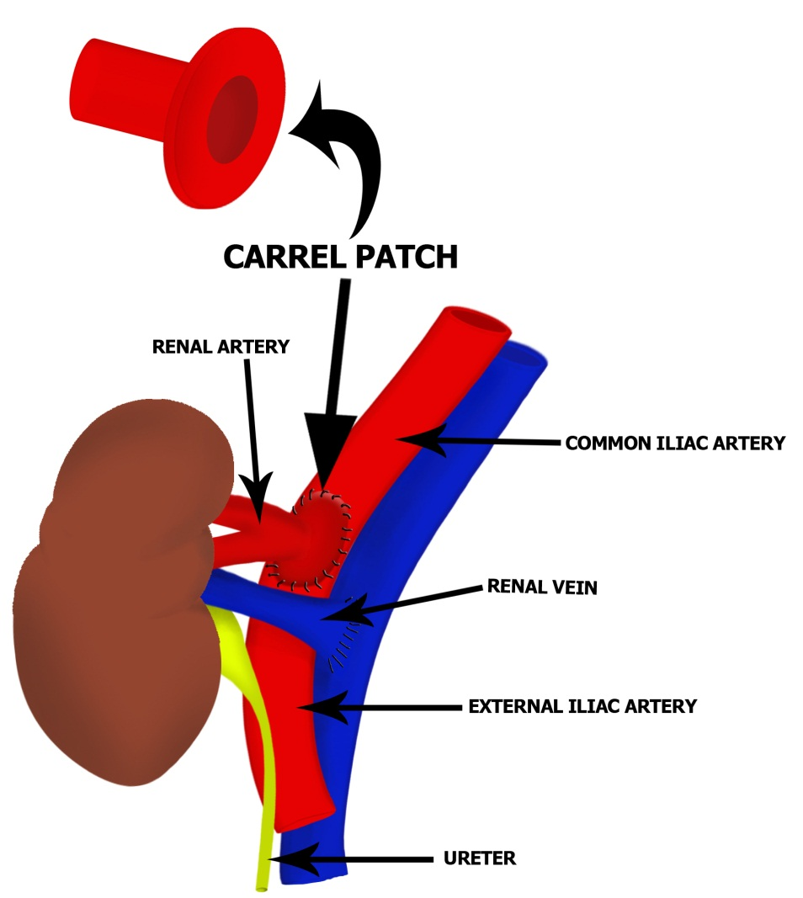

Slide 9
Normal transplanted kidney Doppler Imaging
Non-vascular evaluation:
Parenchyma (corticomedullary differentiation)
Collecting system
Ureter and urinary bladder
2. Vascular evaluation:
Main renal artery
Main renal vein
Intra-renal vessels (arcuate arteries)

Slide 10
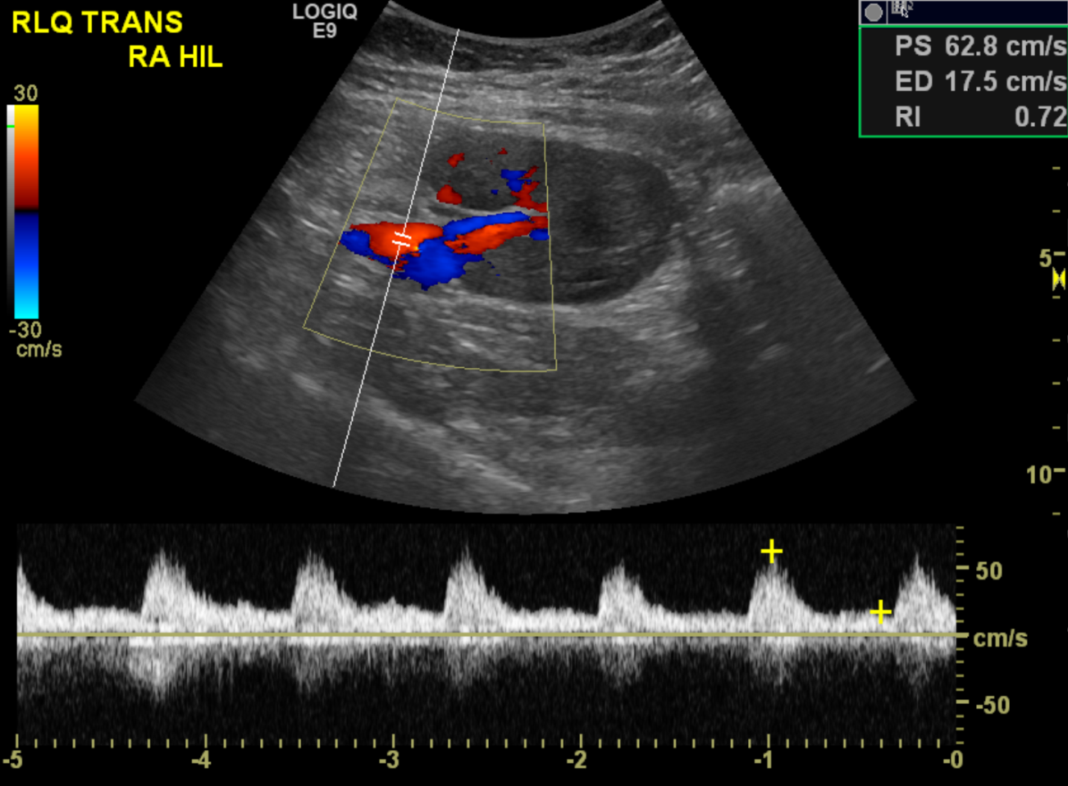
Main renal artery
Pre- and Post anastmosis
Direction → towards the kidney
Waveform → arterial with continuous diastolic flow
PSV 60-200 cm/sec
Ratio to EIA <1.8-3.5
RI 0.5-0.8

Slide 11
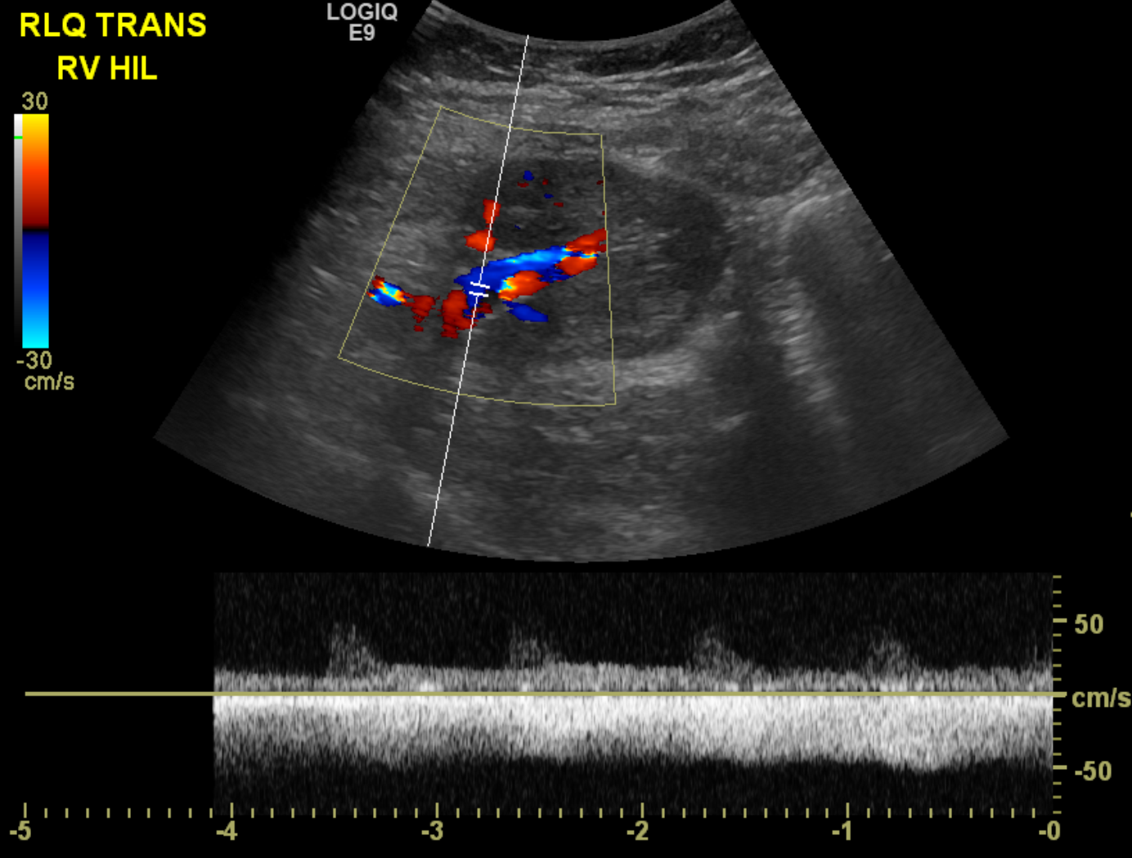
Main renal vein
Direction
Waveform → continuous flow

Slide 12
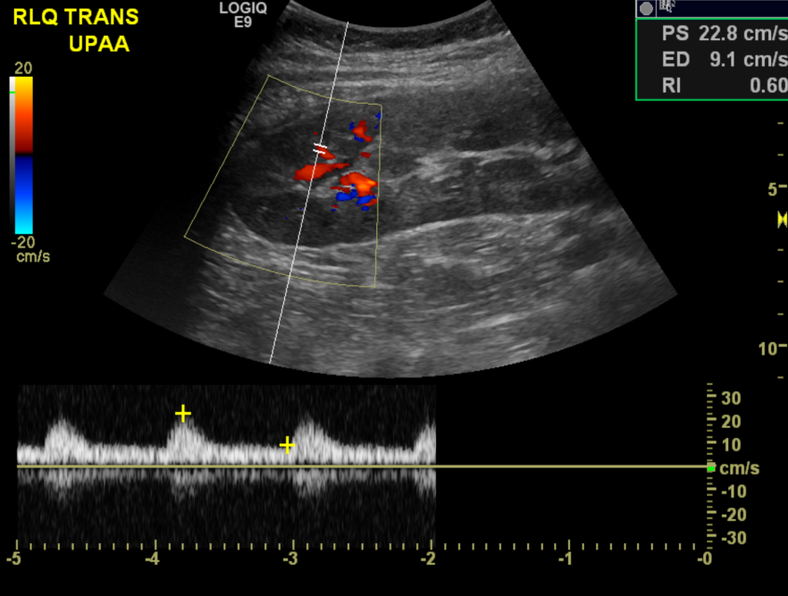
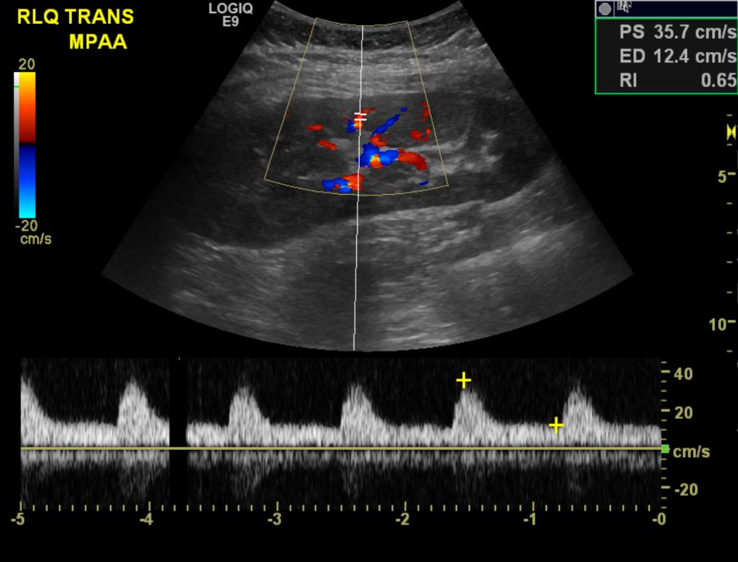
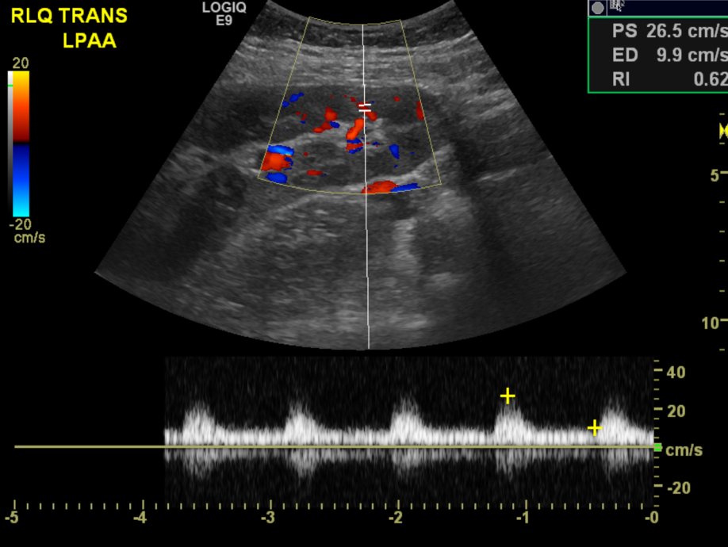
Intra-renal vessels
RI 0.5-0.8

Slide 13
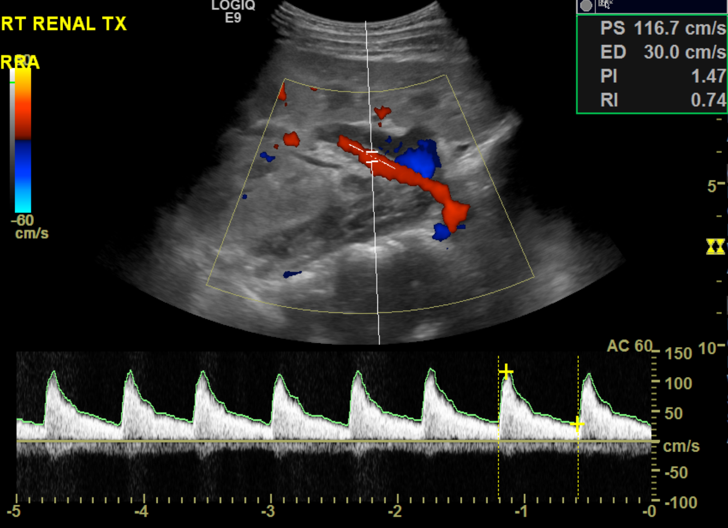
Another normal renal transplant Doppler

Slide 14
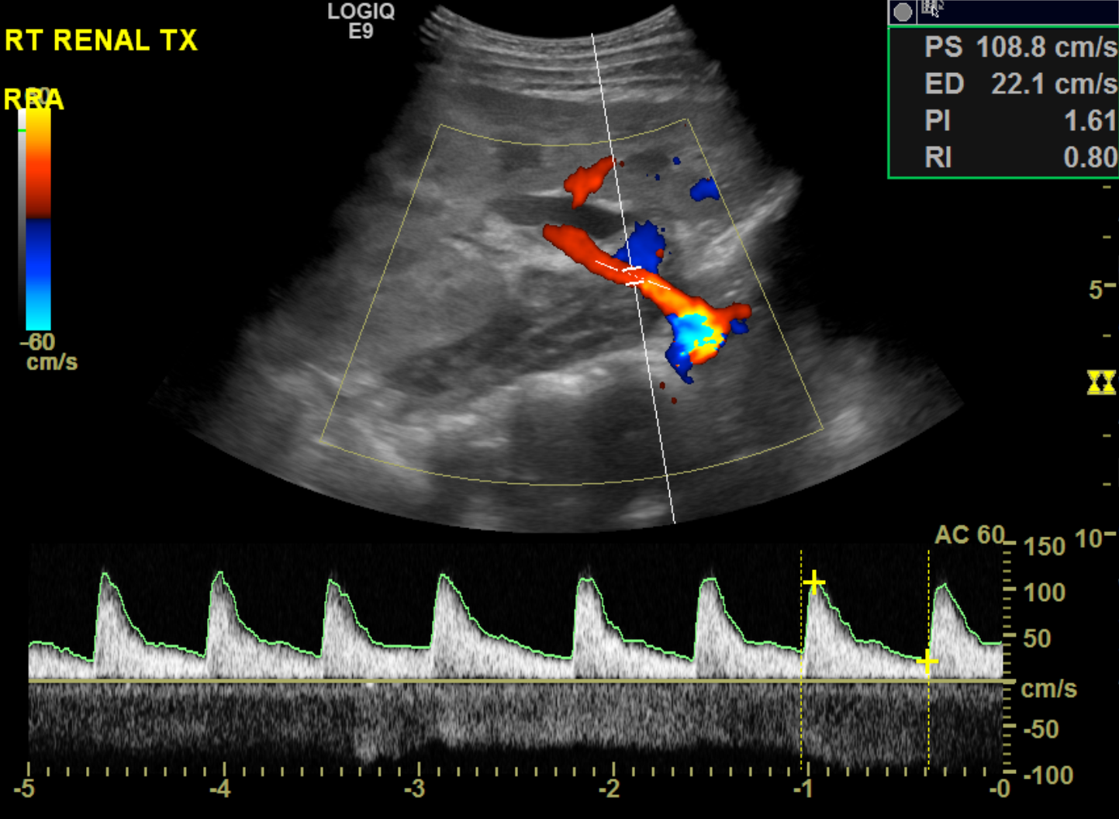

Slide 15
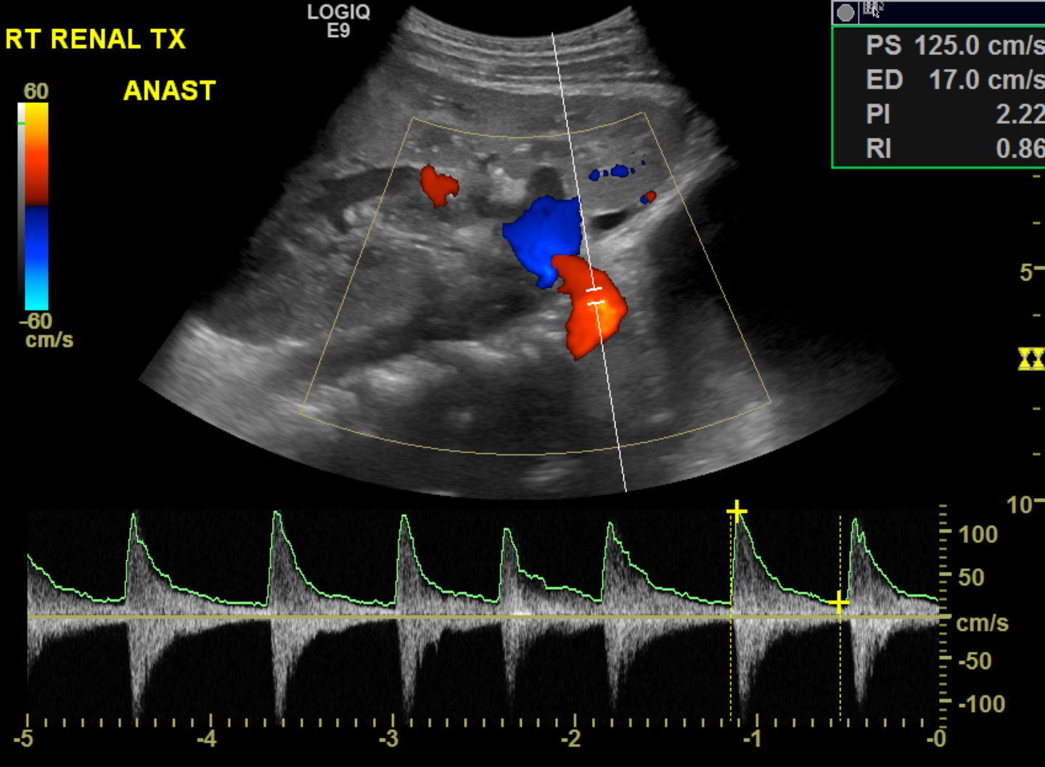

Slide 16
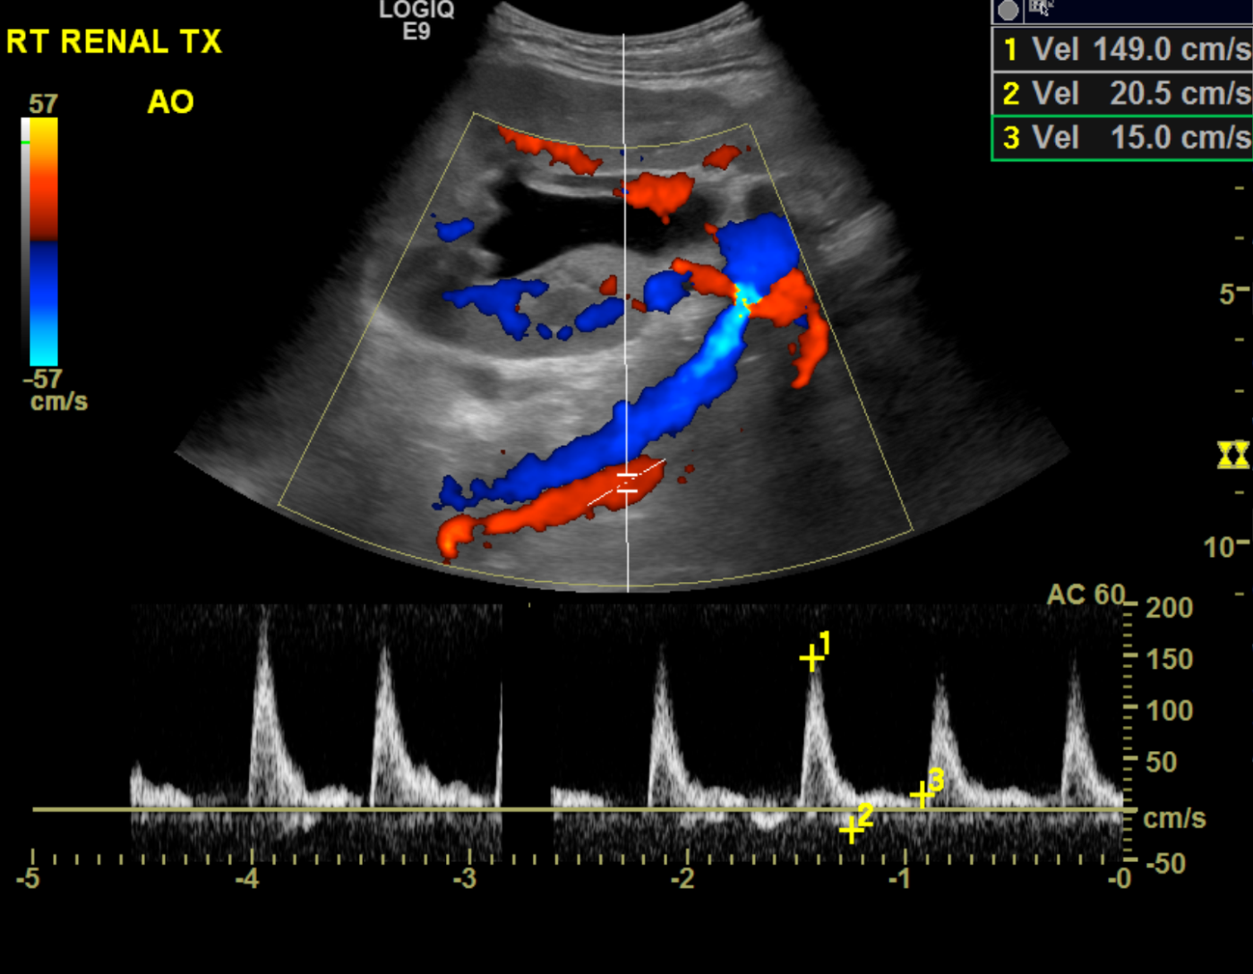

Slide 17
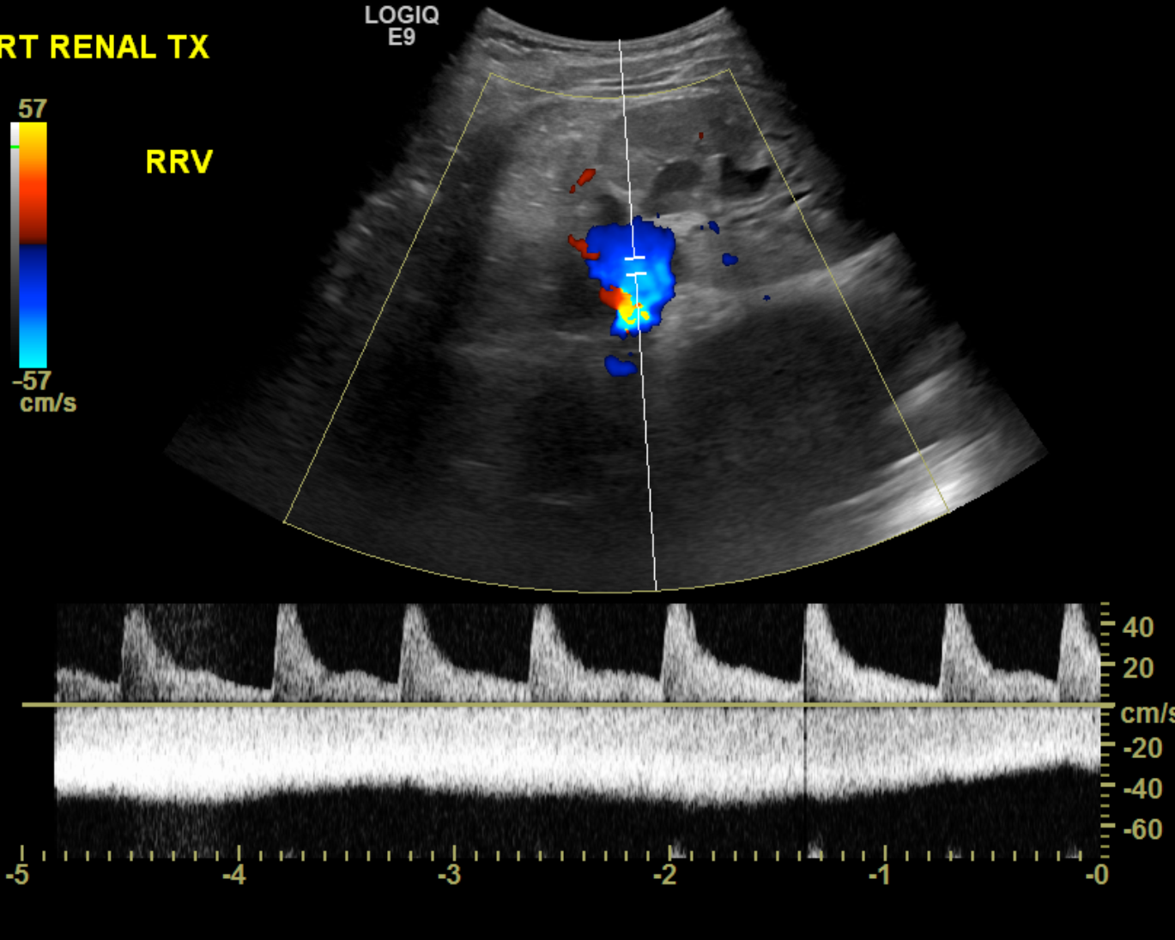

Slide 18
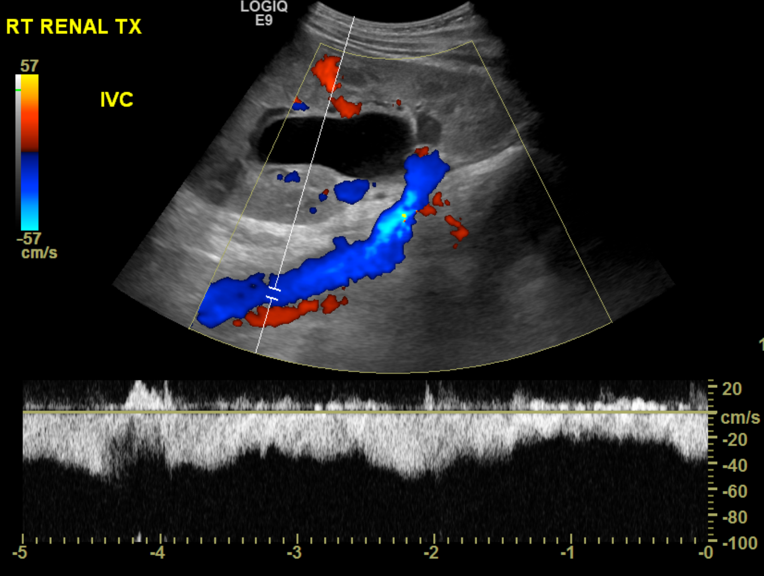

Slide 19
Renal transplant complications
Vascular complications
Urologic complications
Other non-vascular complications:
Peritransplant fluid collection, calculous disease, neoplasm, hernia..etc

Slide 20
Vascular complications
Renal artery
Renal vein
AV fistula and pseudoaneurysm

Slide 21
Renal artery
Renal artery thrombosis:
Rare
Immediate post operative
Hyper acute graft rejection

Slide 22
Renal artery
2. Renal artery stenosis:
Most common vascular complication
Hypertension, graft malfunction
At anastmosis
PSV >250-300 cm/sec
Focal aliasing
Renal artery : EIA > 1.8-3.5
Distal RI <0.5
Tardus parvus wave form → distal to stenosis

Slide 23
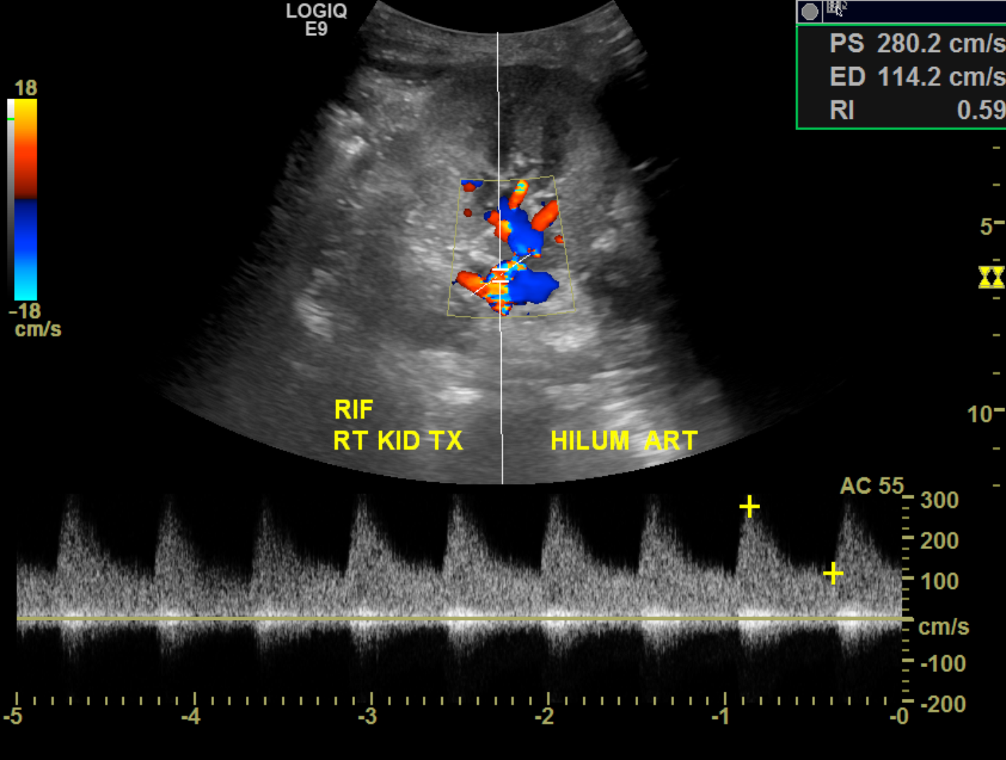
Case #1

Slide 24
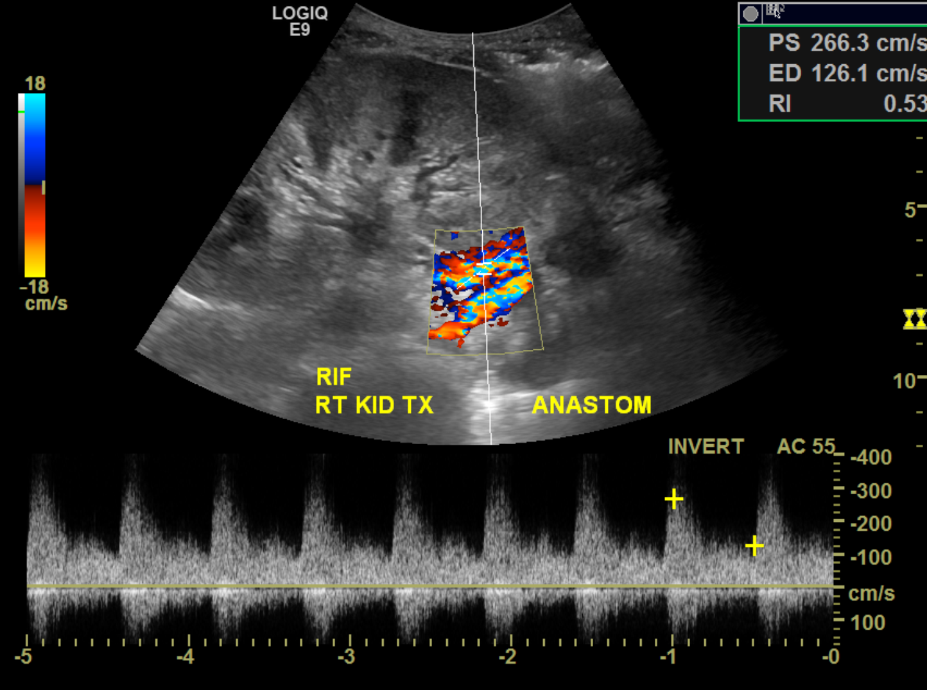

Slide 25
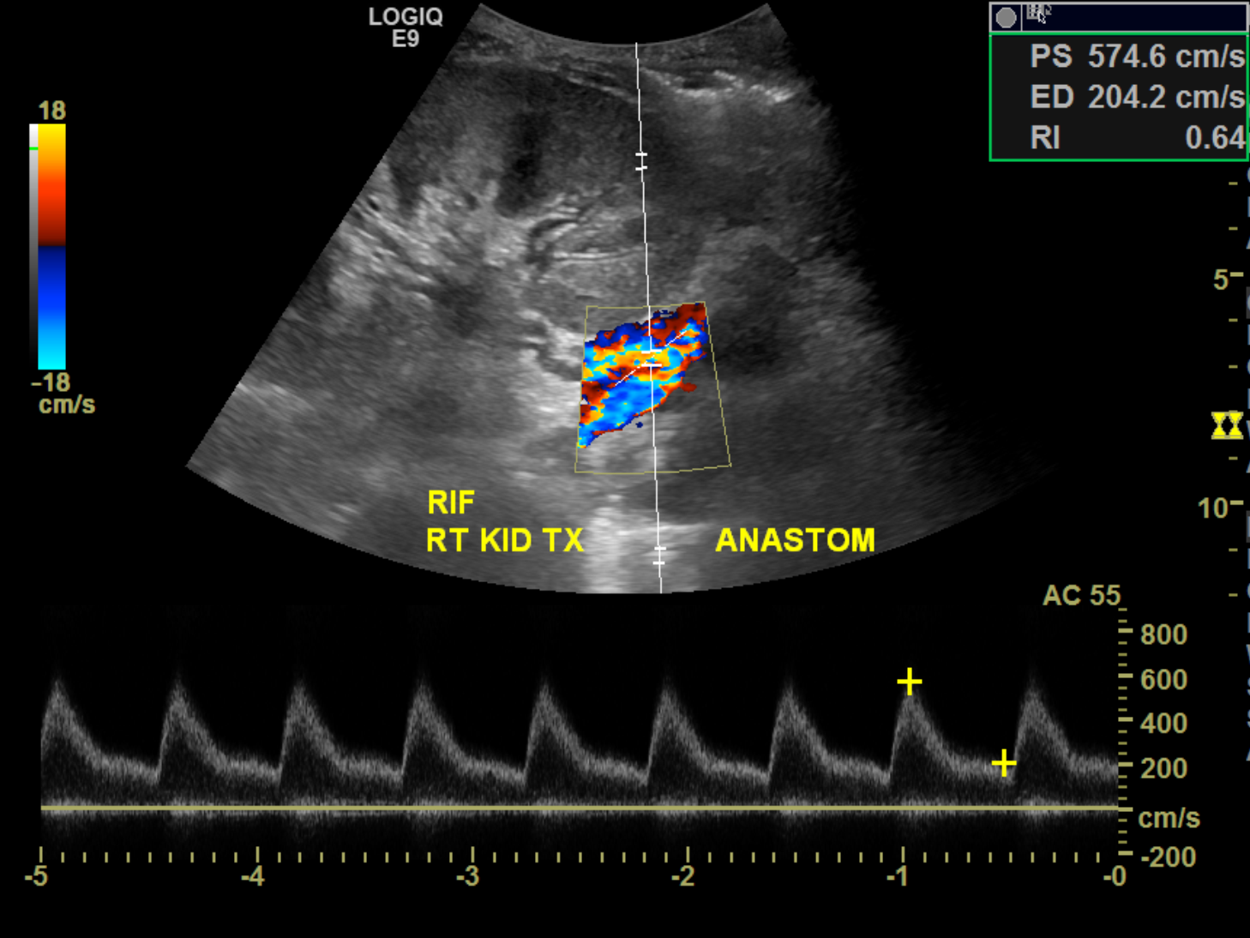

Slide 26
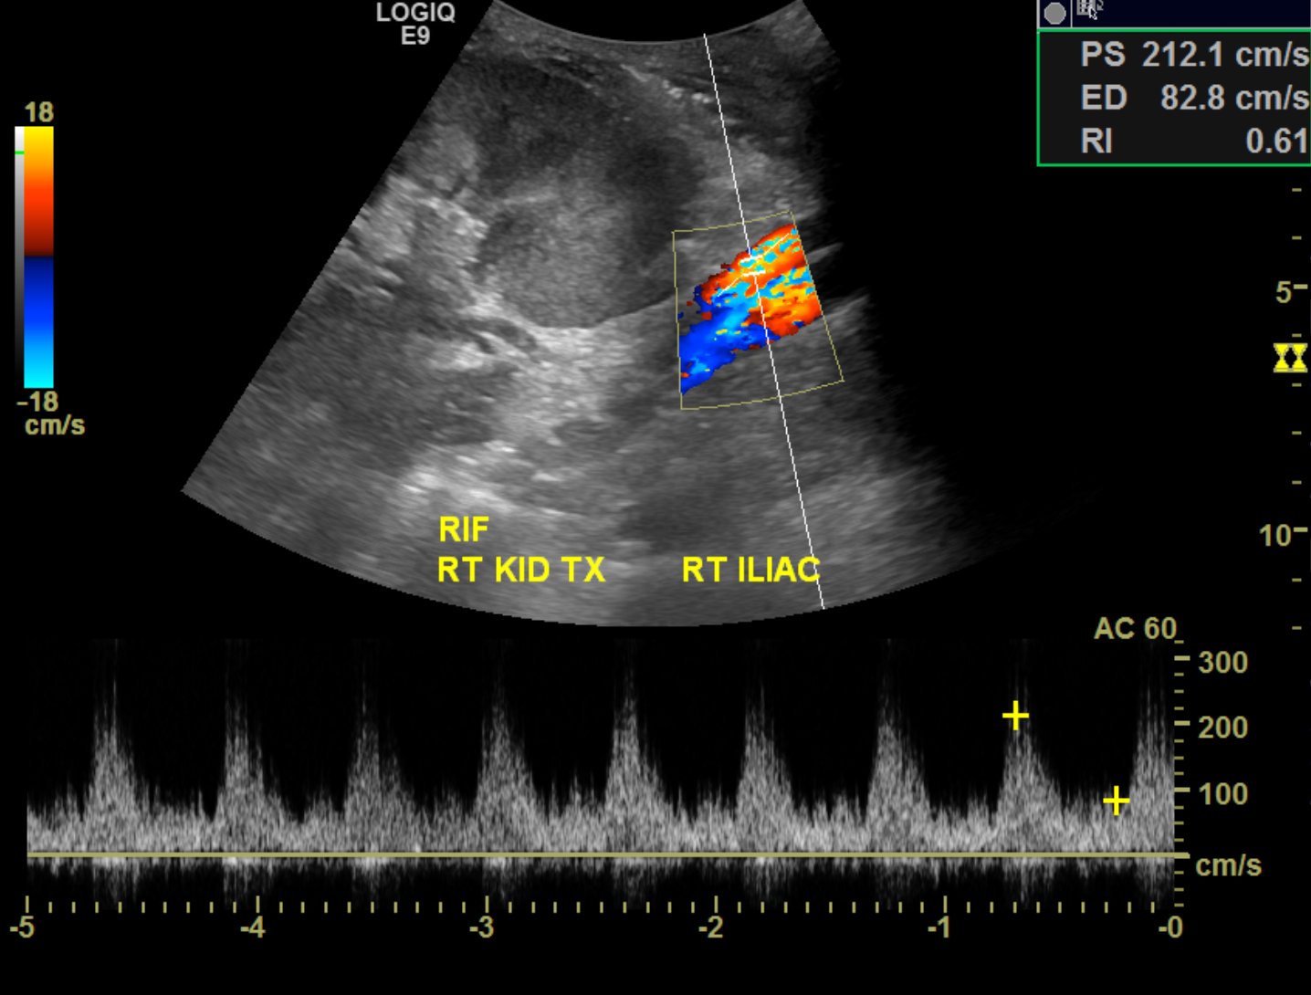

Slide 27
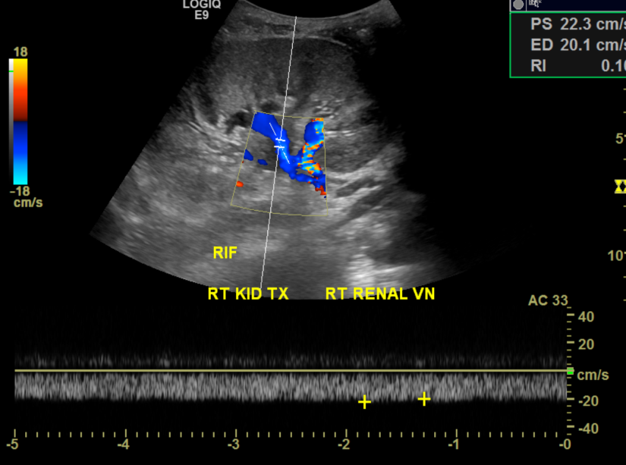

Slide 28
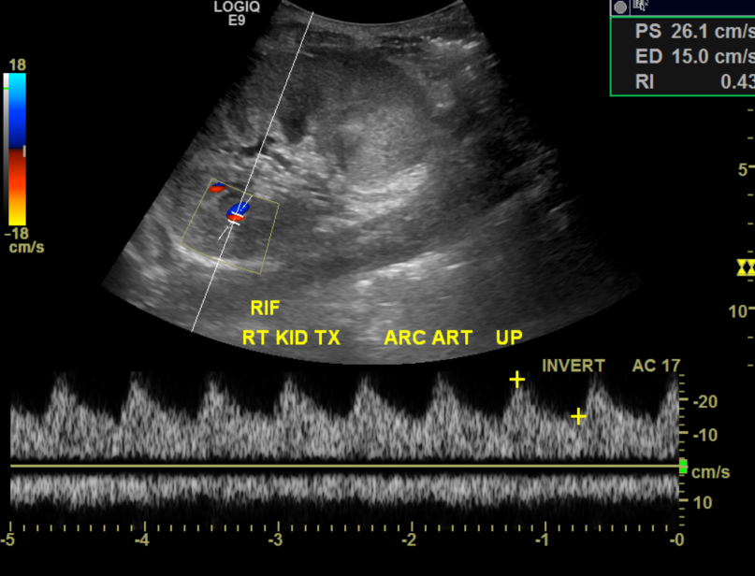
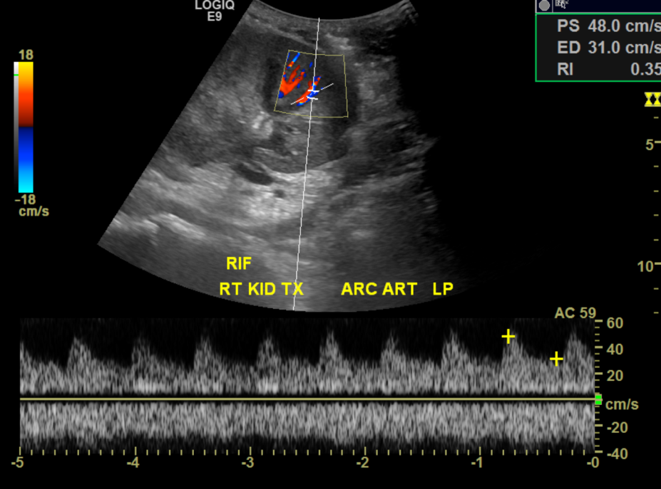
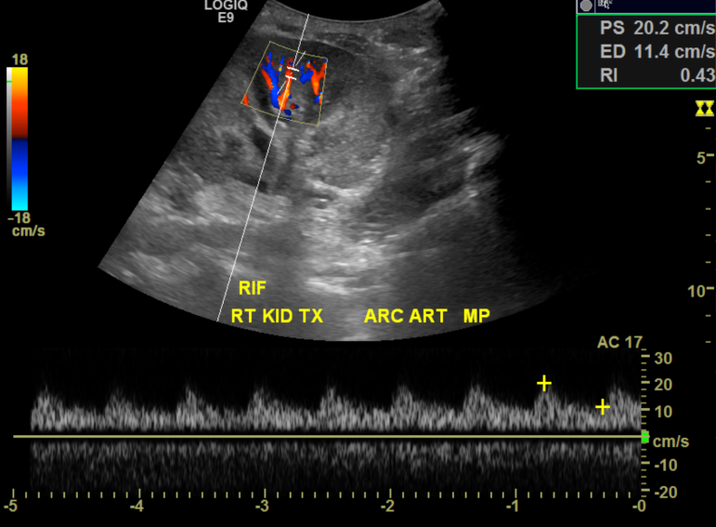

Slide 29
Renal vein
Renal vein thrombosis
1st week of surgery
Surgical injury or compression by fluid collection
Hypovolemia or hypercoagulable state
Graft area tenderness or decreased renal function
Absence flow
Patent renal artery at first
Reversal of diastolic flow in renal artery
Elevated RI in RA

Slide 30


Slide 31
Case of transplanted kidney MRV thrombosis
CLINICAL INDICATION: 3-year-old male with history of end-stage renal
disease secondary to congenital nephrotic syndrome, now postop day 6
status post renal transplant complicated by venous
thrombosis/obstruction, status post thrombectomy and subsequent
venous bypass from right common iliac vein to left common iliac vein.
COMPARISON: Multiple previous exams, most recently renal transplant
ultrasound and MR venogram performed on 12/15/2015.
TECHNIQUE: Real-time grayscale and color Doppler sonographic
evaluation of the transplant kidney in the right lower quadrant was
performed, and selected images were saved for review.
FINDINGS:
The bilateral native renal fossae are not evaluated.
The transplant kidney in the right lower quadrant measures 11.9 cm in
length. Cortical echogenicity is mildly increased, and
corticomedullary differentiation is preserved. There is no evidence
of hydronephrosis. The previously seen ureteral stent is not
definitely visualized. There is a small amount of complex perinephric
fluid again seen.
The transplant renal artery demonstrates a bifid configuration, as
before. The upper renal artery segment demonstrates increased peak
systolic velocity of approximately 274 cm/s, and there is reversal of
diastolic flow with resistive index greater than 1. The lower renal
artery segment demonstrates peak systolic velocity of 110 cm/s and
loss of forward flow in diastole with resistive index of 1.
Previously, diastolic flow in the transplant renal artery was
diminished. The arterial anastomosis at the level of the right common
iliac artery demonstrates turbulent flow with peak systolic velocity
of 265 cm/s. There is preserved but diminished diastolic flow with
resistive index of 0.92.
Doppler assessment of the intrarenal arteries demonstrates high
resistance waveforms with loss of diastolic flow throughout.
The transplant renal vein demonstrates a short segment of absent
color flow near the hilum, with increased intraluminal echoes and
dampened venous waveform, suspicious for recurrent venous thrombosis.
The remaining visualized portions of the renal vein appear patent.
However, the venous anastomosis and new bypass graft are not well
demonstrated on the current exam.
The urinary bladder is not well seen, likely decompressed due to
Foley catheter placement.
IMPRESSION:
1. Right lower quadrant transplant kidney with redemonstrated mildly
echogenic parenchyma and a small amount of complex perinephric fluid.
No hydronephrosis.
2. Findings suspicious for small recurrent thrombosis in the renal
transplant vein near the hilum. The venous anastomosis and bypass
graft are not well visualized.
3. Persistently elevated renal arterial resistive indices, now with
absent to reversed diastolic flow, and high resistance intrarenal
waveforms throughout.

Slide 32
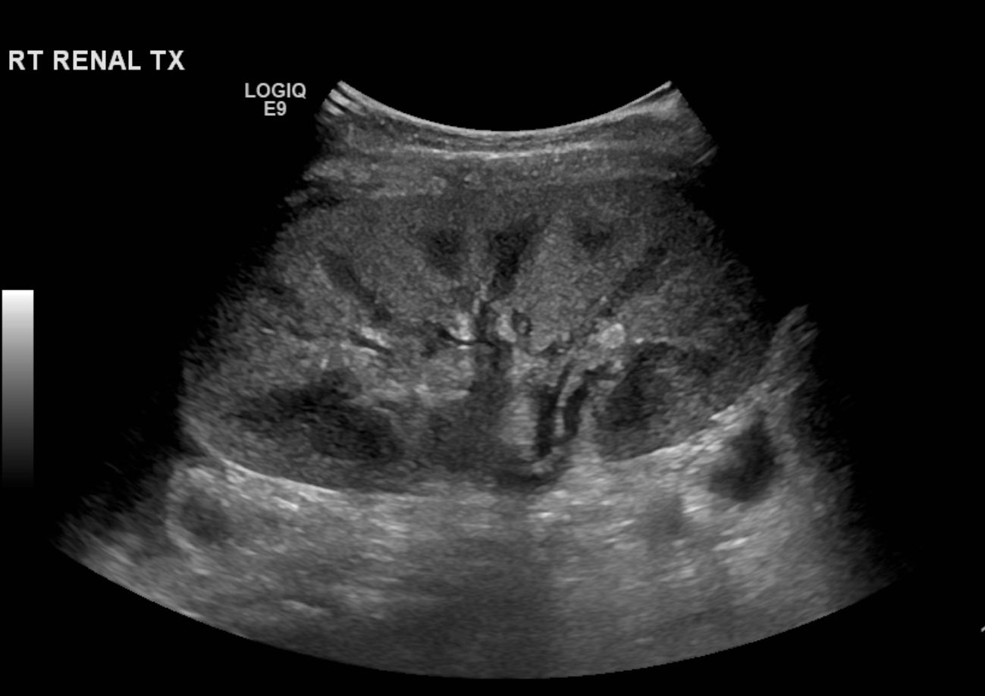
Case#2
3-year-old male with history of ESRD secondary to congenital nephrotic syndrome.
Now POD 6 status post renal transplant

Slide 33
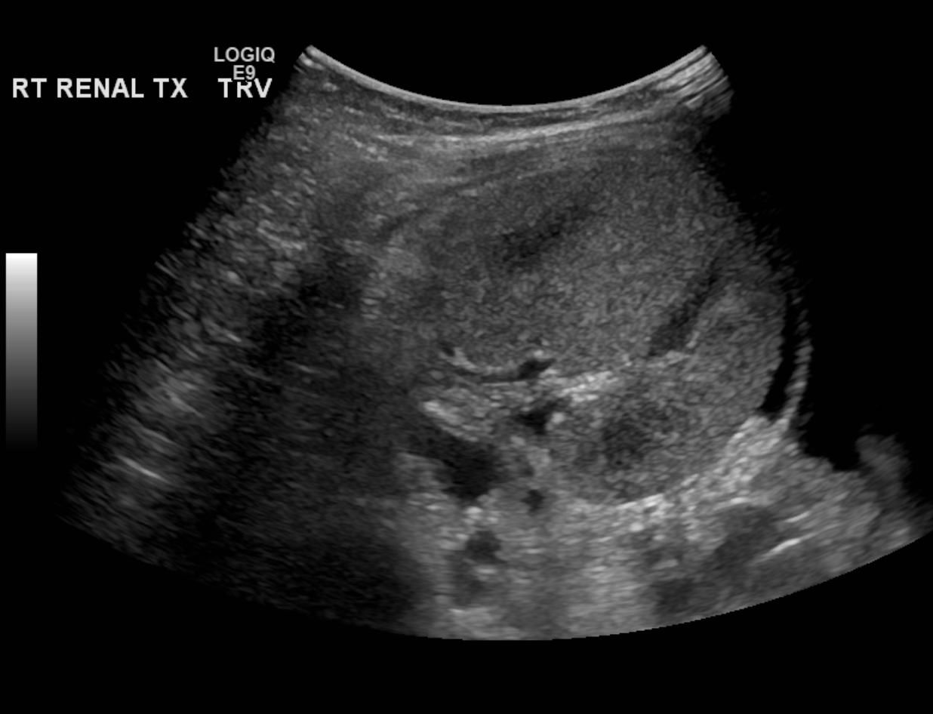

Slide 34
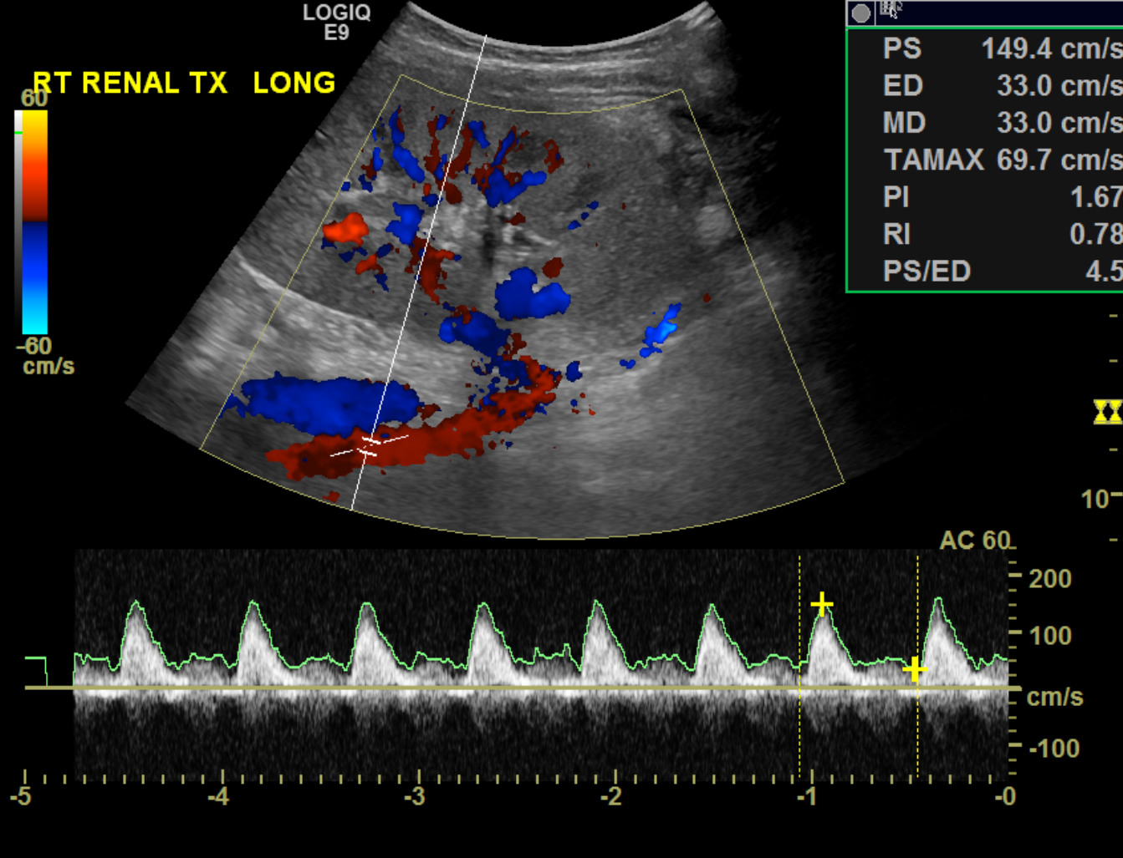

Slide 35
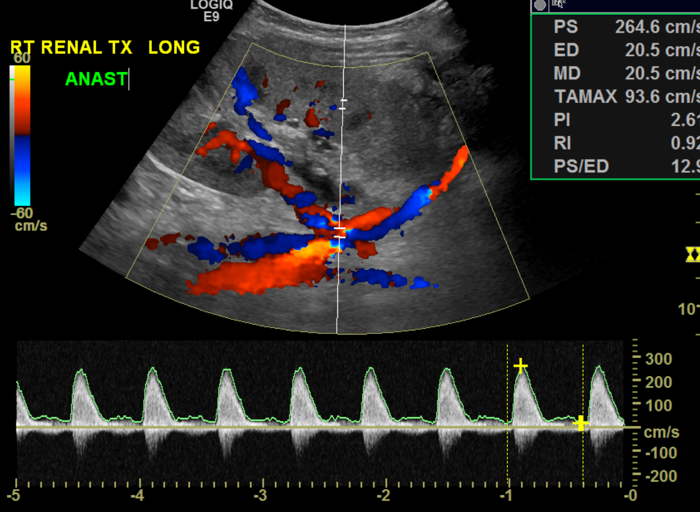

Slide 36
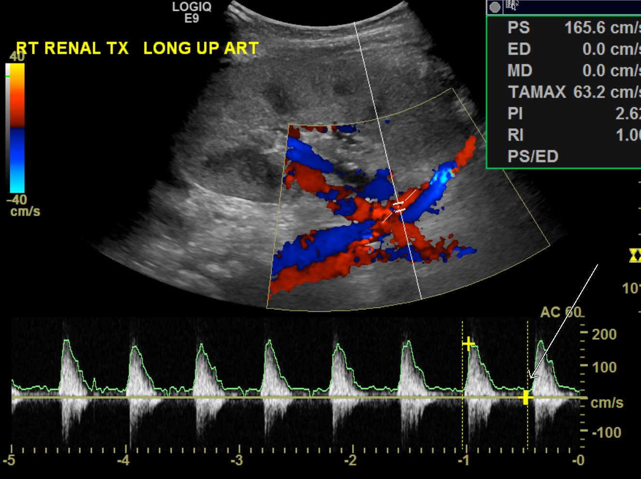

Slide 37
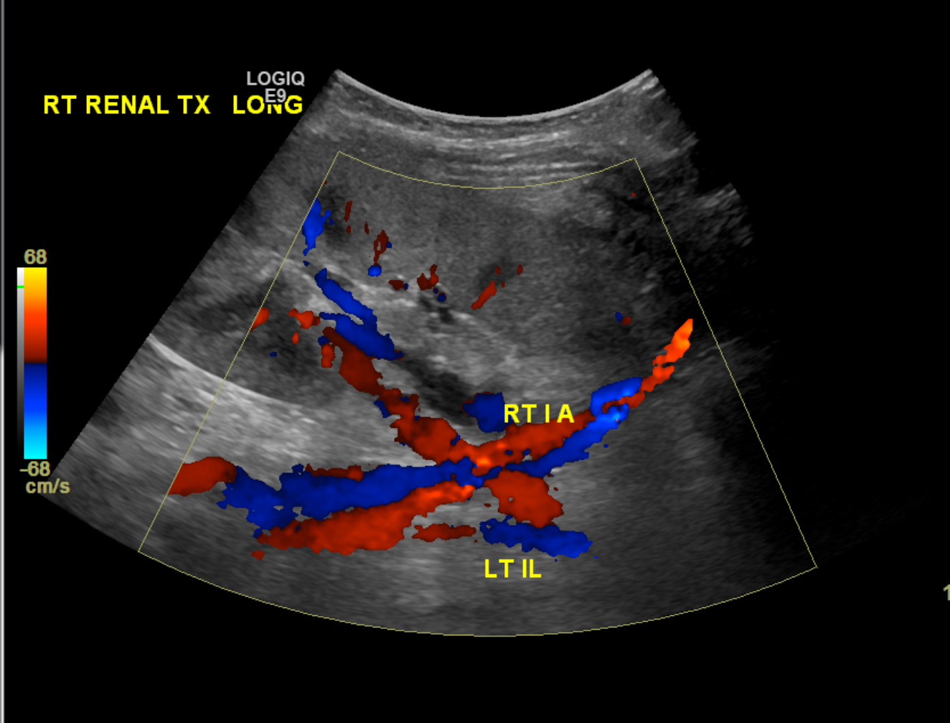

Slide 38
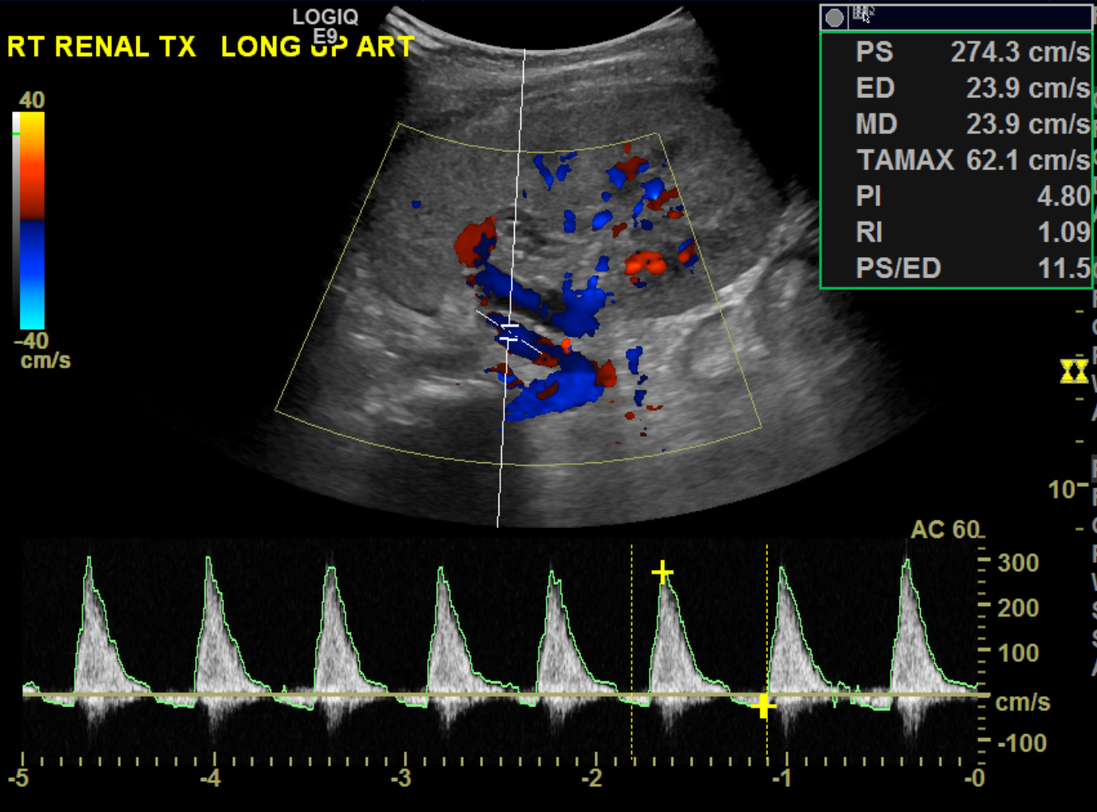

Slide 39
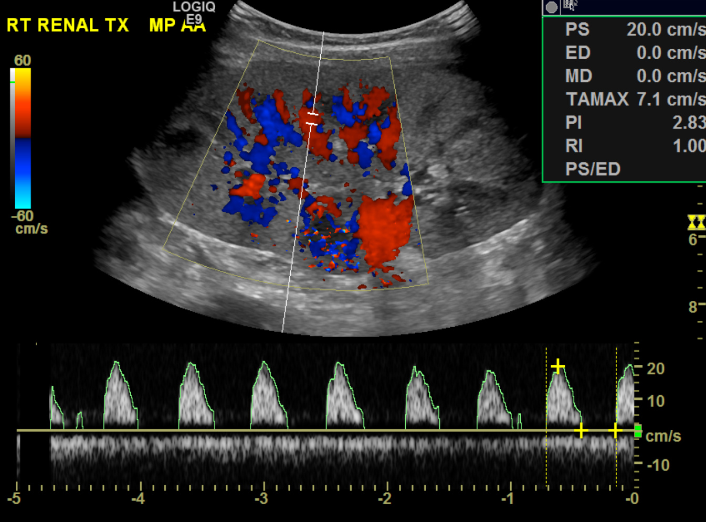

Slide 40
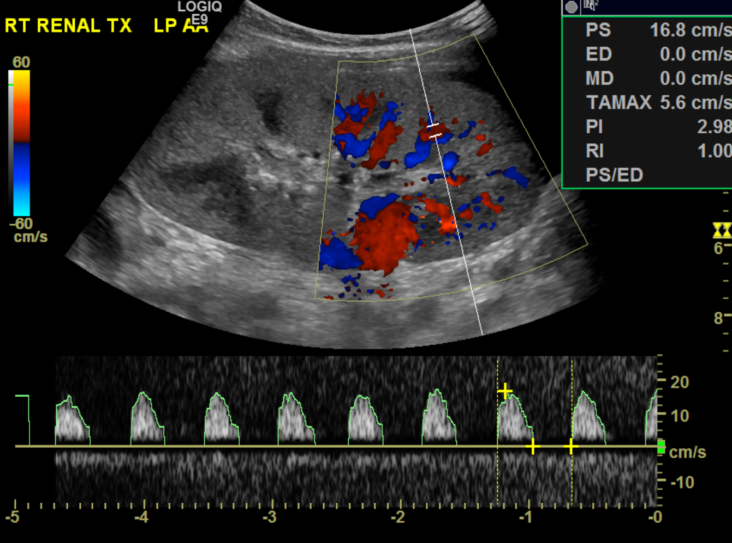

Slide 41
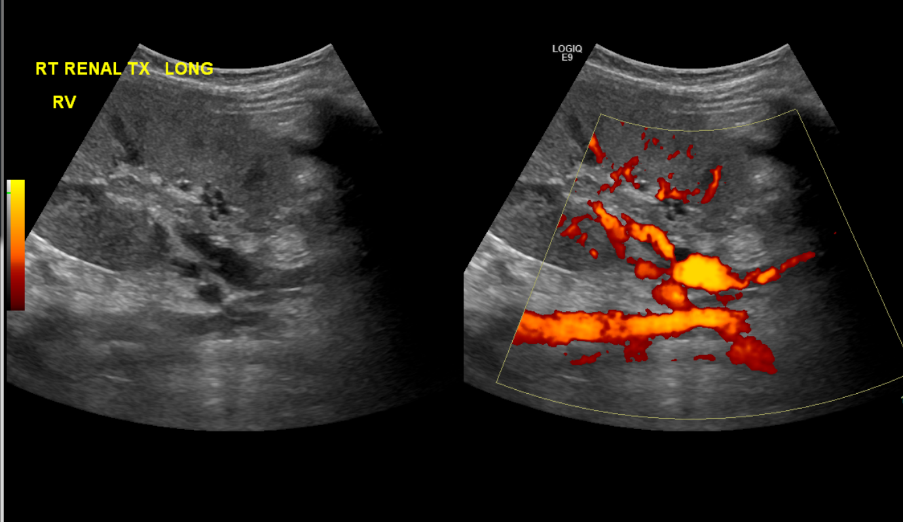

Slide 42
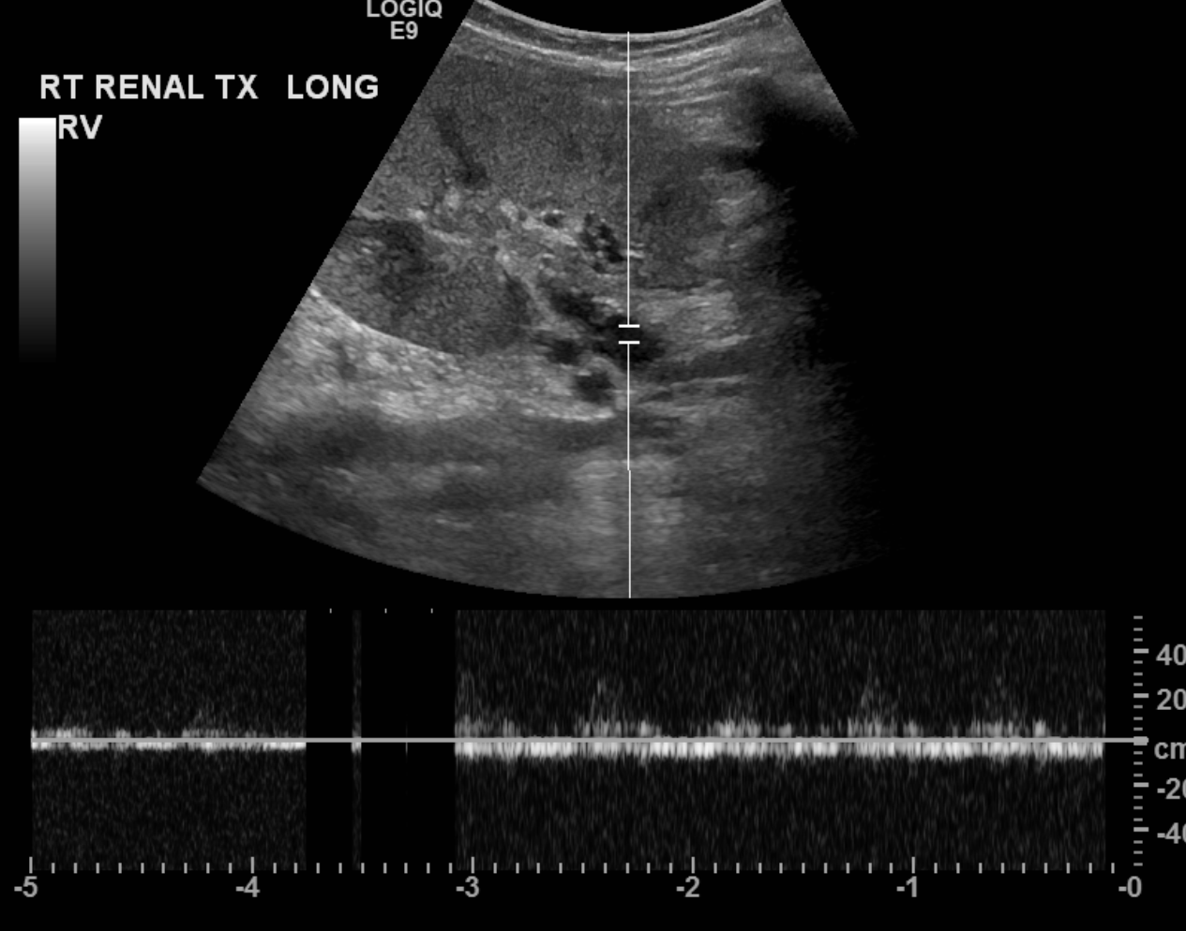
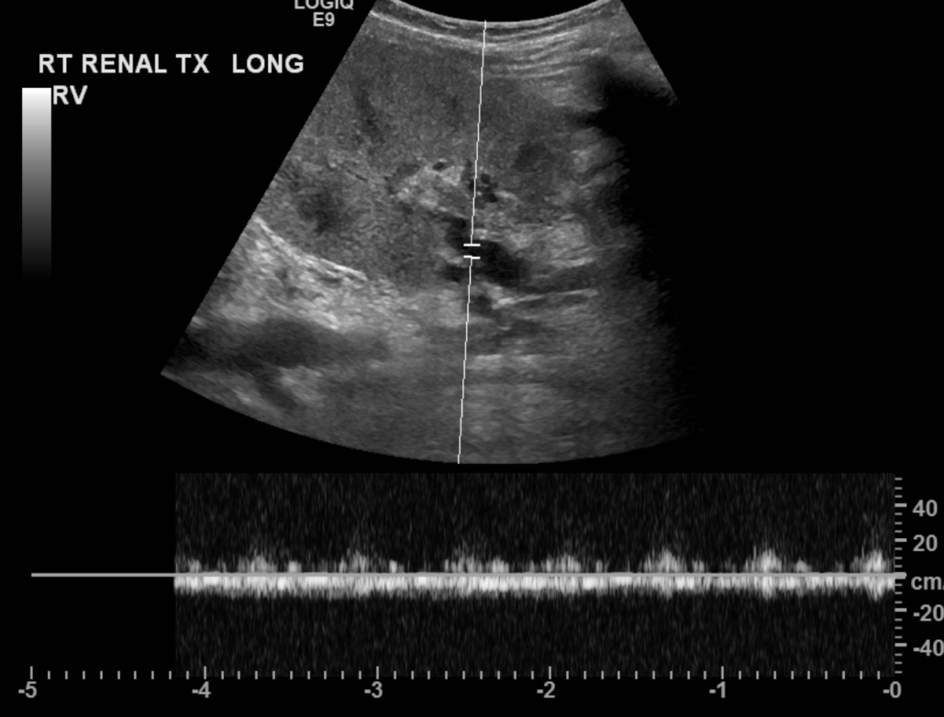

Slide 43
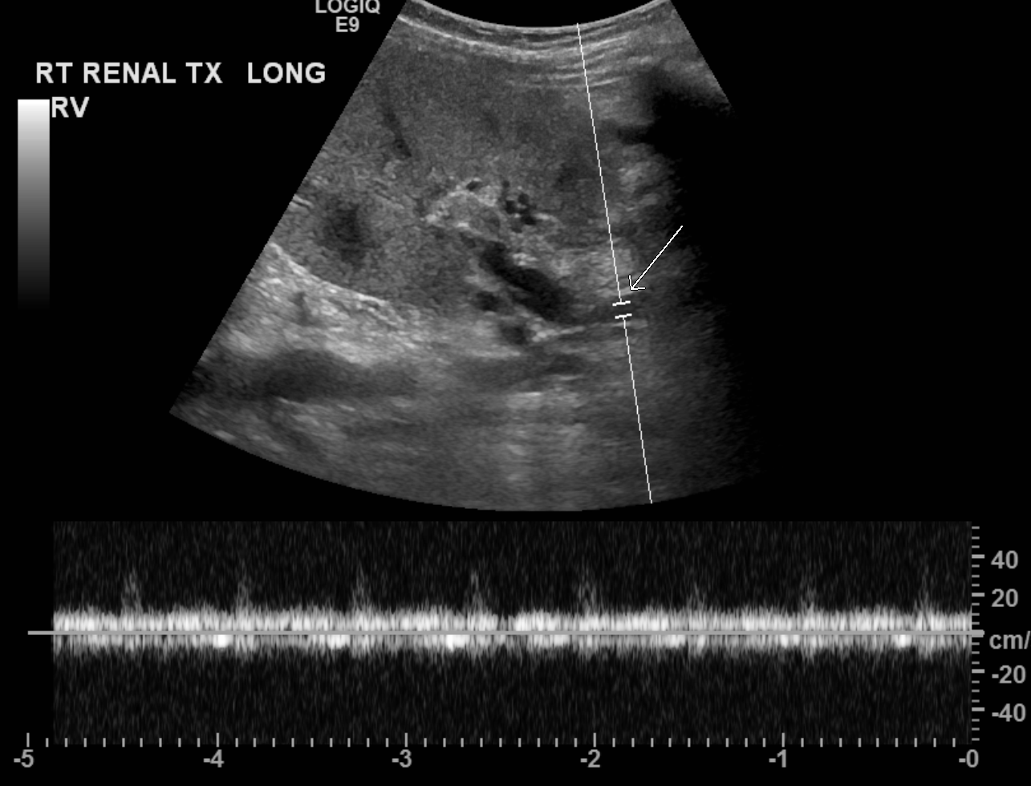

Slide 44
EXAM: Renal and bladder ultrasound
CLINICAL HISTORY: 2 week old 24 weeks gestational age with hematuria
and acute renal failure, please evaluate for thrombosis.
COMPARISON: Head ultrasound dated March 20, 2016.
FINDINGS:
Right kidney:
Echogenicity: Slightly echogenic with preserved corticomedullary
differentiation.
Position: Normal
Hydronephrosis: There is no hydronephrosis or hydroureter.
Size: Normal, 3 cm
Spectral Doppler:
Main renal artery and renal vein:
Arterial waveform: Abnormal with complete reversal of diastolic flow
consistent with intraparenchymal venous thrombosis.
Venous waveform: Patent.
Resistive index: The main renal artery RI is abnormally high
measuring 1. Resistive indices of the intraparenchymal arcuate
vessels are normal ranging between 0.7-0.8.
Left kidney:
Echogenicity: Slightly echogenic with preserved corticomedullary
differentiation.
Position: Normal
Hydronephrosis: There is no hydronephrosis or hydroureter.
Size: Normal, 2.8 cm
Spectral Doppler:
Main renal artery and renal vein:
Arterial waveform: Abnormal with complete reversal of diastolic flow
consistent with intraparenchymal venous thrombosis.
Venous waveform: Patent.
Resistive index: The main renal artery RI is abnormally high
measuring 1. Resistive indices of the intraparenchymal arcuate
vessels are normal ranging between 0.7-0.8.
Bladder:
Filling: Completely decompressed.
IMPRESSION:
1. Abnormal Doppler exam of both kidneys consistent with bilateral
renal vein thrombosis. These findings were discussed with Dr.Chun
from NICU on March 22, 2016 at approximately 11:40 AM.
2. The urinary bladder is completely decompressed be fully evaluated.

Slide 45
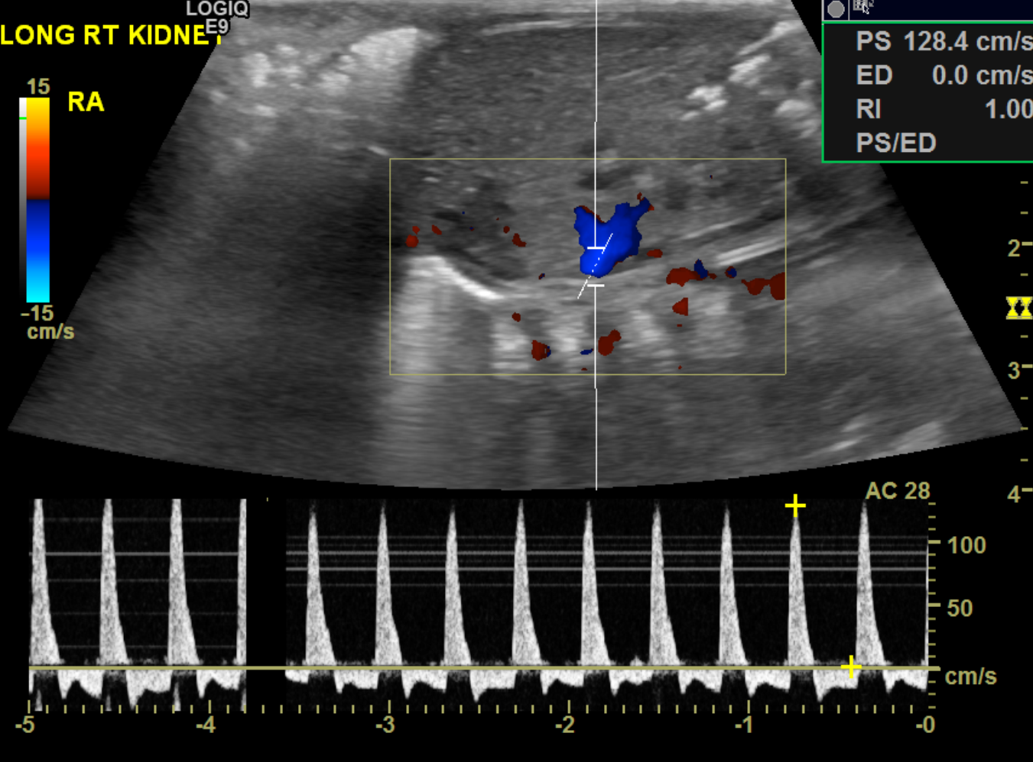
Case#3
Bilateral renal vein thrombosis

Slide 46
Case of transplanted renal vein thrombosis
Addendum Begins
Findings section of the report should read: Main renal vein is not
visualized, concerning for renal vein thrombosis.
Addendum Ends
RENAL TRANSPLANT ULTRASOUND
HISTORY: Renal transplant 12/10/2015
TECHNIQUE: Real time sonographic evaluation of the transplanted
kidney using grayscale, color Doppler, and spectral waveform
analysis.
COMPARISON: None
FINDINGS:
Bilateral native kidneys appear small and echogenic, compatible with
end-stage renal disease.
The transplanted kidney is in the left lower quadrant. Transplanted
kidney demonstrates decreased corticomedullary differentiation and
increased cortical echogenicity with preserved cortical thickness. No
hydronephrosis. There is mild fluid surrounding the transplant
kidney, likely prior surgical.
Transplanted kidney measures 11.2 cm.
Arcuate artery resistive indices:
Upper: 1.0 cm/s
Middle: 1.0 cm/s
Lower: 1.0 cm/s
Main renal artery anastomoses with the left iliac artery.
Pre-anastomotic left iliac artery peak systolic velocity: 339 - 536
cm/s
Main renal artery velocities:
Anastomosis: 209.9 cm/s
Middle: 101.9 cm/s
Distal: 154.0 cm/s
Main renal vein demonstrates normal color flow and venous waveform.
No evidence of renal vein thrombosis.
Bladder is decompressed with a Foley catheter.
IMPRESSION:
1. Renal vein not well visualized with reversal of diastolic flow in
the main and arcuates renal arteries. These findings could be seen in
the immediate postoperative setting but raises suspicion for renal
vein thrombosis. Close follow up is recommended.

Slide 47
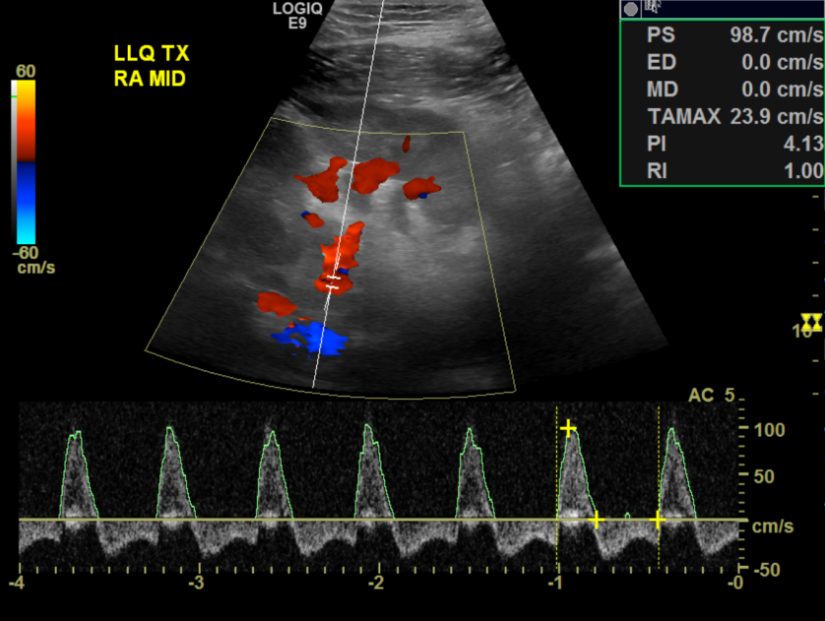
Case#4
Renal vein thrombosis

Slide 48
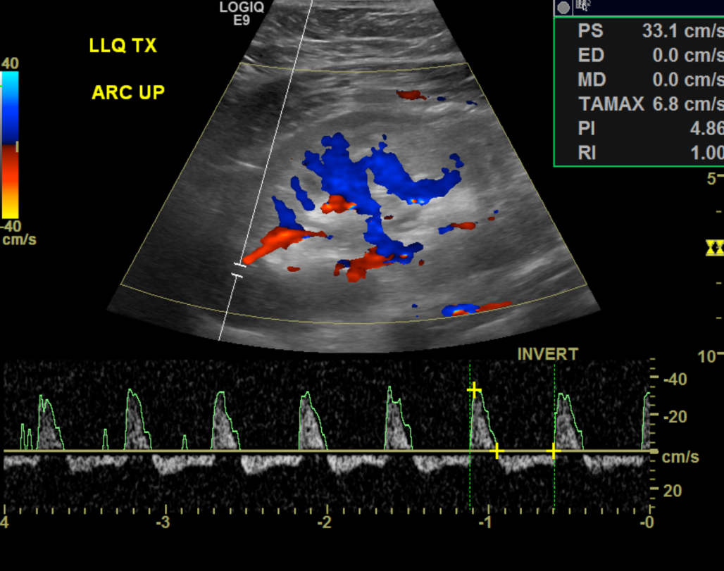
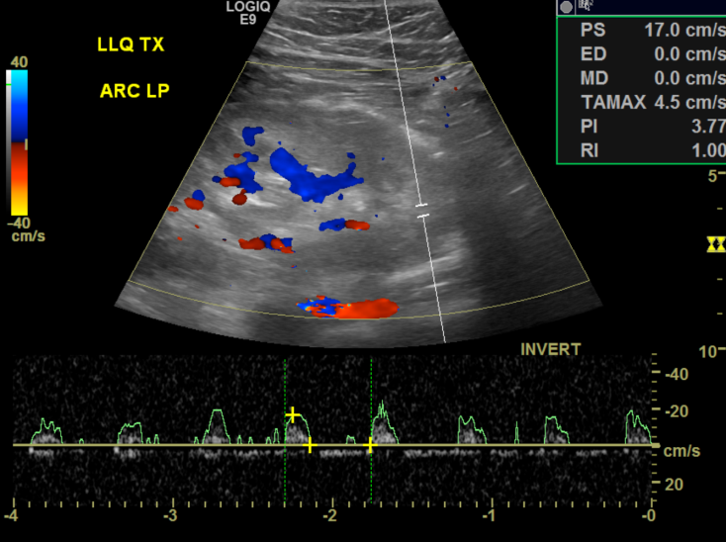
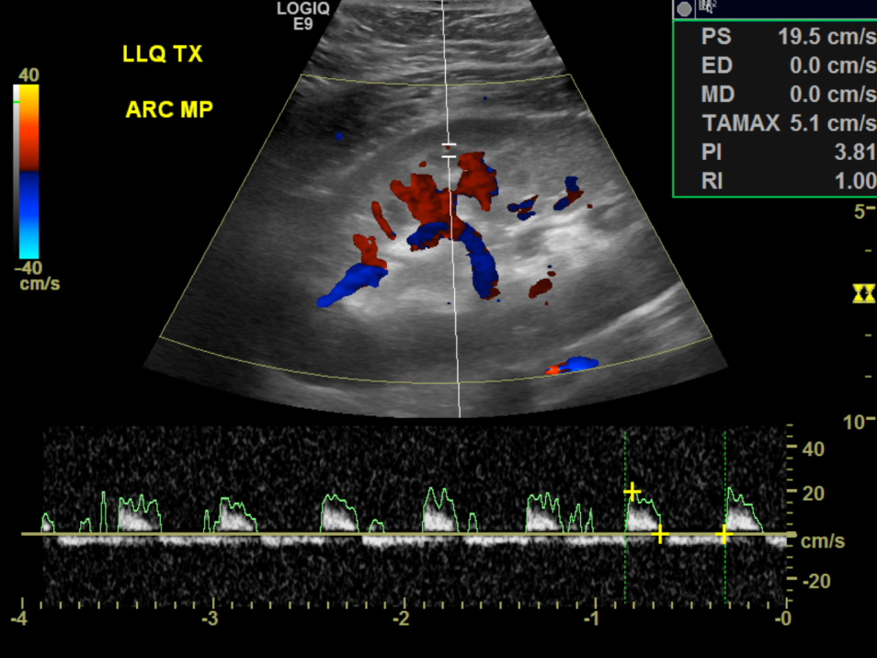

Slide 49
AV fistula and Pseudoaneurysm
Post renal biopsy
12%
Asymptomatic
Hematuria or decrease graft function
AVF →high velocity arterial flow
arterial broadening & turbulence
“Arterialized” venous flow
Pseudoaneurysm →
cyst with swirling yin-yang flow

Slide 50
Case of pesudoaneurysm
History: 15YO FEMALE S/P RENAL TRANSPLANT 3 WEEKS AGO C/O RIGHT LEG
PAIN AND BRUIT OVER RENAL TRANSPLANT. EVAL FLOW TRANSPLANT KIDNEY AND
EVAL FOR THROMBOSIS RIGHT LOWER EXTREMITY.
Technique: Grayscale, color-flow and power Doppler sonographic
interrogation of the transplant kidney was performed.
Comparison: July 31, 2011.
Findings: The kidney measures 12.4 cm in length and demonstrates
normal contour and echotexture. The collecting system is decompressed.
And normal arterial waveform is present in the renal artery where the
resistive index is 0.64 and a maximum velocity is 112.5 cm/sec. The
resistive index near the anastomosis within the iliac artery is 0.6.
Power Doppler was used to detect resistive indices in the arcuate
arteries which range from 0.54 to 0.62.
At the anastomosis there is turbulent flow and a mixed waveform is
present.
An anechoic mass is noted inferior to the kidney, in the region of the
anastomosis. Color-flow images are characteristic of a
pseudoaneurysm.
Impression:
1. Normal appearing transplant kidney with resistive indices all less
than 2.8.
2. Anechoic mass in the region of the transplant with color-flow
suggestive of pseudoaneurysm. Findings were discussed with the
clinical team in person at the time of interpretation.

Slide 51
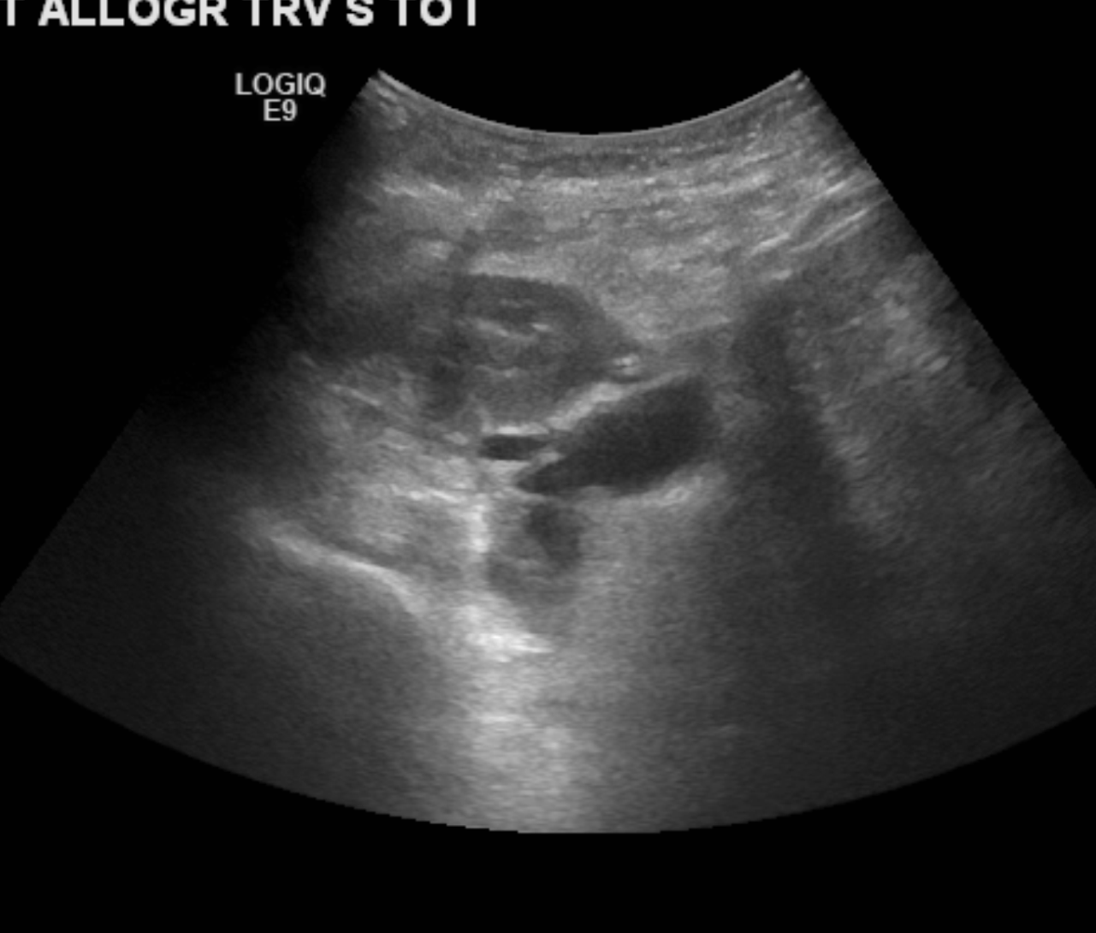
Case#5
15 YO female s/p renal transplant 3 weeks ago, Now p/w right leg pain and bruit over transplant

Slide 52
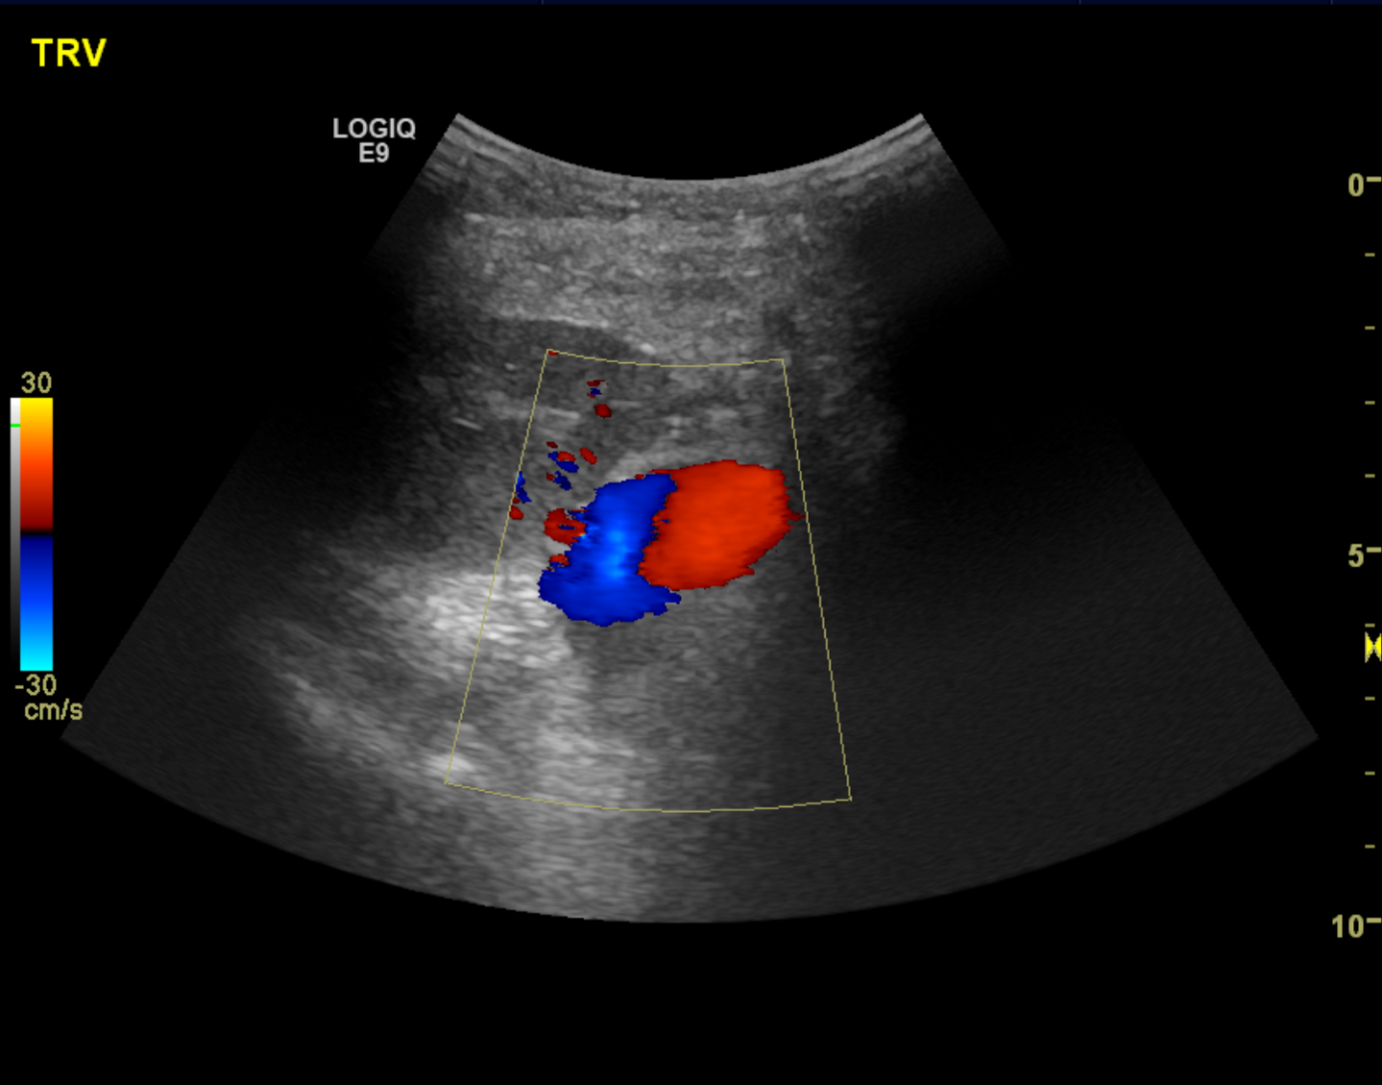


Slide 53
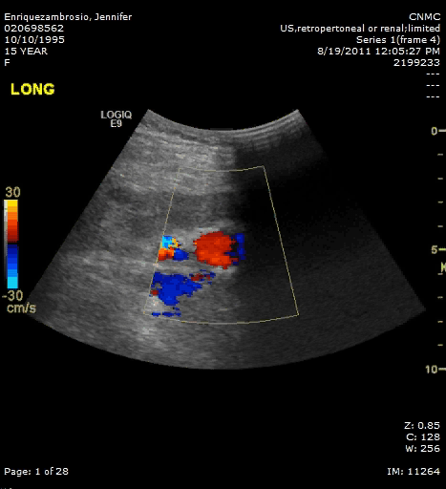

Slide 54
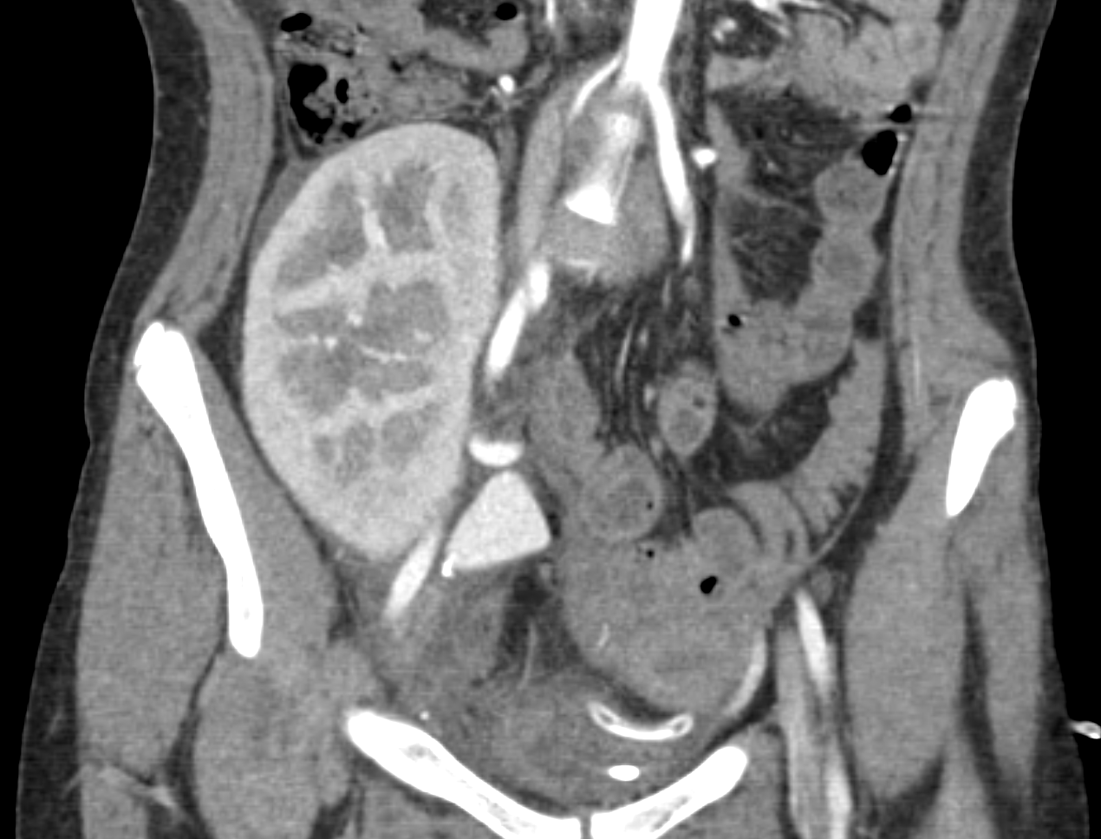

Slide 55
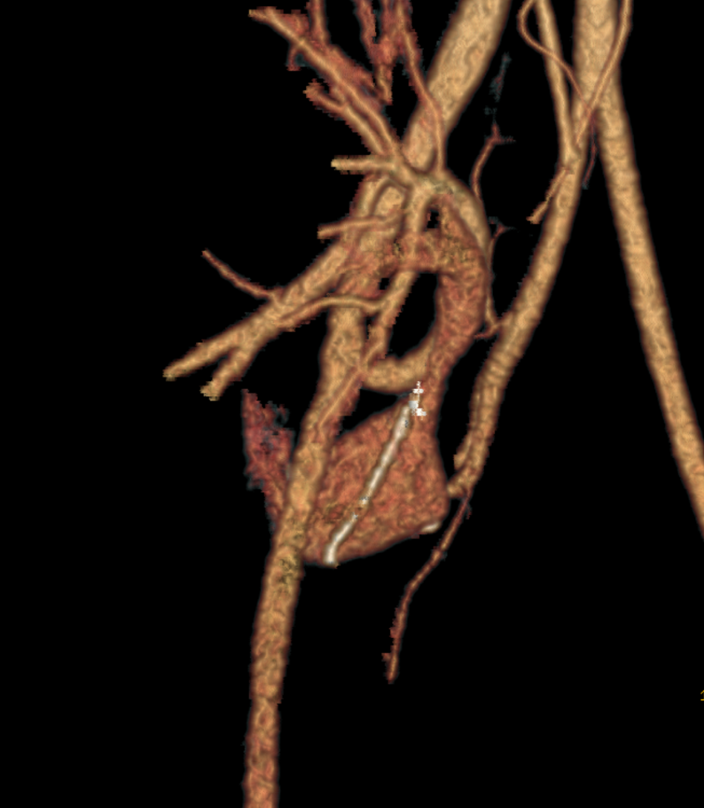

Slide 56

Part 2
Imaging of liver transplant and complications

Slide 57
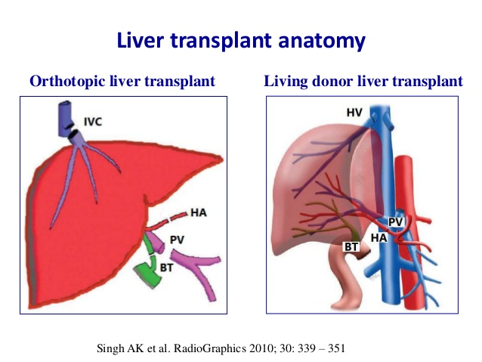
How liver transplant is done?

Slide 58
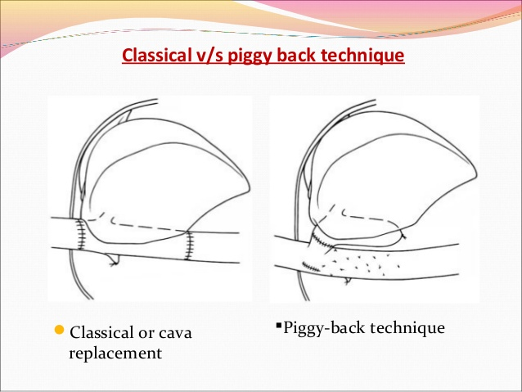
https://www.google.com/url?sa=i&rct=j&q=&esrc=s&source=images&cd=&cad=rja&uact=8&ved=0ahUKEwj8m8GTyezMAhUUOVIKHbRVDh8QjB0IBg&url=http%3A%2F%2Fwww.slideshare.net%2Fhr77%2Fliver-transplantation-workshop&psig=AFQjCNG9oyM1ejUGzHD5K6G8KXBZBgVPRw&ust=1463968227732760

Slide 59
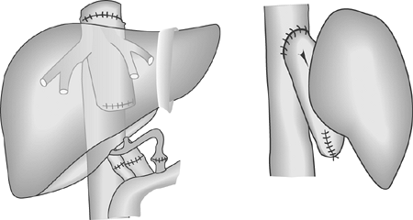
https://www.google.com/url?sa=i&rct=j&q=&esrc=s&source=images&cd=&cad=rja&uact=8&ved=0ahUKEwiis7O6yezMAhUURVIKHZ4hBPQQjB0IBg&url=http%3A%2F%2Fezio.com.br%2Futi%2Findex%2F187.html&psig=AFQjCNG9oyM1ejUGzHD5K6G8KXBZBgVPRw&ust=1463968227732760

Slide 60
Normal liver transplant Doppler imaging
Hepatic artery
Direction
Waveform → arterial with continuous diastolic flow
PSV <200 cm/sec
RI 0.5-0.8

Slide 61
Portal vein
Direction → towards the liver (hepatopedal)
Waveform → monophasic with phasicity
Hepatic veins
Direction →away from liver
Waveform → triphasic
IVC

Slide 62
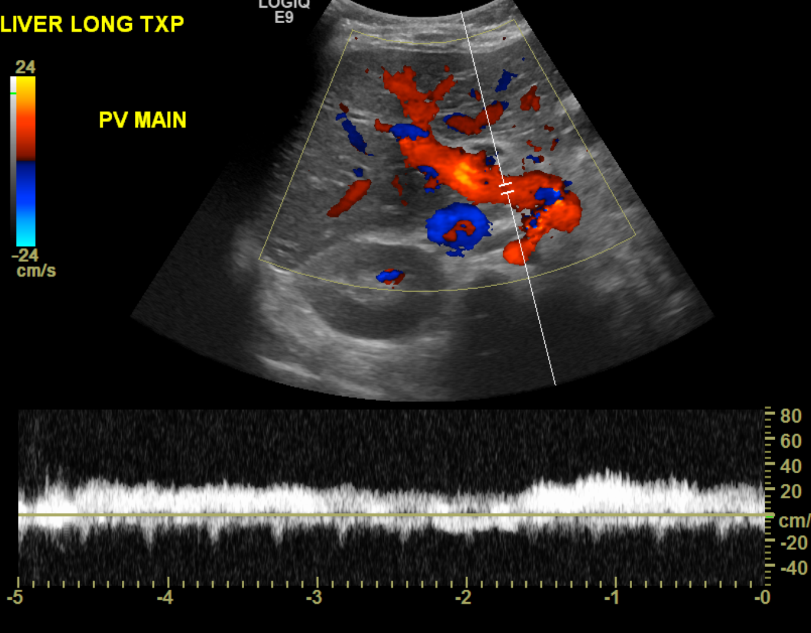
Normal liver transplant Doppler exam
Main Portal vein

Slide 63

Hepatic artery

Slide 64

Left portal vein

Slide 65

Right portal vein

Slide 66



Hepatic veins

Slide 67



Slide 68
Complications of liver transplant
Vascular complications
Biliary complications
Other complications; such as hematoma, infection, neoplasm…etc

Slide 69
Vascular complications
Hepatic artery
Portal vein
IVC
Hepatic veins

Slide 70
Hepatic artery
Stenosis
2-11%
Poor surgical technique or clamp injury
Low RI
Tardus parvus waveform distally
PSV >200 cm/sec
Thrombosis
MC vascular complication
Graft rejection
Common in pediatric population
Non-visualization of HA

Slide 71
Hepatic artery
Pseudoaneurysm
AVF

Slide 72

Case#6 s/p liver transplant elevated LFT
Caiado Et al , Radiographics 2007

Slide 73
Portal vein
Less common 1-13%
Stenosis
At anastmosis
Faulty surgical technique
Discrepancy between calibers
Hypercoagulability
velocity >125 cm/sec
3:1 difference in velocity

Slide 74
Portal vein
2) Thrombosis
3%
Main extrahepatic segment
Treated by Angioplasty or surgical resection
Absent flow
Anechoic/hypoechoic clot

Slide 75
History: liver transplant portal vein thrombosis increase bilirubin
levels
Duplex evaluation of the abdomen correlated with previous ultrasound
from 8/8/2012 and previous CT from 8/21/2012. Patient is status post
liver transplant. Prominent hepatic veins which are patent are again
present. At the region of the porta hepatis there is again noted
moderately dilated anechoic structure measuring up to 7 mm in short
axis, this likely reflects the thrombosed portal vein. The left
portal vein is visualized and appears patent. Multiple collateral
vessels are seen by the porta hepatis. The hepatic artery is
visualized centrally and has good flow with a resistive index of
0.53. No definite intrahepatic ductal dilatation is seen. No focal
hepatic masses detected.
Patient status post splenectomy. Region of pancreas is not well seen.
There is right lower quadrant renal transplant in place measuring
approximately 12 cm in length, this is larger than on the previous
examination at which time it measured approximately 10 cm in length.
Some of this may be due to differences in measurement. No
hydronephrosis or focal renal mass is seen. Duplex evaluation of the
renal allograft shows resistive indices ranging from 0.65 at the main
renal artery to 0.78 at the anastomosis with the iliac artery. There
is patency of the main renal vein of the allograft. No perinephric
fluid collection is seen by the transplant.
Urinary bladder is normal in size in 2 planes and is moderately
distended. No free fluid is seen within the pelvis.
Native kidneys are small.
Impression: No definite intrahepatic biliary ductal dilatation is
seen.
Likely central portal venous thrombosis.
Good flow seen within the hepatic veins as well as the hepatic artery
within the liver transplant.
Normal appearance to the right lower quadrant renal transplant.

Slide 76

Case# 7
11 y.o s/p liver transplant now with increase bilirubin levels

Slide 77



Slide 78


Slide 79



Slide 80


Slide 81
CT venogram of the abdomen, 6/30/2015.
HISTORY: 13-year-old female with history of sickle cell and biliary
atresia, liver and renal transplant, portal hypertension GI bleeding.
Evaluate anatomy.
TECHNIQUE: Multidetector axial images were obtained of the abdomen
following uneventful administration of 85 cc Visipaque 320
intravenous contrast. Images were reformatted in the coronal and
sagittal planes. Oral contrast was not given.
COMPARISON: 6/21/2015 and 8/21/2012.
FINDINGS:
Gastrojejunostomy tube with prominent loop in the stomach, tip in the
mid to distal duodenum. Extensive post-operative changes
redemonstrated related to prior bowel surgeries as well as liver and
renal transplant, including numerous surgical clips and embolization
coils. Vascular stent in the upper posterior midline abdomen that
does not opacify with contrast, uncertain as to the nature of the
structure being stented, but stable in appearance).
Transplant liver demonstrates pneumobilia, not evident on recent
study from 6/21/2015 and increased compared with 8/21/2012. There are
branching low-attenuation areas centrally in the liver suggesting
central biliary ductal dilatation, probably present on 6/21/2015 and
slightly increased compared with 8/21/2012. Liver demonstrates mildly
heterogeneous enhancement, including a few small triangular areas of
more prominent non-mass-like enhancement; for instance, 1.4 cm x 1 cm
area along the anterior peripheral edge (series 3 image 14) and 1.6
cm x 0.7 cm area more inferiorly and laterally (series 3 image 44),
which may reflect areas of transient hepatic attenuation difference
related to differential hepatic artery and portal venous blood flow.
The main portal vein is not seen. Enhancing vascular structures are
seen paralleling the intrahepatic central biliary tree, likely
representing portions of the right and left portal veins. They appear
patent, although become very small in caliber centrally. The superior
mesenteric vein is patent, and extends into a cluster of numerous
smaller tortuous vessels in and about the porta hepatis (in
particular circumferentially about the first and proximal second
portion of the duodenum), compatible with collateral vessels in the
setting of previous portal vein thrombosis and cavernous
transformation. One of the larger vessels extending from the superior
mesenteric vein into the collateral network (series 3 images 35-38)
may suggest prior surgical (Rex) shunt; correlate with surgical
history. Additional small vessels extending from the bowel appear to
drain directly into other collateral vessels in the porta hepatis.
The IVC is well opacified. The hepatic veins are not as well
opacified, likely related to slightly early phase of imaging. Spleen
has been resected and the splenic vein is not identified. Inferior
mesenteric vein is not clearly delineated.
Abdominal aorta is normal in course, caliber, and contour. Celiac
trunk and SMA origins are patent. Proximal portion of the hepatic
artery is patent, and the distal portion is not well characterized.
Splenic artery not present, status post splenectomy, with surgical
clips noted adjacent to the celiac trunk.
Gallbladder and spleen are surgically absent. Pancreas enhances
homogeneously. Both native kidneys are again noted to be atrophied.
Visualized portion of right lower quadrant transplant kidney enhances
normally. No evidence of free air or significant ascites in the
included abdomen. Stable scattered mildly prominent mesenteric and
retroperitoneal lymph nodes.
Visualized loops of bowel are mildly prominent in caliber, similar to
prior study, without specific evidence of obstruction or pneumatosis.
Included lung bases are clear of consolidation. No pleural effusions
noted.
Post-surgical changes of the anterior abdominal wall. Transitional
lumbosacral vertebral anatomy. No acute osseous abnormalities noted.
IMPRESSION:
1. Cavernous transformation of the main portal vein with numerous
collateral vessels. Patent superior mesenteric vein, as well as
additional smaller vessels, draining into the collateral network.
Prominent tortuous vessels about the proximal duodenum suggest
duodenal varices. Patent right and left portal venous branches, but
very small in caliber centrally. Hepatic veins not well opacified,
likely related to slightly early phase imaging. Absent splenic vein
in the setting of previous splenectomy.
2. Post-surgical changes related to liver and renal transplant,
include surgically absent gallbladder. Heterogeneous enhancement of
the liver, including a few non-mass-like areas that demonstrate
prominent enhancement, favored to represent transient hepatic
attenuation difference in the setting of differential portal venous
and hepatic arterial blood flow.
3. Dilatation of the central biliary tree and pneumobilia, mildly
increased compared with prior studies.
4. Right lower quadrant renal transplant. Atrophic native kidneys.
5. Mildly prominent bowel loops, similar to prior study, without
evidence of high-grade obstruction or pneumatosis.
6. Gastrojejunostomy tube, tip in the mid to distal duodenum but with
segment curled back into the stomach.

Slide 82


Slide 83


Slide 84


Follow up

Slide 85
In Summery
Stenosis
→ tardus parvus waveform distally & low RI
→Aliasing and increase velocity @ stenosis
→ look for stenosis → do CTA/MRA if you couldn’t identify it on US
Thrombosis → anechoic/hypoechoic clot and no flow
Pseudoaneurysm →yin-yang sign
AVF → turbulent flow and arterialized vein

Slide 86
References
Coley BD. Pediatric applications of abdominal vascular Doppler imaging: Part I. Pediatr Radiol. 2004;34(10):757-71.
Coley BD. Pediatric applications of abdominal vascular Doppler: Part II. Pediatr Radiol. 2004;34(10):772-86.
Akbar SA, Jafri SZ, Amendola MA, Madrazo BL, Salem R, Bis KG. Complications of renal transplantation. Radiographics. 2005;25(5):1335-56.
Singh AK, Nachiappan AC, Verma HA, et al. Postoperative imaging in liver transplantation: what radiologists should know. Radiographics. 2010;30(2):339-51.
Suzuki L, De oliveira IR, Widman A, et al. Real-time and Doppler US after pediatric segmental liver transplantation : I. Portal vein stenosis. Pediatr Radiol. 2008;38(4):403-8.

Slide 87
Thank you

