Slide 1
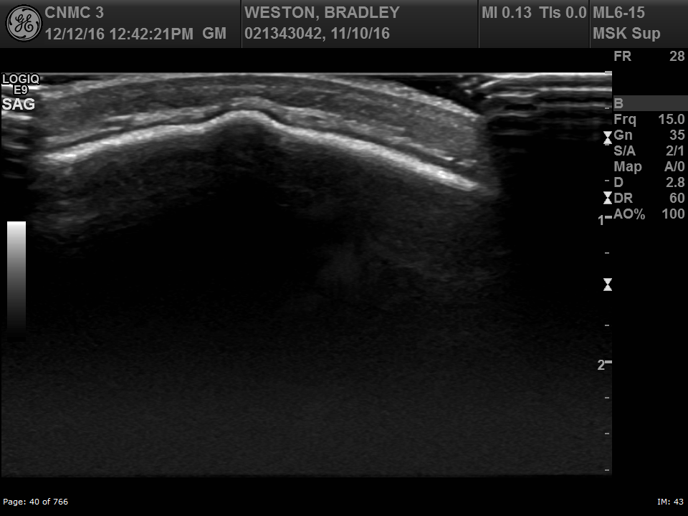
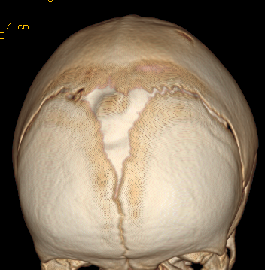
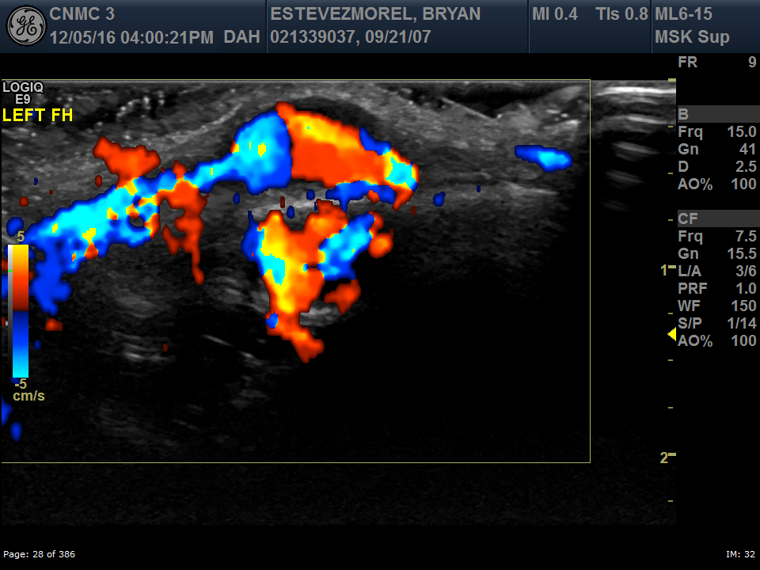
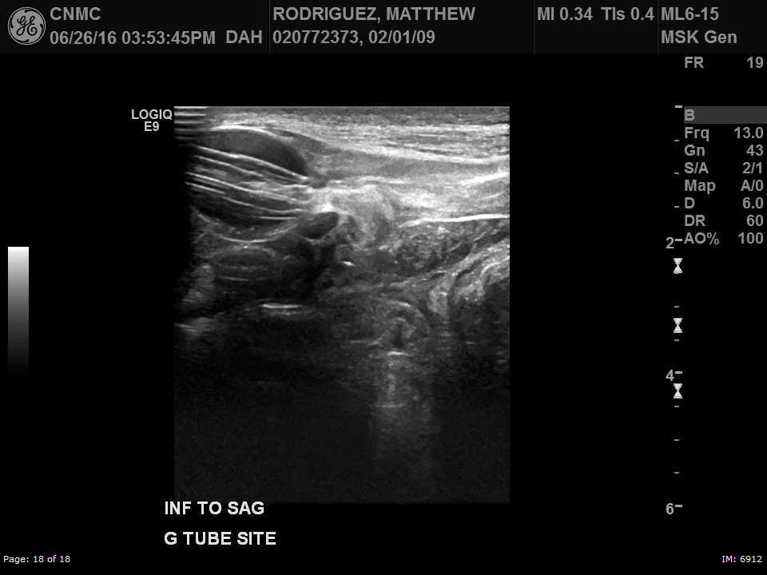
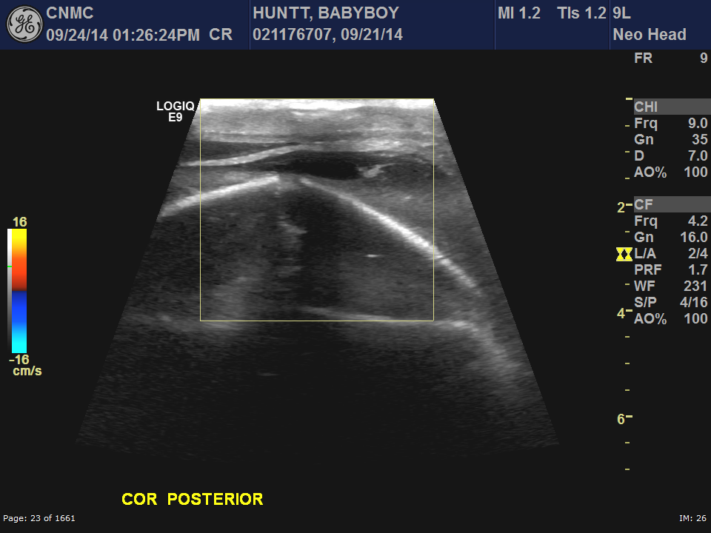
Ultrasound QA Conference
Anjum Bandarkar, M.D.
Children’s National Health System,
Washington D.C.

Slide 2
Objectives
1. Describe cranial suture ultrasound for craniosynostosis
Differentiate cephalohematoma from subgaleal hematoma
Evaluate G-tube balloon placement using ultrasound
Tracking PICC lines & variant venous anatomy
Demonstrate Pseudoaneurysm of Superficial temporal artery

Slide 3
Objectives
1. Describe cranial suture ultrasound for craniosynostosis
Differentiate cephalohematoma from subgaleal hematoma
Evaluate G-tube balloon placement using ultrasound
Tracking PICC lines & variant venous anatomy
Demonstrate Pseudoaneurysm of Superficial temporal artery

Slide 4
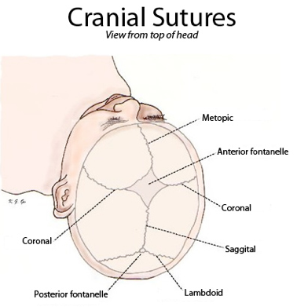
Cranial Suture Ultrasound

Slide 5
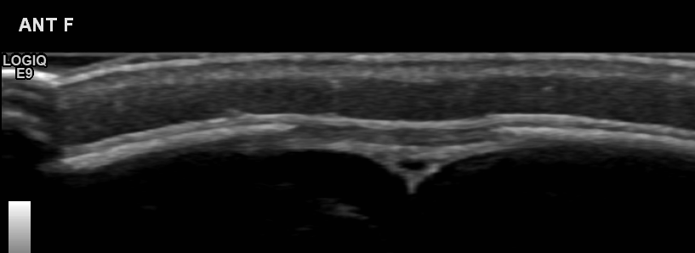
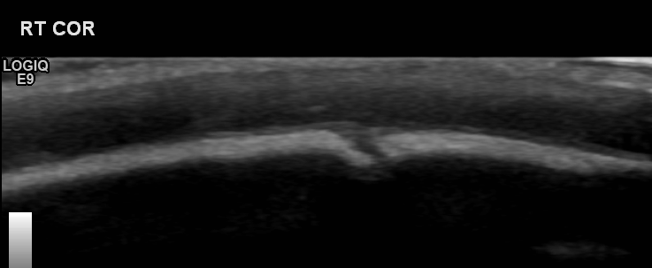
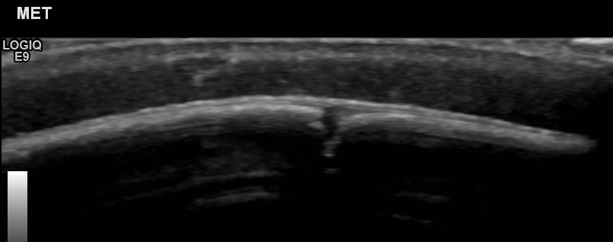
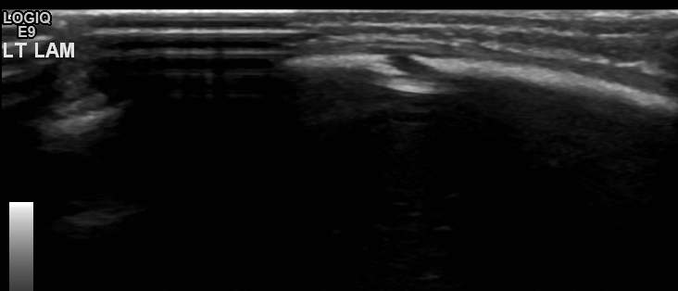
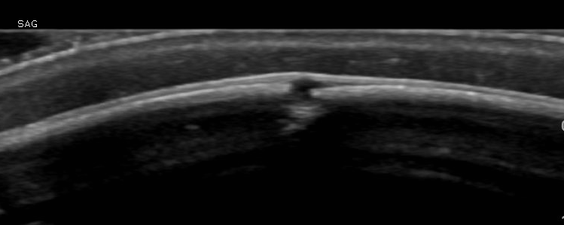
Cranial Suture Ultrasound
Normal sutures

Slide 6
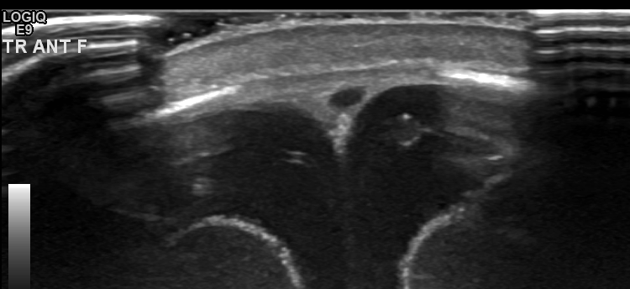
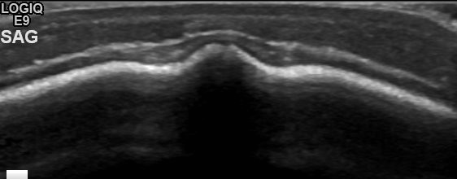
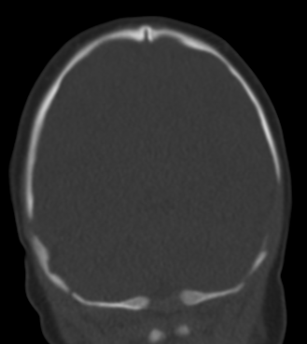
Cranial Suture Ultrasound
Sagittal synostosis

Slide 7
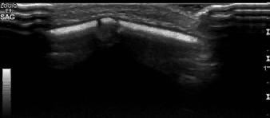
Cranial Suture Ultrasound

Slide 8
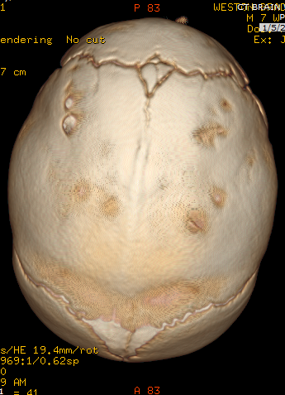
Cranial Suture Ultrasound
Sagittal synostosis: Premature fusion of sagittal suture
Dolichocephalic / Scaphocephalic skull
Ridging of fused suture
Increased AP dimension of skull
Restricted biparietal growth

Slide 9
Cranial Suture Ultrasound
Craniosynostosis: Premature fusion of sutures
Calvarial bones grow perpendicular to suture lines
Birth prevalence 3-5 per 10,000 live births
Surgical management bet. 3 – 9 months
Strip craniectomy, Barrel-stave osteotomies

Slide 10
Objectives
1. Describe cranial suture ultrasound for craniosynostosis
Differentiate cephalohematoma from subgaleal hematoma
Evaluate G-tube balloon placement using ultrasound
Tracking PICC lines & variant venous anatomy
Demonstrate Pseudoaneurysm of Superficial temporal artery

Slide 11
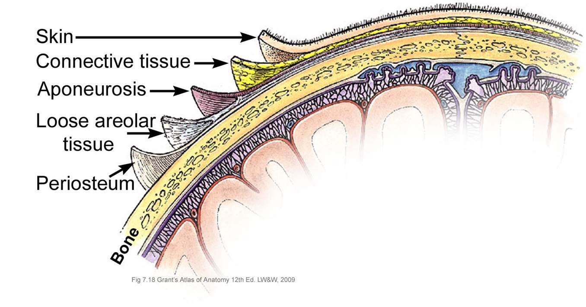
Cephalohematoma
SCALP Layers

Slide 12
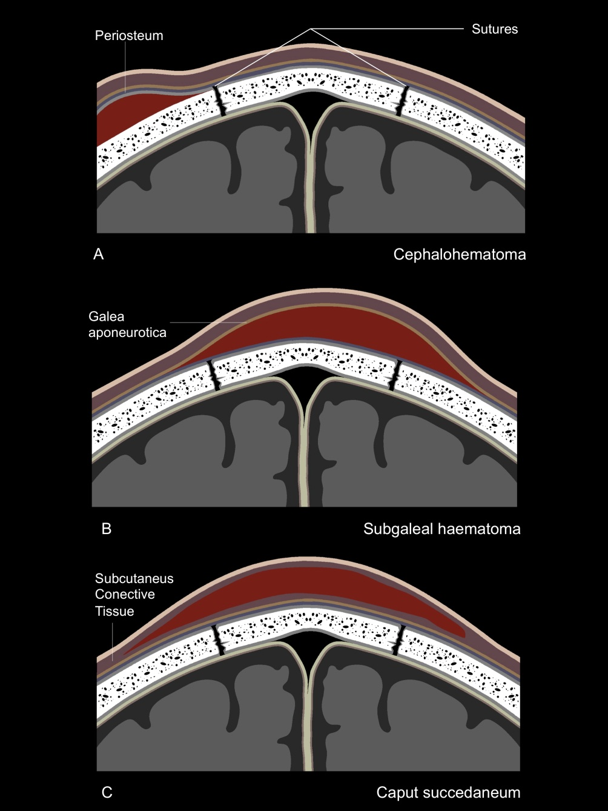
Cephalohematoma

Slide 13
Cephalohematoma
Usually develops after delivery using instruments
Soft tissue mass on the head usually in the parietal region
May not be visible at birth but should appear by day 2-3
Subperiosteal hematoma
No associated skull fracture
Limited by suture lines
Large cephalohematomas may occur with vitamin K deficiency
in the newborn

Slide 14
Cephalohematoma
Differential Diagnosis:
Subgaleal hemorrhage
  Into the subaponeurotic space from rupture of the emissary veins
  Crosses suture lines
  Covers a much larger area than a cephalohematoma
  Potentially life-threatening
  50% occur with vacuum extraction
Caput succedaneum
  Occurs after vaginal delivery
  Subcutaneous hemorrhage requiring no intervention
  Not limited by suture lines

Slide 15
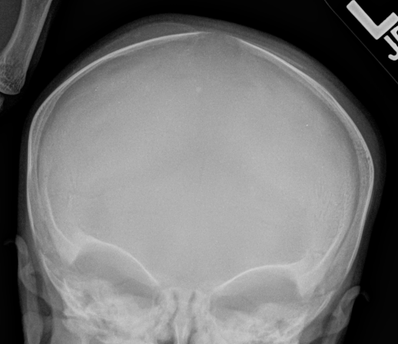
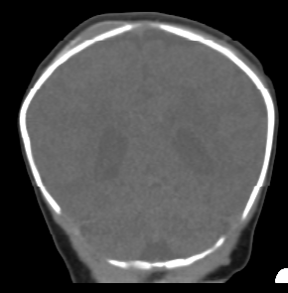
Cephalohematoma

Slide 16
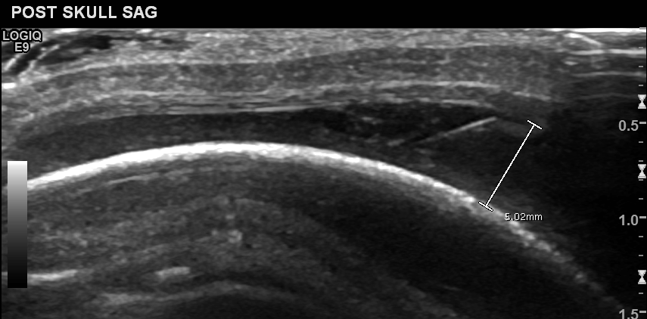
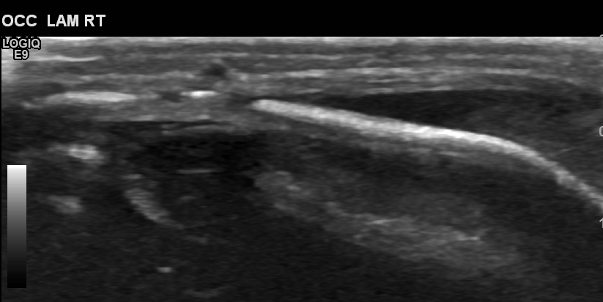
Cephalohematoma

Slide 17
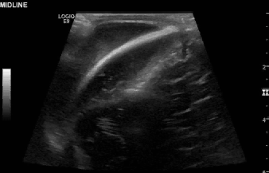
Cephalohematoma

Slide 18
Subgaleal hematoma

Slide 19
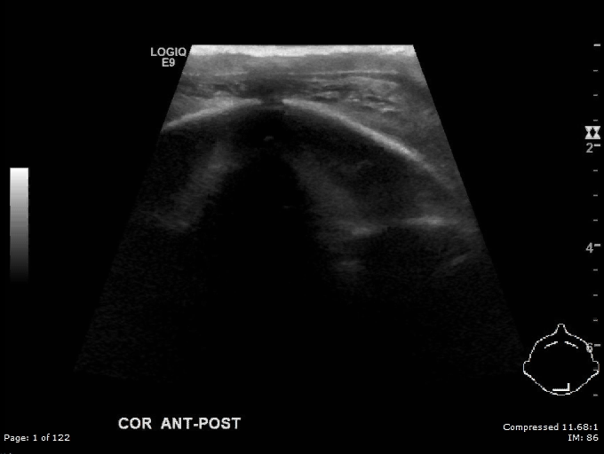
Subgaleal hematoma

Slide 20
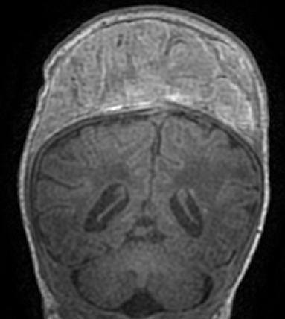
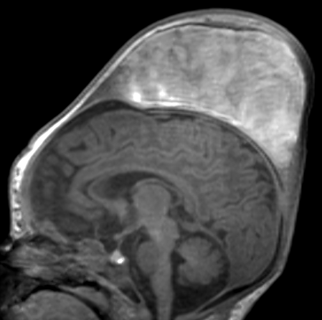
Subgaleal hematoma

Slide 21
Cephalohematoma vs
Subgaleal hematoma
Need to use Linear high frequency M6-15 MHz probe
Need to demonstrate relationship with adjacent suture

Slide 22
Objectives
1. Describe cranial suture ultrasound for craniosynostosis
Differentiate cephalohematoma from subgaleal hematoma
Evaluate G-tube balloon placement using ultrasound
Tracking PICC lines & variant venous anatomy
Demonstrate Pseudoaneurysm of Superficial temporal artery

Slide 23
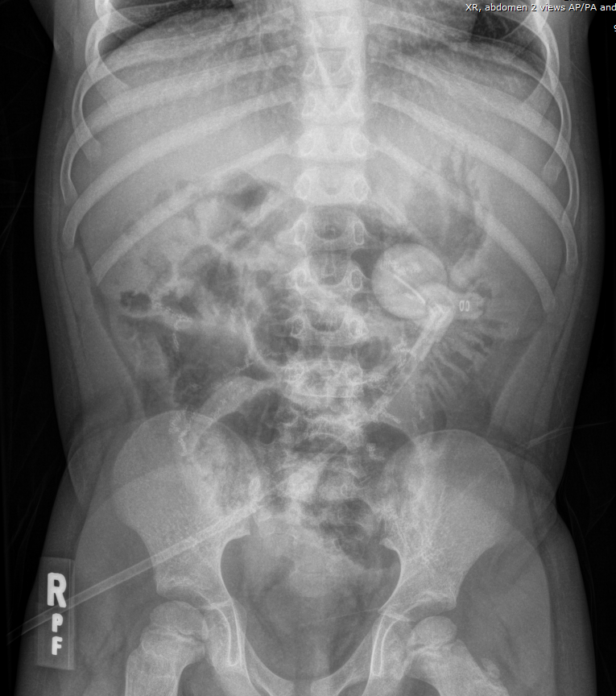
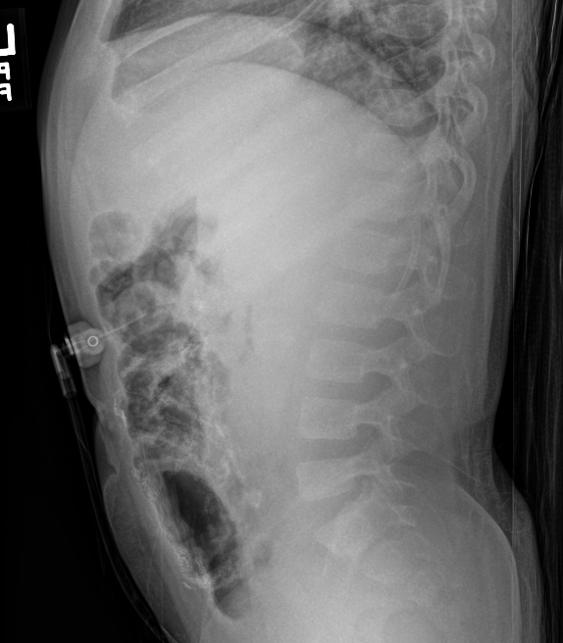
Gastrostomy tube check US
Normal intragastric position of Gtube balloon

Slide 24
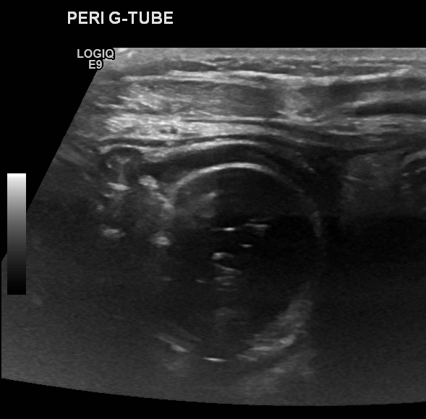
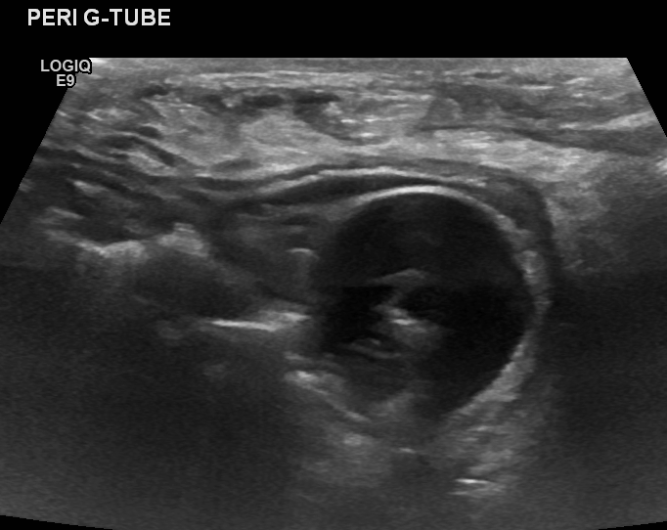
Gastrostomy tube check US
Normal intragastric position of
Gtube balloon

Slide 25
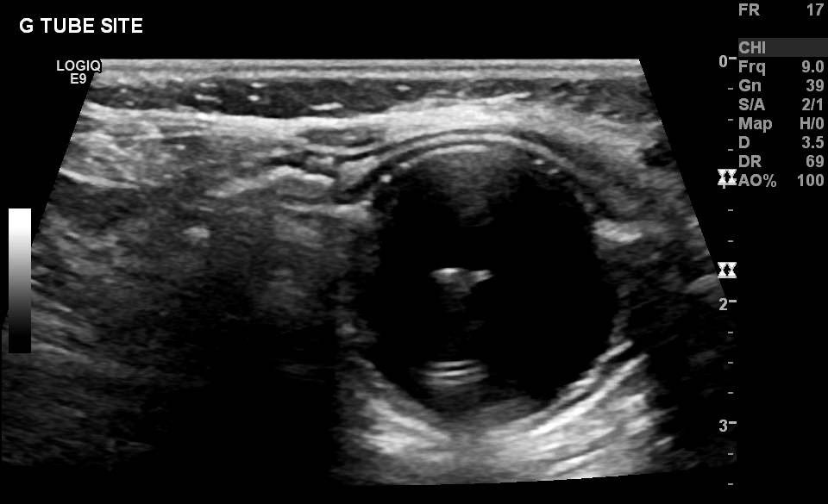
Gastrostomy tube check US
Normal intragastric position of Gtube balloon

Slide 26
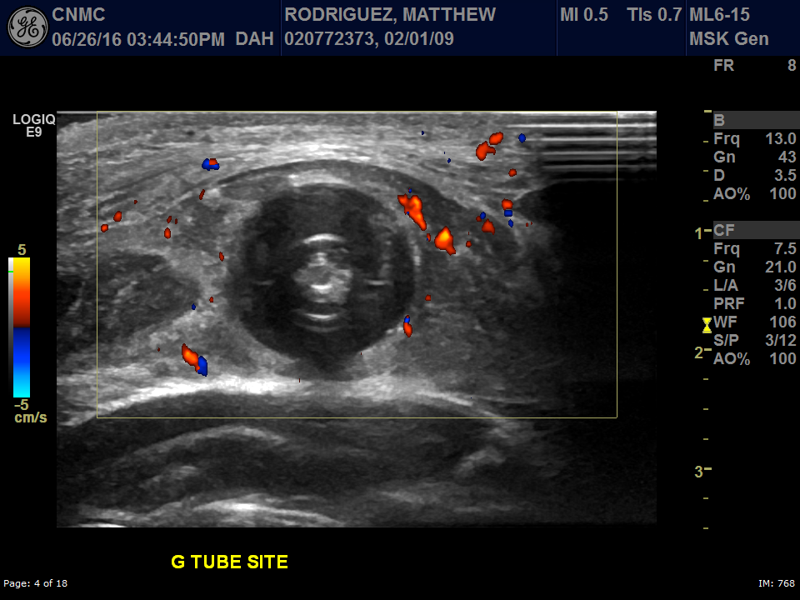
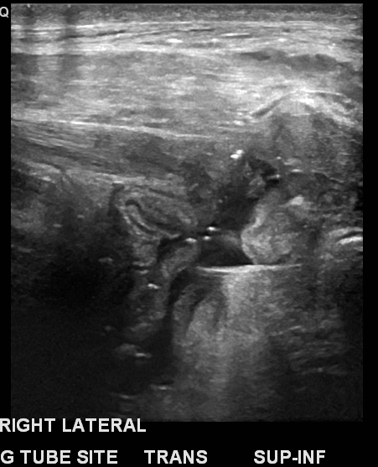
Gastrostomy tube check US
Subcutaneous location of G-tube balloon

Slide 27
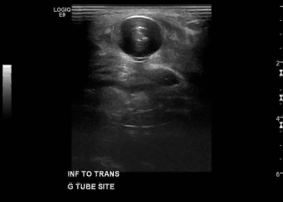
Gastrostomy tube check US
Subcutaneous location of G-tube balloon

Slide 28
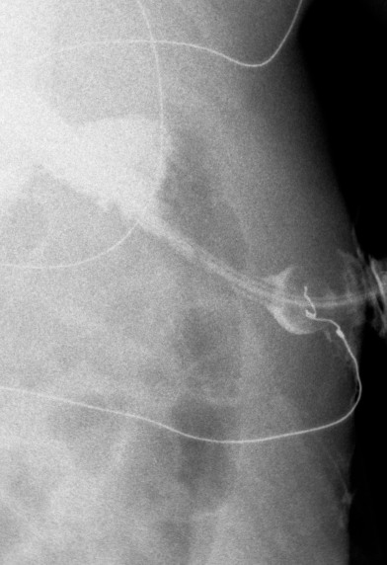
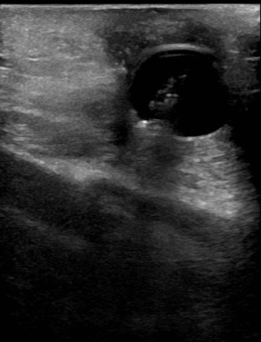
Gastrostomy tube check US
Subcutaneous location of G-tube balloon in the abdominal wall tract

Slide 29
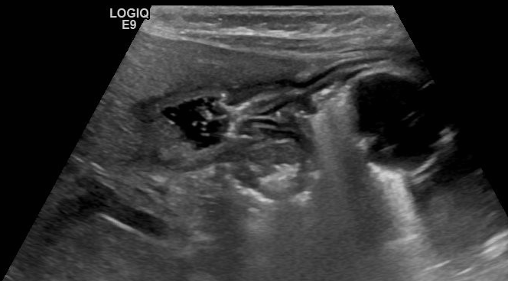
Gastrostomy tube check US
Gtube balloon located close to the pylorus

Slide 30
Objectives
1. Describe cranial suture ultrasound for craniosynostosis
Differentiate cephalohematoma from subgaleal hematoma
Evaluate G-tube balloon placement using ultrasound
Tracking PICC lines & variant venous anatomy
Demonstrate Pseudoaneurysm of Superficial temporal artery

Slide 31
Tracking PICC lines & variant veins
Need to check x-ray before starting US exam
Need to demonstrate PICC line course adequately
For variant IVC anatomy, need transverse images through midline

Slide 32
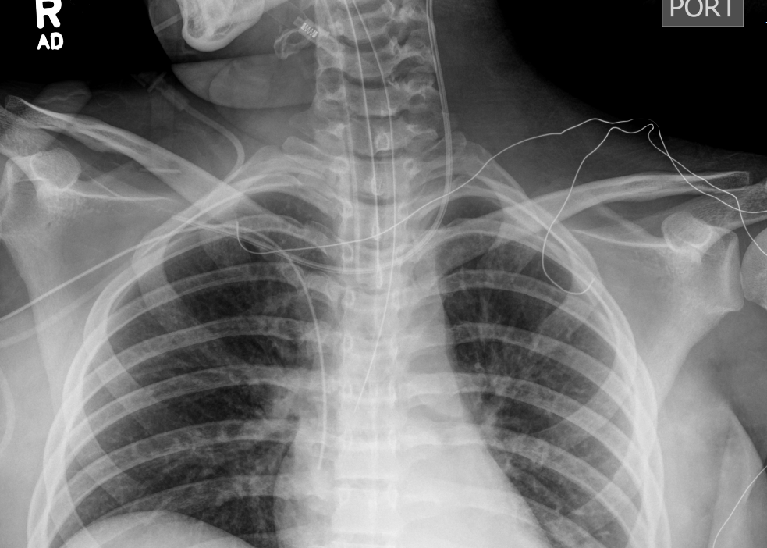
Tracking PICC lines & variant veins

Slide 33
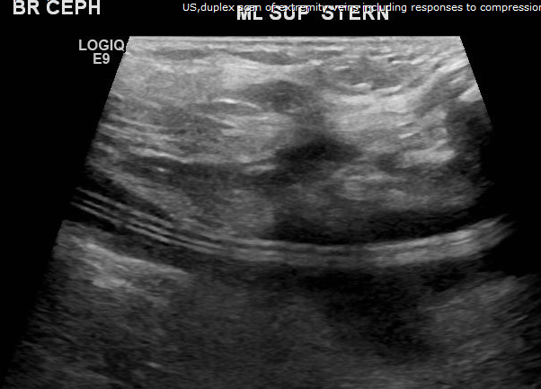
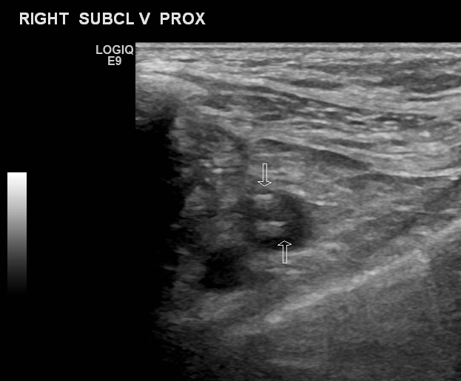
Tracking PICC lines & variant veins
Central line crosses from left
brachiocephalic to right subclavian.

Slide 34
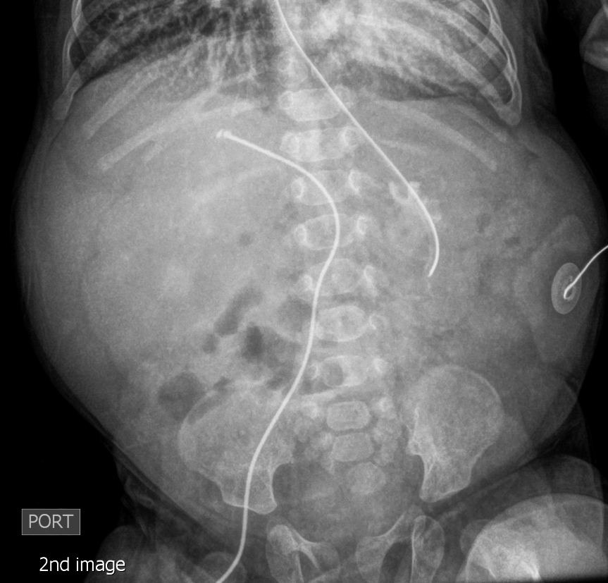
Tracking PICC lines & variant veins

Slide 35
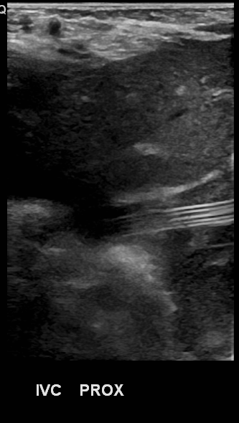
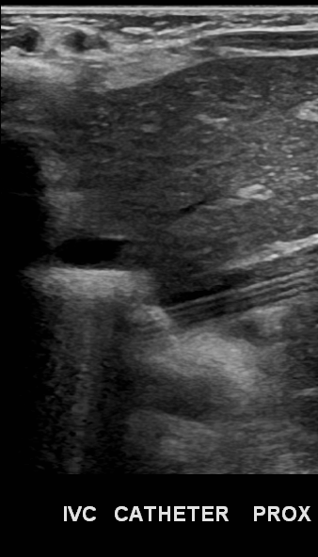
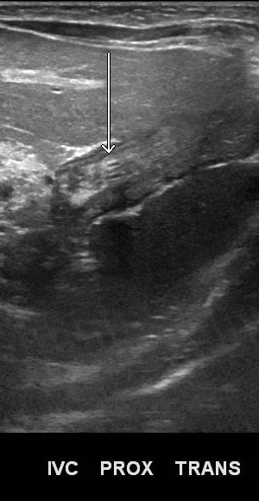
Tracking PICC lines & variant veins

Slide 36
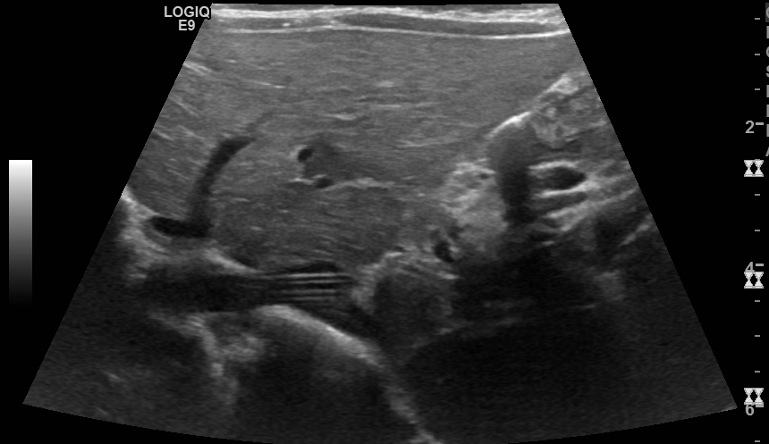
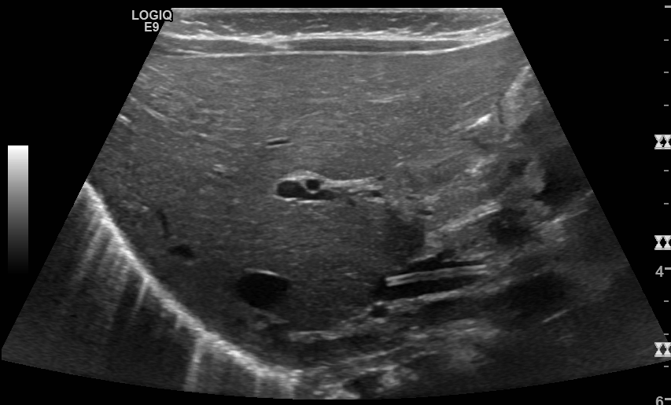
Tracking PICC lines & variant veins
Central line versus enteric tube

Slide 37
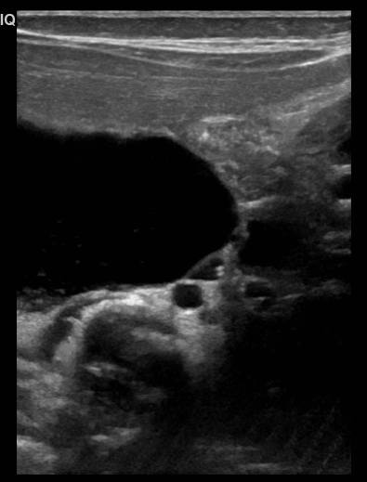
Tracking PICC lines & variant veins

Slide 38
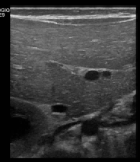
Tracking PICC lines & variant veins

Slide 39
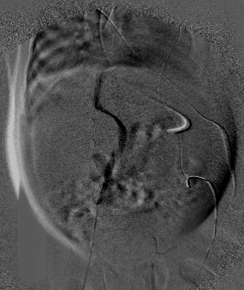
Tracking PICC lines & variant veins

Slide 40
Objectives
1. Describe cranial suture ultrasound for craniosynostosis
Differentiate cephalohematoma from subgaleal hematoma
Evaluate G-tube balloon placement using ultrasound
Tracking PICC lines & variant venous anatomy
Demonstrate Pseudoaneurysm of Superficial temporal artery

Slide 41
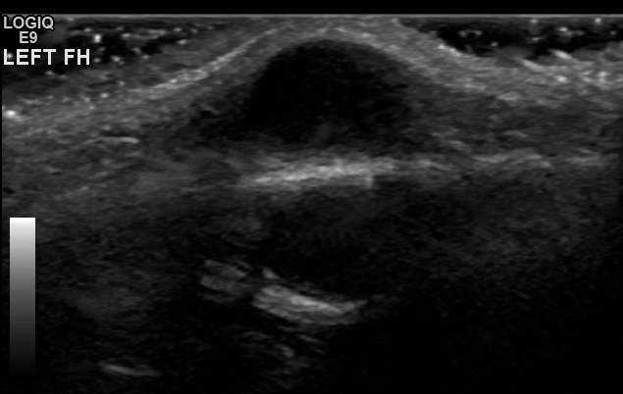

Pseudoaneurysm of
Superficial Temporal Artery
9-year-old boy who fell from
his bike 2 months ago and
noticed a bump along the
left side of his forehead.

Slide 42
Pseudoaneurysm of
Superficial Temporal Artery

Slide 43


Pseudoaneurysm of
Superficial Temporal Artery

Slide 44


Pseudoaneurysm of
Superficial Temporal Artery

Slide 45
Pseudoaneurysm of
Superficial Temporal Artery
Post traumatic pseudoaneurysm of superficial temporal artery
Pulsatile mass
Swirling flow and yin-yang sign on Doppler – bidirectional flow

Slide 46
Thank you!

