Slide 1
US for Diagnosis of Musculoskeletal Conditions in the Young Athlete: Emphasis on Dynamic Assessment
Nimisha Mehta, MD

Slide 2
Introduction
Ultrasound is an important tool for diagnosis and therapeutic management of a variety of MSK conditions
Advantage of US in the young athlete is the ability to diagnose dynamic conditions that are occult with other modalities – provide additional info & aid in treatment

Slide 3
Objectives
Normal Patterns
Acquired MSK conditions – tendon and ligament disorders
Congenital variants
  Conditions affecting the ulnar nerve

Slide 4
Normal Patterns
High frequency linear probe
Tendons – echogenic fibrillar structures with multiple parallel lines in longitudinal plane and “dotlike” echoes in the transverse plane
  Specular reflection of individual collagen bundles
Ligaments – lamellar arrangement of fibers – fibrillar and hyperechoic

Slide 5
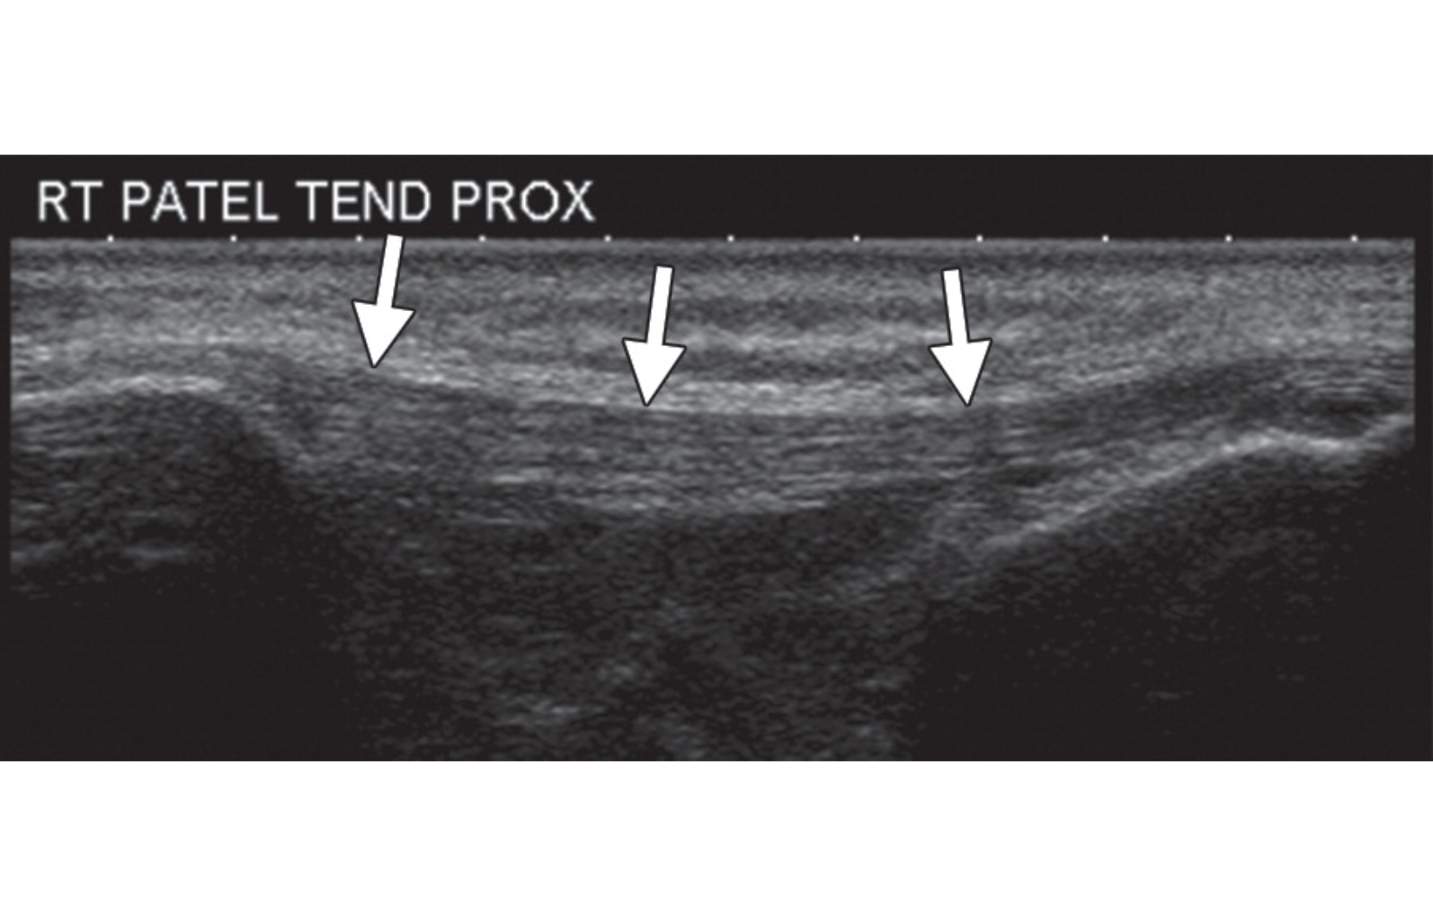
Normal tendon

Slide 6
Anisotropy
Artifact notably in muscles and tendons
Angle of ultrasound beam should be perpendicular to the tendon
  If angle is decreased normal hyperechoic tendon will become darkly hypoechoic and resemble pathology

Slide 7
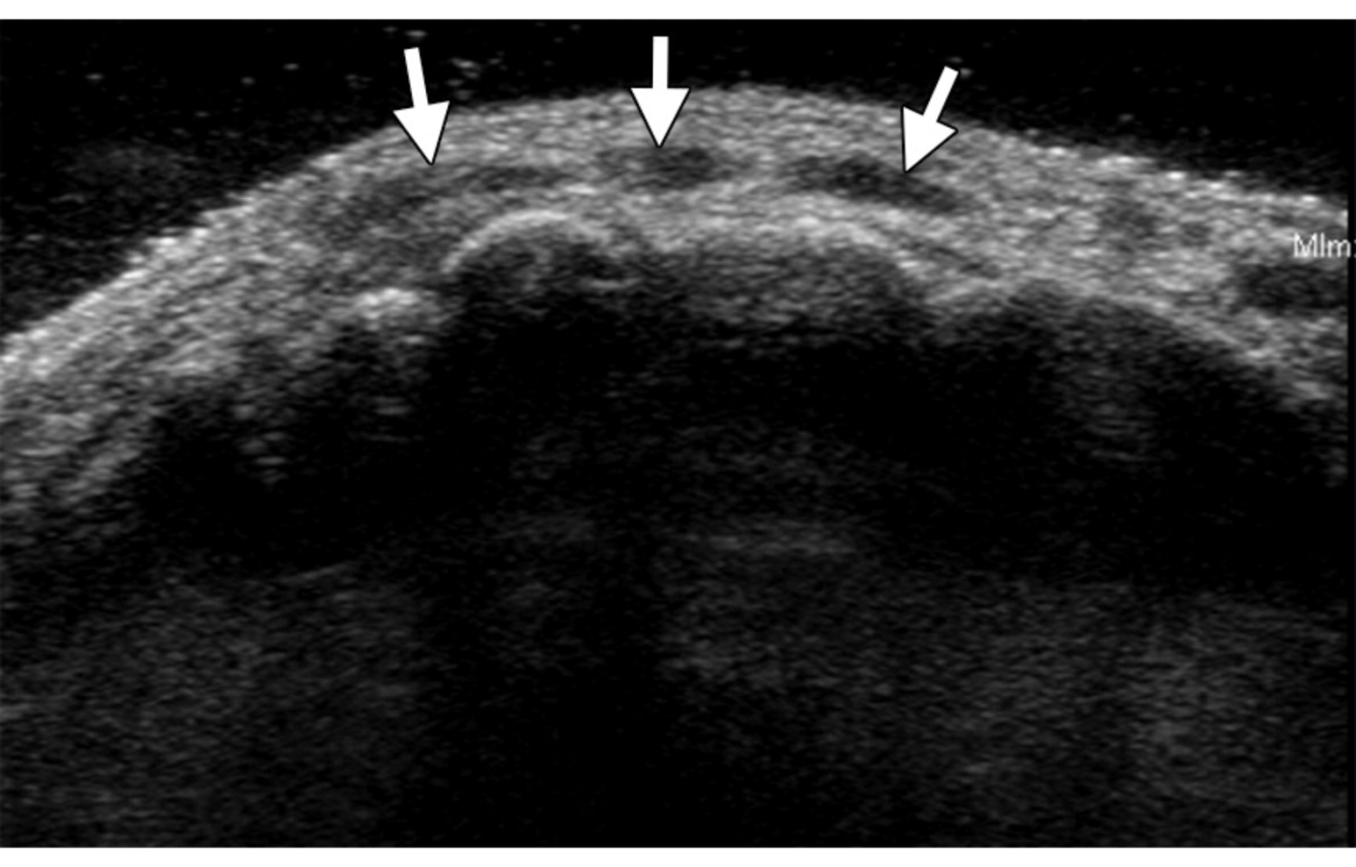
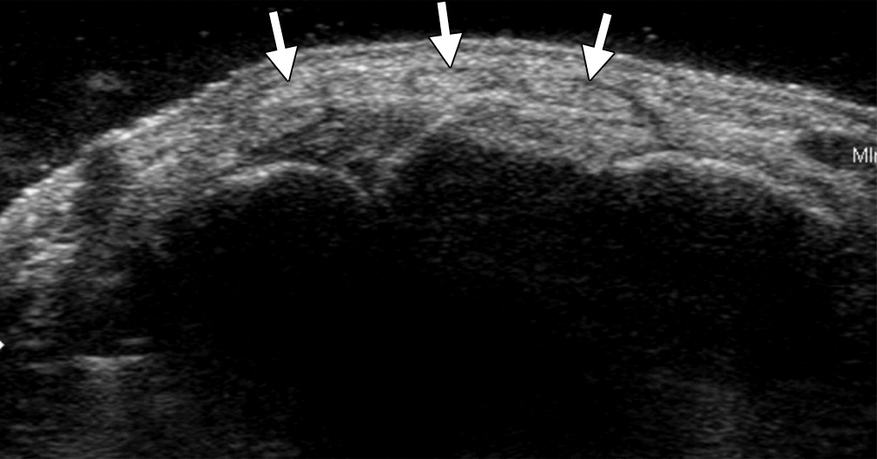
Anisotropy
Notes:
TV image of dorsal wrist near MCP joints

Slide 8
Acquired Conditions
Pediatric population – tendons and ligaments are typically stronger than the growth plate
  Growth plate commonly associated with injuries
Overuse injuries = chronic repetitive traction injury at tendon attachment to an ununited apophysis
Chronic apophyseal stress injuries (osteochondrosis/apophysitis)
  Osgood-Schlatter disease – patellar tendon onto tibial tubercle
  Sinding-Larsen-Johannson syndrome – proximal patellar tendon
  Sever disease – Achilles tendon insertion at the calcaneus
  Triceps tendon insertion at the olecranon

Slide 9
Tendinopathy
Tendinosis – most frequent in athletes
  Collagen degeneration and fiber disorientation
  Increase mucoid ground substance and absence of inflammatory cells
  Neovascularity
US findings of tendinosis
  Focal thickening
  Heterogeneous decreased echogenicity
  Loss of normal fibrillar pattern
  Intratendinous hyperemia
  Occasional calcifications
Proximal patellar tendinosis – “jumper’s knee”
Notes:
Basket term for tendinosis, tendinitis, and paratendinitis
Collagen degeneration and fiber disorientation

Slide 10
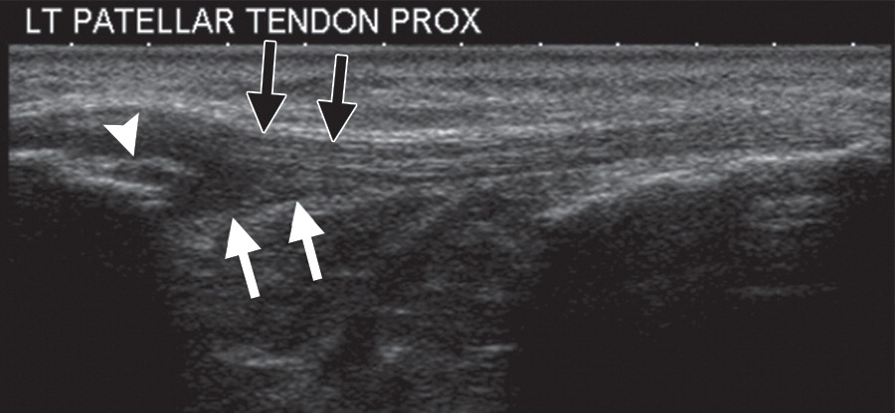
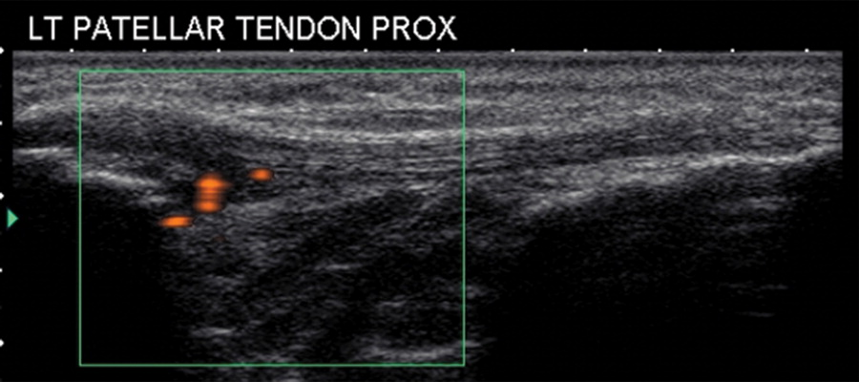
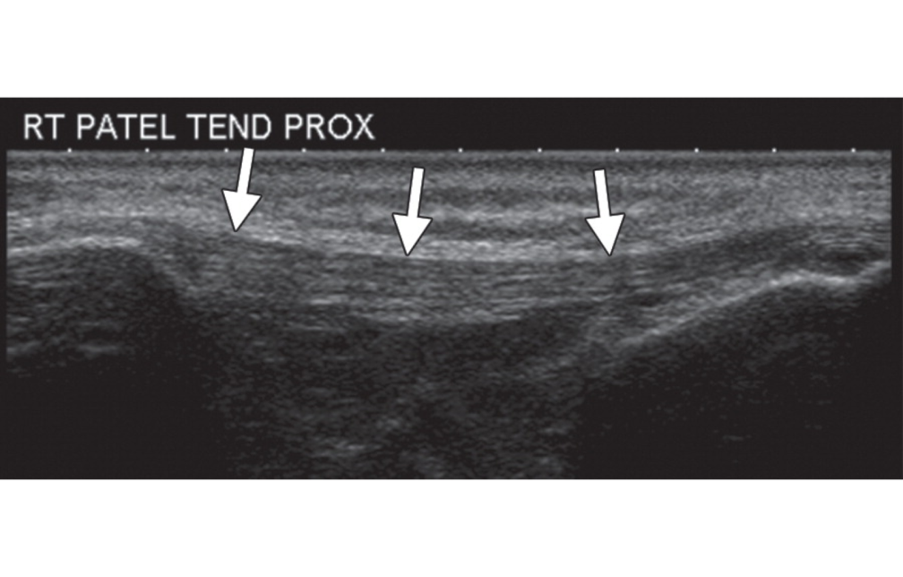
Tendinosis
Longitudinal US image of patellar tendon shows focal thickening, heterogeneous decreased echogenicity, and loss of the normal fibrillar pattern in the deep central fibers (white arrows)
Note the sparing of the more superficial fibers (black arrows) and calcification in the tendon at the enthesis site (arrowhead).
Longitudinal power Doppler US image in the same patient depicts hyperemia in the left patellar tendon.
Normal
Notes:
Hyperemia from neovascularity – not necessarily inflammation

Slide 11
Tenosynovitis
Alone or with tendinosis
Anechoic fluid
Hypoechoic thickened synovial tissue abnormally distending the tendon sheath
US Doppler: Hyperemia in the thickened synovial tissue

Slide 12
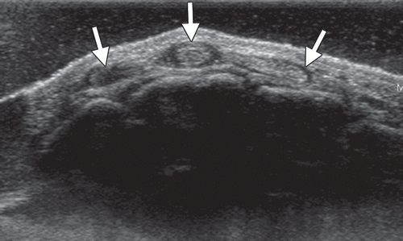
Tenosynovitis
Transverse US image in the same patient as in a, obtained more distally at the level of the proximal metacarpals, shows abnormal thickening with decreased echogenicity of the surrounding tendon sheaths at the level of the middle, index, and (to a lesser extent) ring fingers (arrows), consistent with tenosynovitis.

Slide 13
Partial Tear
Can occur either transverse or longitudinal plane – can be difficult to differentiate from tendinosis
  Transverse partial tear
    Localized hypoechoic blood collection
    Retraction of the partially torn tendon
    Localized irregularity of the tendon surface
  Longitudinal partial tear
    Hypoechoic intrasubstance cleft
Dynamic assessment
  Helpful to depict which tendons are involved

Slide 14
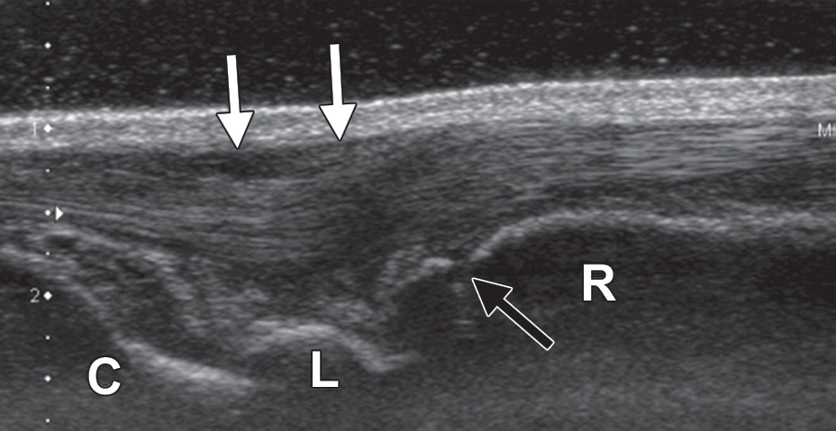
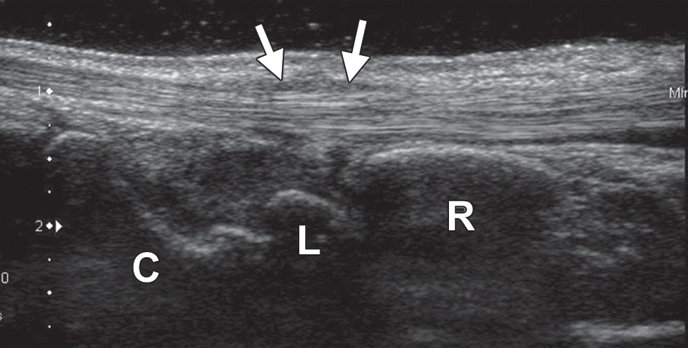
Partial Tear
Normal
Longitudinal US image in a 12-year-old female gymnast with dorsal wrist pain (a) shows abnormal thickening and decreased echogenicity in the tendons, consistent with tendinosis, although some of the findings are due to anisotropy. For comparison, a longitudinal US image in an asymptomatic skeletally mature individual (b) shows the normal hyperechoic appearance of the tendons as they pass through the extensor retinaculum. Black arrow in a = distal radial growth plate, white arrows = extensor retinaculum, C = capitate, L = lunate, R = radius.

Slide 15
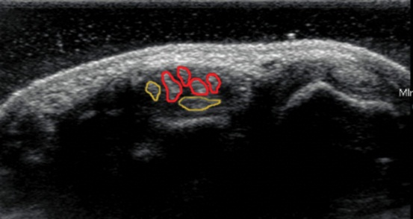
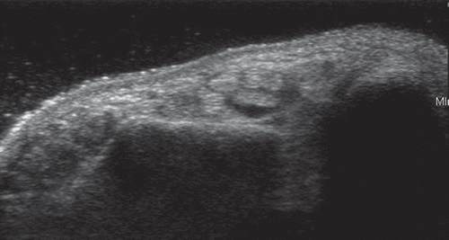
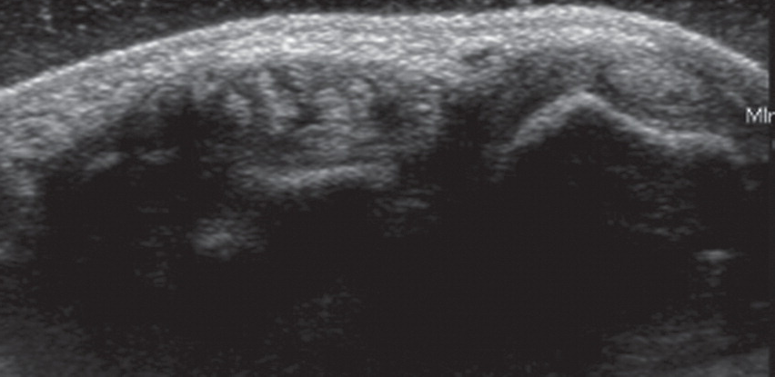
Partial Tear
Normal
Transverse US images in the same patient as in a at the level of the distal radius and ulna, just proximal to the extensor retinaculum, show longitudinal split tears of the extensor digitorum communis tendons to the middle and ring fingers (red outlines in d) and the normal extensor indicis proprius tendon and extensor digitorum communis tendon to the index finger (gold outlines in d).

Slide 17
Full Thickness Tear
Acute
  Hypoechoic blood fills the gap between the tendon edges allowing visualization of the tear
Subacute/chronic setting
  Echogenic material can represent an organized hematoma and fill the defect – mimicking an intact tendon
  Dynamic assessment is helpful
    Passive movement can reveal a nondisplaced tear

Slide 18
Ligament Injuries
Similar to tendons
Tears
  Focal or diffuse areas of decreased echogenicity
  Susceptible to anisotropy
Locations
  Anterior talofibular ligament (ATFL)
  Extra-articular knee ligaments – MCL
  Ulnar collateral ligaments at elbow and thumb

Slide 19
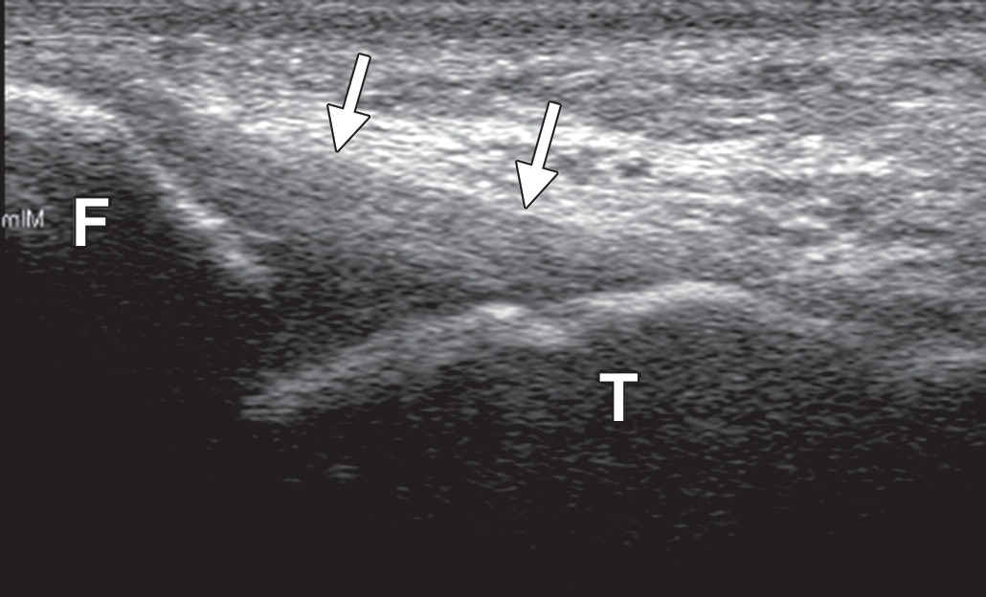
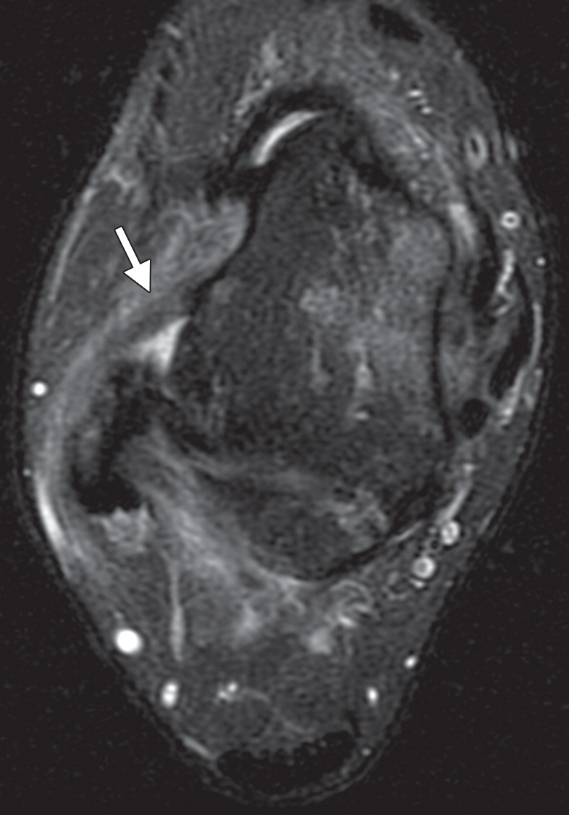
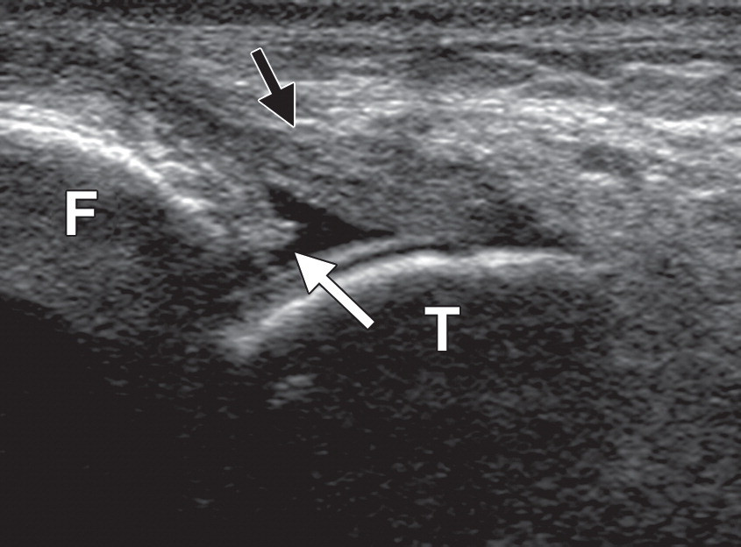
Notes:
Figure 6a ATFL tear and instability in a 16-year-old female soccer player who presented with right ankle laxity 5 months after injury. (a) Axial fat-suppressed T2-weighted MR image shows abnormal thickening and intermediate signal intensity in the ATFL (arrow), findings consistent with scarring and degeneration from a prior tear. (b) Longitudinal US image shows discontinuity of the ATFL, with a small stub of ligamentous tissue still attached to the fibular footprint (white arrow). The ligament also shows loss of the normal fibrillar pattern, decreased echogenicity, and abnormal tapering near the fibula (F) (black arrow), findings consistent with prior tearing and subsequent degeneration. T = tibia. (c) Longitudinal US image of the contralateral ankle (image flipped horizontally for comparison) shows a normal hyperechoic ligament with an organized fibrillar pattern and a normal insertion onto the footprint of the fibula (F) (arrows). T = tibia. (d) Photograph of a volunteer shows the single-examiner technique for performing the anterior drawer test while imaging the ATFL. Slight medial rotation of the talus should be applied so that the deltoid ligament does not cause a false-negative test result.

Slide 20
Joint Stability
Static images can detect ligament tears
Dynamic images are helpful to depict joint instability
Anterior drawer stress maneuver

Slide 21
Notes:
Anterior drawer stress maneuver

Slide 22
Joint Instability from ATFL tear

Slide 23
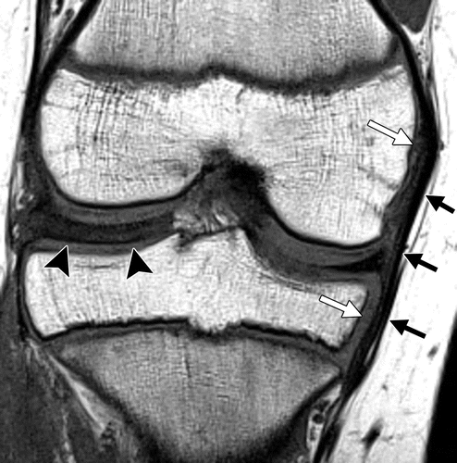
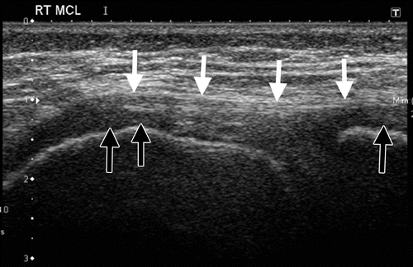
Notes:
Hypoechoic cartilage
Coronal T1, discoid meniscus

Slide 24
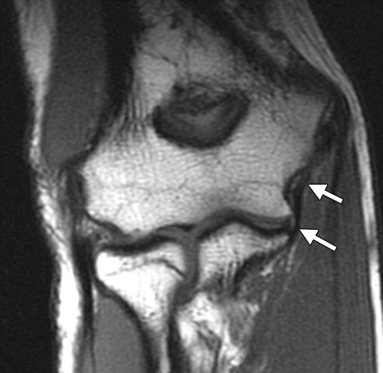
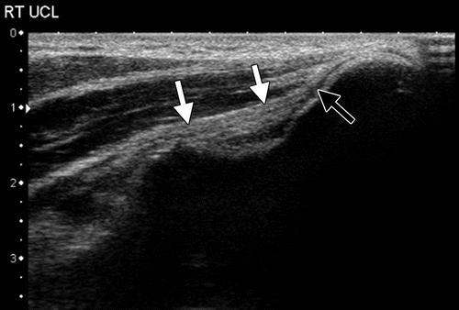

Slide 25
Avulsion Injuries
Avulsion injuries common in adolescent
Increased muscle-tendon tightness
Locations
  Greater tuberosity – supraspinatus, infraspinatus, teres minor
  Lesser tuberosity – subscapularis
  Ischial tuberosity – hamstring tendons – semitendinosus, semimembranosus, biceps femoris
  Anterior superior iliac spine - sartorius
  Anterior inferior iliac spine – rectus femoris
  Medial epicondyle of elbow – ulnar collateral ligament, pronator teres, common flexor tendon
Tendon failure
Dynamic US of peroneal tendons is examination of choice to assess for subluxation or dislocation

Slide 26
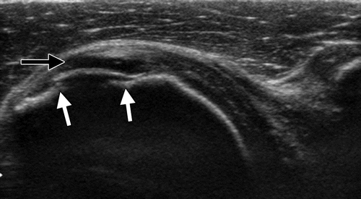
Avulsion Injuries
Cortical step-off at location of tendon insertion
Notes:
Black arrow – unossified cartilage
Lesser tuberosity – subscapularis

Slide 27
Stability
Accurately measure distance of retraction and assess stability of fragment
Notes:
External rotation – joint stability – was stable so conservatively managed

Slide 28
Treatment of Ligament and Tendon Injuries
Conservative – PRICE treatment
  P – protection of ligaments (ex: walking boot)
  R – Rest from physical activity
  I – Application of ice
  C - Compression
  E - Elevation

Slide 29
Treatment of Ligament and Tendon Injuries
If unsuccessful
  Tendon fenestration – dry needling – stimulate growth factors
  Whole-blood or PRP injection
  Prolotherapy – inject irritant – hyperosmolar dextrose – increase inflammation and growth factors
  Surgery

Slide 30
Congenital Variants
Many congenital variants exist → sensation of snapping, clunking, or popping
Majority of times do not cause symptoms
Athletes with repetitive injury – can cause pain and interfere with sports related activity
Dynamic US best to evaluate
Start exam by asking them to reproduce the sensation

Slide 31
Conditions Affecting the Ulnar Nerve
Ulnar nerve dislocation is an uncommon cause of pain and paresthesias in the ulnar nerve distribution
It occurs if the ulnar nerve subluxates and then dislocates over the anterior aspect of the medial epicondyle during flexion and extension of the elbow
Occurs 16% normal individuals
Can hear a “snap”

Slide 32
Conditions Affecting Ulnar Nerve
Ulnar neuropathy
  Sensory problems – 4th or 5th digits
  Motor problems – muscles innervated by ulnar nerve
Dislocation of ulnar nerve
Dislocation of medial head of triceps muscle in conjunction with ulnar nerve dislocation

Slide 33
US findings ulnar neuropathy
Abnormal enlargement of nerve with abrupt caliber change
Loss of normal fascicular pattern
Cubital tunnel – can get anisotropy
Cross-sectional area – 8-10 mm² (measured 4cm proximal to 4cm distal to medial epicondyle)
Swelling ratio: >1.5:1
  Measure at maximal cross-sectional area around medal epicondyle compared with cross-sectional area at midhumerus
  Helpful in obese pts, women, children – small nerve diameter

Slide 34
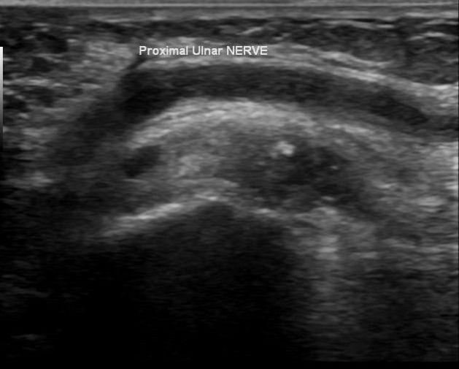
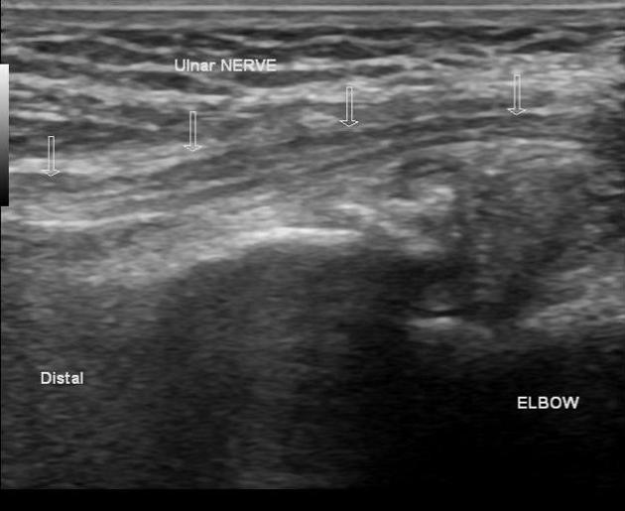
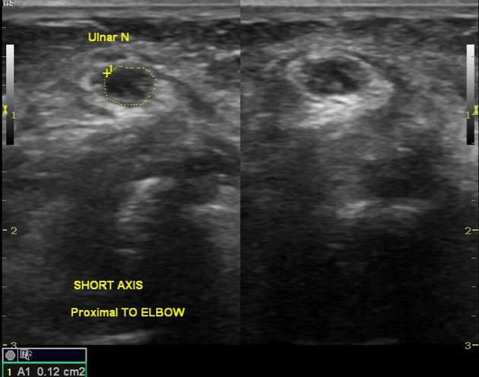
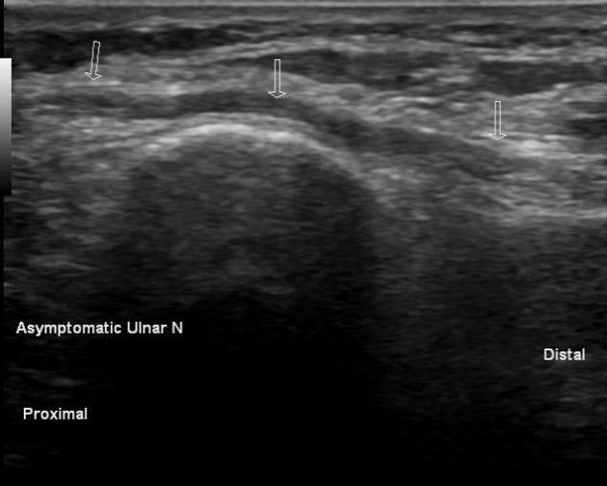

Slide 35
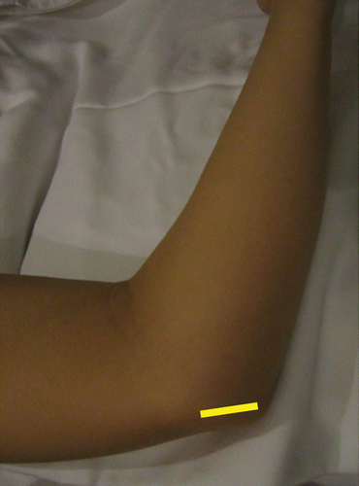
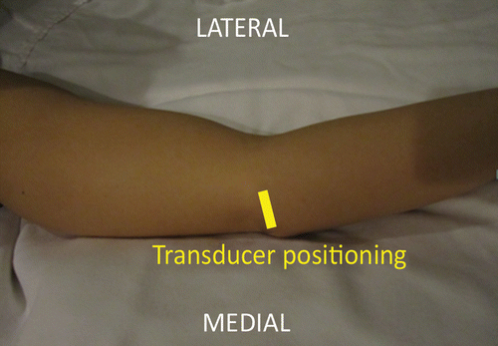
Evaluation of Ulnar Nerve Dislocation
Notes:
Figure 10b Photographs show US transducer placement for ulnar nerve evaluation. (a) With the patient seated and the patient’s arm lying across the examination table, the transducer (yellow line in a and b) is placed between the medial epicondyle and olecranon. (b) While the transducer position is kept steady by applying gentle pressure, the patient’s arm is flexed and the ulnar nerve is assessed for signs of instability. Continued flexion beyond 90° is recommended to increase the likelihood of seeing the nerve dislocate.

Slide 36
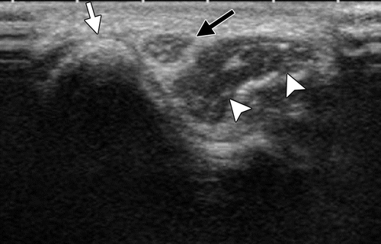
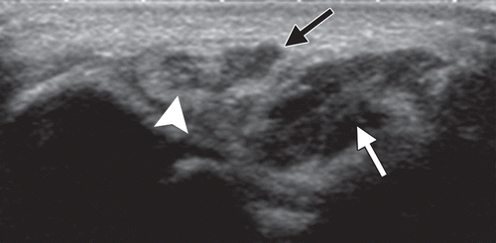
Medial
Epicondyle
Ulnar nerve
Normal Ulnar nerve location
Medial head triceps
Accessory musculotendinous slip
Ulnar nerve
Medial head triceps

Slide 37
Ulnar Nerve Dislocation

Slide 38
Dislocating medial head of the triceps muscle and ulnar nerve
Notes:
Dislocating medial head of the triceps muscle and ulnar nerve in a 14-year-old male soccer player who experienced elbow discomfort during weight training. Cine dynamic US clip obtained during passive elbow flexion shows dislocation of the ulnar nerve, followed by dislocation of the accessory musculotendinous slip and part of the medial head of the triceps muscle body.

Slide 39
Ulnar nerve and medial head triceps dislocation
Very important to diagnose dislocation of both ulnar nerve and medial head of triceps muscle
Can lead to surgical failure if only diagnose ulnar nerve dislocation
Symptoms & predisposing factors
  Single or double snapping sensation
  Pitching, weight training, body builders

Slide 40
Additional Congenital Variants
  Upper extremity region
    Slipping rib syndrome
    Atraumatic anterior subluxation of sternoclavicular joint
  Lower extremity region
    Snapping hip syndrome
    Snapping knee syndrome
    Medial patella plica syndrome

Slide 41
Conclusion
US can aid in diagnosis of multiple musculoskeletal conditions in the young athlete
  Many impossible to diagnose with other modalities
    Proximal patellar tendinosis – common overuse injury
      Tendinopathy
    Dynamic US of lateral ankle
    Ulnar nerve pathology
Many conditions are asymptomatic in general population but may become painful and limit range of motion for athletes

