Slide 1
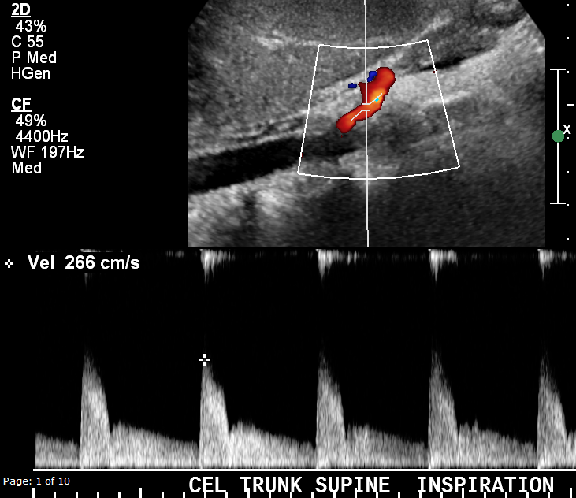
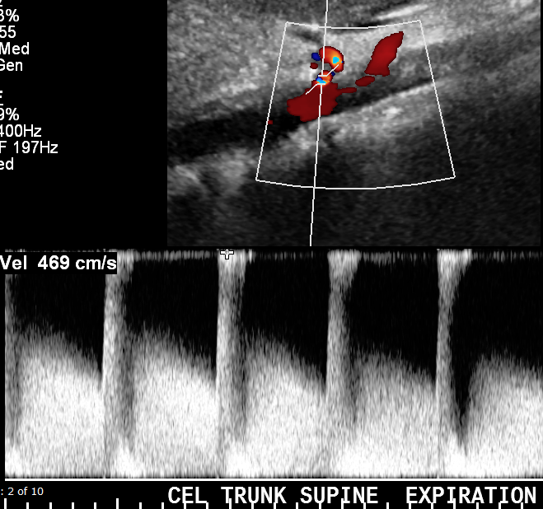
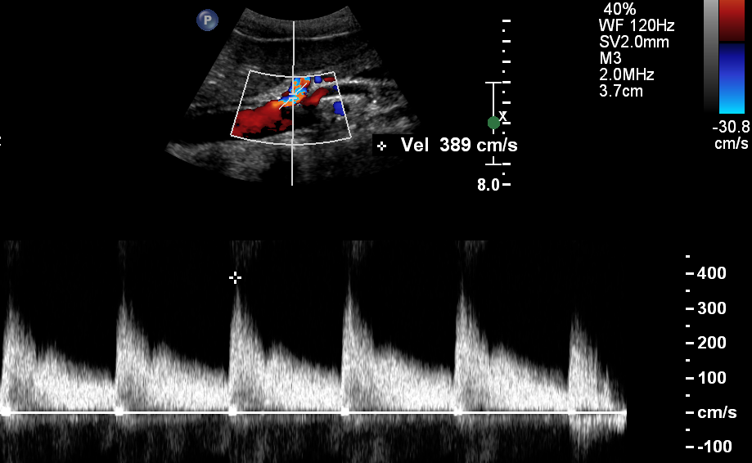
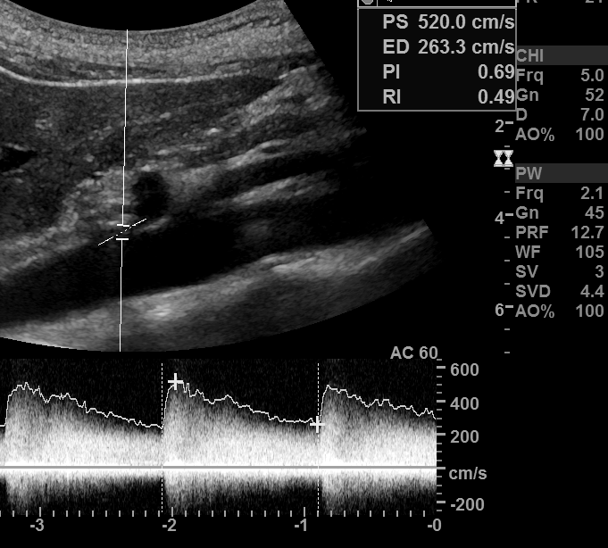
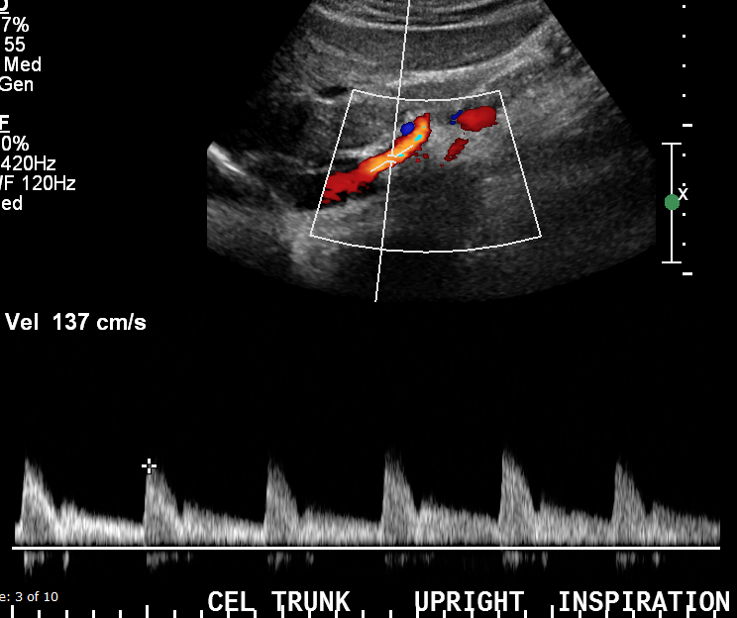
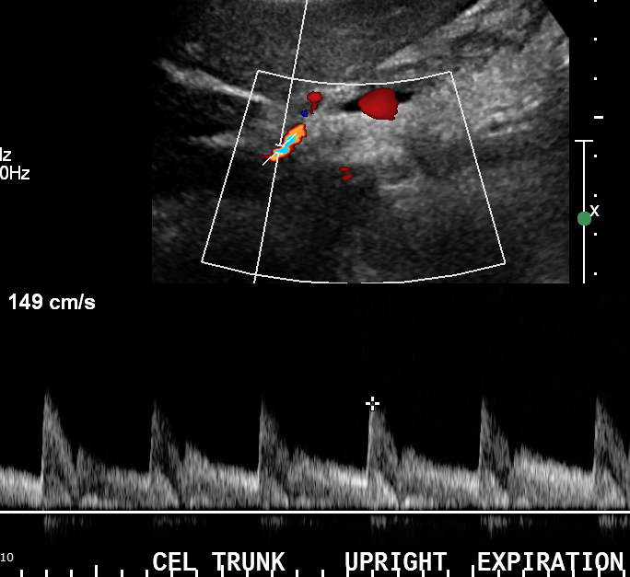
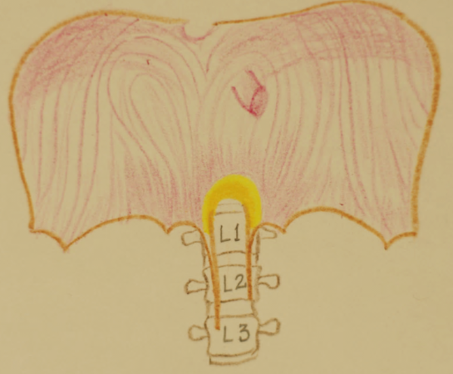
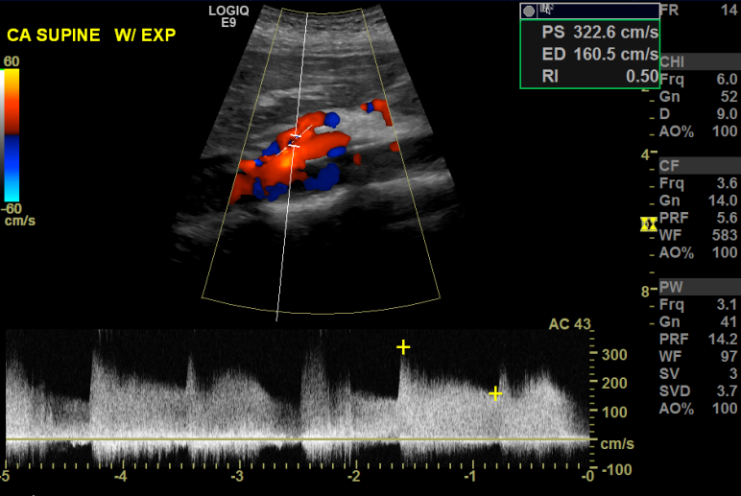
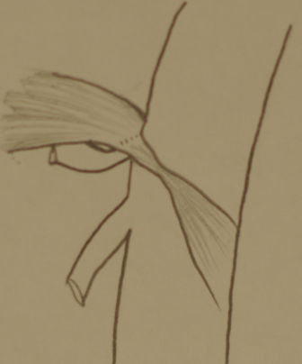
Ultrasound Diagnosis of Median Arcuate Ligament Syndrome (MALS): A Single Institutional Experience
Anjum Bandarkar, MD, Hansel Otero, MD _ Children’s National Health System, Washington, DC, USA
Objectives
Imaging Strategies for MALS
Doppler US Protocol
Doppler US Findings in MALS
Results – 74 patients got Doppler US
Define median arcuate ligament syndrome (MALS) and understand its pathophysiology
Describe imaging strategies in MALS including steps
of Doppler Ultrasound (US) and diagnostic criteria
Discuss our experience in screening and
diagnosing MALS in the pediatric population
emphasizing diagnostic accuracy of Doppler US
Doppler Ultrasound :
First line in screening for MALS
Noninvasive, less expensive
No need for radiation/iodinated contrast
Allows dynamic evaluation of flow in CA
Transducer – Curved 1-5 or 9 MHz
Obtain midline sagittal image of Ao showing CA and superior mesenteric artery (SMA) origins.
Measure baseline neutral peak systolic velocity (PSV) in cm/s in the Ao and CA.
In supine position, measure CA PSV in deep inspiration and in expiration (3 sets) using angle-correction at a point in proximal CA just beyond origin.
Save cine clips of the CA during active inspiration-expiration to assess deflection angle.
In upright position, again measure CA PSV in inspiration and expiration, and Ao PSV.
Presence of fish-hook or J-shape of CA origin.
Aliasing and turbulence in proximal CA.
Juxtaostial narrowing of CA & post-stenotic dilatation.
PSV increases in expiration & improves when upright.
CA PSV >200 cm/s is abnormal
Expiratory PSV in CA >350 cm/s is c/w MALS
CA:Ao PSV ratio greater than 3:1 is c/w MALS
Deflection angle >50degrees (change in CA axis during inspiration-expiration) is also considered positive for MALS
74 patients (61 girls, 13 boys) presented with chronic abdominal pain, age range 11-20 years, mean 15.4 years
27 had positive Doppler US, 47 had negative Doppler US
19/27 had further imaging with CT (n=10) or MRI (n=9)
17 of 19 were true positives(12 got Sx, 5 waiting for Sx),
2 of 19 were false positives where US was concerning for MALS but normal CA was seen on CT/MRI
8/27 had no further imaging, 4/8 got Sx, 4/8 lost to f/up
Sensitivity of Doppler US - 100%, Specificity - 96%,
Diagnostic Accuracy of Doppler US - 97%
In our practice, all US negative cases were considered
true negative. There was no false negative.
Introduction
CT Angiography (CTA):
Considered gold standard for MALS
Excellent contrast & spatial resolution
Multiplanar 3D reformats/ MIPs
Ability to map collaterals
Median Arcuate Ligament Syndrome (MALS)
(Also Celiac Artery Compression Syndrome or Dunbar Syndrome)
MALS is a condition characterized by abdominal pain due to compression of the celiac artery (CA) and possibly the celiac ganglia by the median arcuate ligament.
MALS is a diagnosis of exclusion, generally considered after extensive clinical evaluation
Often found in patients being worked up for postural orthostatic tachycardia syndrome (POTS)
Affects young individuals, particularly thin women
Symptoms: Chronic abdominal pain, typically
postprandial but not always,
Nausea and vomiting, & weight loss.
MRI Abdomen without contrast:
Does not use ionizing radiation or intravenous contrast
Low spatial resolution
Lengthy exam time
Case 1
Case 3
MALS Positive – 27/74
US - 4/8 got Sx
(8/27) - 4/8 Lost to f/u
CTA - 6/10 got Sx
(10/27) - 3/10 waiting
- 1/10 FP
MALS Negative – 47/74
5/47 - got further neg imaging (CT, n=4; MR, n=1) due to severity of symptoms
42/47 - managed conservatively
MRI - 6/9 got Sx
(9/27) - 2/9 waiting
- 1/9 FP
inspiration
expiration
Catheter Angiography:
Has been superseded by CTA/MRI
Large radiation dose
Invasive procedure , not favored
CA
SMA
Ao
CTA findings:
Focal narrowing,
indentation of
juxtaostial CA
Poststenotic dilatation
Hook-shaped contour
Abnormally high take-off of CA with juxta ostial narrowing & aliasing.
Inspiratory PSV of CA – 389 cm/s, Expiratory PSV of CA – 520 cm/s
CA:Ao PSV ratio was 3.7, CTA confirmed narrowing of proximal CA.
Anatomy & Pathophysiology of MALS
Materials & Methods
Case 4
The MAL is an archlike fibrous band connecting the right and left diaphragmatic crura across the aortic hiatus
It crosses the aorta (Ao) above the CA at about L1 level
Low position of the MAL or high take-off of the CA may cause compression of proximal CA
Degree of MAL compression can be variable
During expiration, compression is increased
because the CA ascends cephalad leading to
the superior indentation along proximal CA
During inspiration, compression is
decreased due to caudal descent of CA in
abdominal cavity
In upright position, CA assumes an even
more vertical orientation, thus relieving the
MAL compression
Retrospective review of 74 patients referred for Doppler US for suspected MALS over 2 years
Sonographic images, reports, subsequent CT/MR, surgical notes and plans for follow up were reviewed
Doppler US was classified as positive or negative based on whether MALS was diagnosed or not
Sensitivity, specificity & accuracy of Doppler US were
calculated
Diagnostic Criteria for MALS on Doppler US:
1. Elevated CA PSV > 200 cm/s
2. Expiratory CA PSV > 350 cm/s
3. CA:Ao PSV ratio of 3:1
4. Deflection angle of CA > 50 degrees
Diagnostic Criteria for MALS on CTA/MRI:
1. Focal narrowing/indentation of proximal CA
2. Narrowing pronounced in expiration &
improves in inspiration
FSPGR inspiration
FSPGR expiration
L1
L1
Case 2
Non contrast MRI abdomen
inspiration
expiration
CA directed caudal in inspiration, CA narrowing more pronounced in expiration. US shows focal narrowing at CA origin with turbulence & post stenotic dilatation.
References
Case 5
Harjola PT. A rare obstruction of the coeliac artery. Ann Chir Gynaec 1963;52:547.
Gruber H, Loizides A, Peer S, Gruber I. Ultrasound of the median arcuate ligament syndrome: a new approach to diagnosis. Medical ultrasonography. 14(1):5-9. 2012.
Mak GZ, Speaker C, Anderson K. Median arcuate ligament syndrome in the pediatric population. Journal of pediatric surgery. 48(11):2261-70. 2013.
Mesenteric/Splanchnic Artery Duplex Imaging, Vascular Professional Performance Guideline, Society for Vascular Ultrasound, 2013
Ozel A, Toksoy G, Ozdogan O, Mahmutoglu AS, Karpat Z. Ultrasonographic diagnosis of median arcuate ligament syndrome: a report of two cases. Medical ultrasonography. 14(2):154-7. 2012.
Wolfman D, Bluth EI, Sossaman J. Median arcuate ligament syndrome. Journal of ultrasound in medicine : official journal of the American Institute of Ultrasound in Medicine. 22(12):1377-80. 2003.
Klimas A, Lemmer A, Bergert H, Brodhun M, Scholbach T, Großer K. Laparoscopic treatment of celiac artery compression syndrome in children and adolescents. VASA. 2015;44(4):305-12
Deflection Angle
CA directed vertically down in inspiration, CA directed cephalad in expiration. CTA shows J-shaped CA in expiration, and CA points straight down in inspiration.
B flow image
inspiration
expiration
Conclusions
Doppler US is a highly accurate screening and diagnostic
tool for suspected MALS.
Cross-sectional imaging confirmation is frequently performed but may not be necessary when the diagnosis is obvious on Doppler US.
Following a standard Doppler US protocol is key to high sensitivity, specificity and diagnostic accuracy.
Management
Laparoscopic MAL release with ablation of celiac
ganglion plexus is considered to be a viable therapeutic intervention.

